Slide 1
John 3:16 (II)

Slide 2
John 3:16 – one of the most aggressive and militant passages in NT
John 3:16 – one of the most misunderstood passages in NT

Slide 3
For God so loved the world that He gave His only begotten Son, that whoever believes in Him should not perish but have everlasting life.

Slide 4
For God so loved the world that He gave His only begotten Son, that whoever believes in Him should not perish but have everlasting life.

Slide 5
For God so loved the world that He gave His only begotten Son, that whoever believes in Him should not perish but have everlasting life.

Slide 6
For God so loved the world that He gave His only begotten Son, that whoever believes in Him should not perish but have everlasting life.

Slide 7
For God so loved the world that He gave His only begotten Son, that whoever believes in Him should not perish but have everlasting life.

Slide 8
For God so loved the world that He gave His only begotten Son, that whoever believes in Him should not perish but have everlasting life.

Slide 9
For God so loved the world that He gave His only begotten Son, that whoever believes in Him should not perish but have everlasting life.

Slide 10
‘That’ may introduce a purpose or result clause
The point: God’s gift calls for our response
Denies vanity of life. Ec.1-2; 12
Modern philosophy is bankrupt
Sartre
Thomas Huxley

Slide 11
For God so loved the world that He gave His only begotten Son, that whoever believes in Him should not perish but have everlasting life.

Slide 12
‘Whoever’ extends offer of salvation to all humanity
‘Whoever’ extends offer of salvation to all humanity as individuals
Each must decide for himself
Denies partiality of God.
Lost people cannot blame Him
Ac.10:34-35

Slide 13
For God so loved the world that He gave His only begotten Son, that whoever believes in Him should not perish but have everlasting life.

Slide 14
‘Believes’ –Lit., ‘the keeping on believing one’
Denies ‘faith alone’ doctrine
3:3,5, new birth: faith alone??
Faith: conviction full of joyful trust that Jesus is Messiah…conjoined w. obedience to Christ (Thayer, p. 511).
Contrast: ‘belief consists of accepting something, not doing something’ (Merrell C. Tenney).

Slide 15
‘Believes’ –Lit., ‘the keeping on believing one’
1. Did they have to ‘do something’?
2. Mt.10:32-33
Denies ‘faith alone’ doctrine
Accepting Christ is more than merely agreeing with Him.
⁴² Nevertheless even among the rulers many believed in Him, but because of the Phari-sees they did not confess Him, lest they should be put out of the synagogue; ⁴³ for they loved the praise of men more than the praise of God – Jn.12.

Slide 16
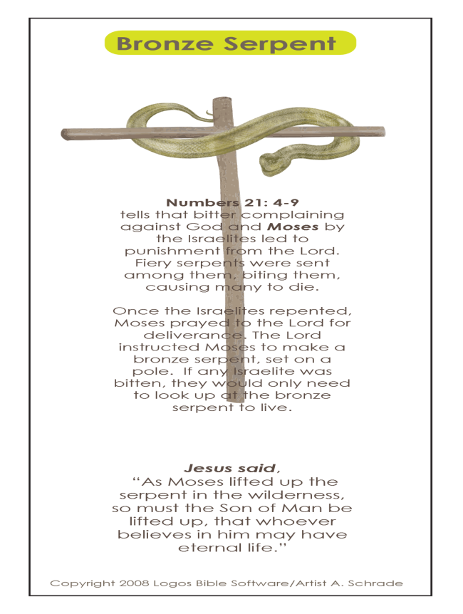
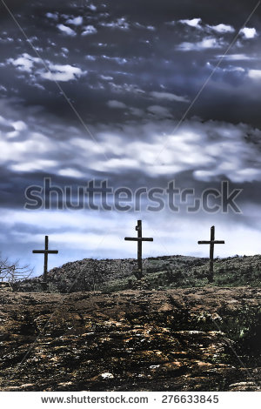
John 3:14
God’s part
Man’s part
look | believe
“AS” (TYPE)
“SO”
(ANTITYPE)

Slide 17
John 3:15
Whoever believes
No mere mental act would save from bite . . . or from sin
Jew sits under tree believing . . .
Lord’s parallel destroys ‘faith alone’
36:
Unconditional?
Unchangeable?
believes
has eternal life
not obey
shall not see life

Slide 18
‘Believes’ –Lit., ‘the keeping on believing one’
Denies ‘faith alone’ doctrine
Denies perseverance of saints
The ’believer’ IS secure . . .
BUT: what if one stops believing?
“…who have strayed concerning the truth, saying that the resurrection is already past; and they overthrow the faith of some” – 2 Tim.2:18. Cf. Hb.3:12

Slide 19
‘Believes’ –Lit., ‘the keeping on believing one’
Denies ‘faith alone’ doctrine
Denies perseverance of saints
Universalism
If so, why Jn.3:16 – ‘one who believes should not perish’?
Unbelievers are lost (Mk.16:16).

Slide 20
For God so loved the world that He gave His only begotten Son, that whoever believes in Him should not perish but have everlasting life.

Slide 21
‘In Him”: 15-16
Limits source of salvation to Jesus
Jn.5:39-40 (OT) // Jn.20:31 (NT)
Cannot have Jesus without His word (Jn.20:31)
Denies pluralism: preach as many saviors or ways as people want

Slide 22
For God so loved the world that He gave His only begotten Son, that whoever believes in Him should not perish but have everlasting life.

Slide 23
‘Perish’ ?
‘To incur the loss of true or eternal life; to be delivered up to eternal misery’ – Th.

Slide 24
‘Should not’ perish
What is possible or probable
[N]KJV; ASV; NASB (orig.); NRSV; ISV
Parallel constructions:
Fragments, Jn.6:12
Nation, Jn.11:50
Parallel cautions:
Faith may fail, Lk.22:32
Abandoned faith, 1 T.4:1

Slide 25
‘Should not’ perish
Denies
Perseverance of saints.
John 1:7 – ‘that all WILL believe’??
‘He gave his only Son, in order that every-one who believes in him should not perish but should have eternal life…does not, of course, argue for uncertainty as to the fate of the believer. This fact is obvious, not from this text, but from …Jn.10:28 and 11:26...’ – GGBB, 474

Slide 26
‘Should not’ perish
Denies
Perseverance of saints.
Annihilation theories.
“Perish” is not annihilation
Jn.17:12, son of perdition
Mt.26:24, better if not born
Ph.1:21, is annihilation gain?
If death is annihilation, all will perish!

Slide 27
‘Should not’ perish
Denies
Perseverance of saints.
Annihilation theories.
Purgatory – only two destinies: perish or salvation

Slide 28
For God so loved the world that He gave His only begotten Son, that whoever believes in Him should not perish but have everlasting life.

Slide 29
As snake-bite victims look on brazen snake. . . for physical health / life . . .
So eternal life comes to those who have faith in Jesus
1. NOT mere eternal existence
2. Opposite: eternal death, Rv.20:14
Denies: worldliness. Col.3:1-3

Slide 30
If we preach truth and ‘leave others alone,’ what part of Jn.3:16 survives? (I)
Neglect / low view of OT
Oneness Pentecostalism
Atheism
Deism
Calvinistic predestination
Limited atonement
Premillennialism
Unconditional salvation
Critical views of God
Judaism
Modernism

Slide 31
If we preach truth and ‘leave others alone,’ what part of Jn.3:16 survives? (II)
Vanity of life
Partiality of God
Faith alone
Perseverance of saints
Universalism
Pluralism
Annihilation
Purgatory
Worldliness

Slide 32
GREATEST SOURCE
GREATEST MESSAGE
GREATEST LOVE
GREATEST SACRIFICE
For God so loved the world that He gave His only begotten Son, that whoever believes in Him should not perish but have everlasting life.
DESERVES GREATEST RESPONSE

