Slide 1
Ark Of Covenant Corrects God’s Critics
1-2 Samuel

Slide 2
Three arks
Noah: Gn.6-9
Moses: Ex.2
Covenant: only furniture in holy of holies
Acacia wood overlaid with gold
Cover: ‘mercy seat’ and cherubim
‘Lost’

Slide 3
I. God Cannot Be Dominated

Slide 4
1 Sam.4:1-3
Blackmail:
‘God, glorify your Name: give us victory or Philistines will get ark!’
Reply: ‘I’ll glorify My Name by giving you defeat’ (4:10-11, 18-22).
God warned them, 2:12-17, 22-25
Thought they could ‘use’ God
If one turns away his ear from hearing the law, even his prayer is an abomina- tion – Pr.28:9

Slide 5
Joshua 6 – good luck?
Idolaters carried idols to battle. 1 Chr.14:…12
Ep.5:5, idolatry: alive and well in Ephesus

Slide 6
I. God Cannot Be Dominated II. God Cannot Be Defeated

Slide 7
1 Sam.5:1-12
1. Dagon, 1-5
2. Tumors, 6-12
Once they got what they wanted, they didn’t want what they got
Would give anything to return it, 6:1-12
– God will not suffer defeat, Ps.2:1-4

Slide 8
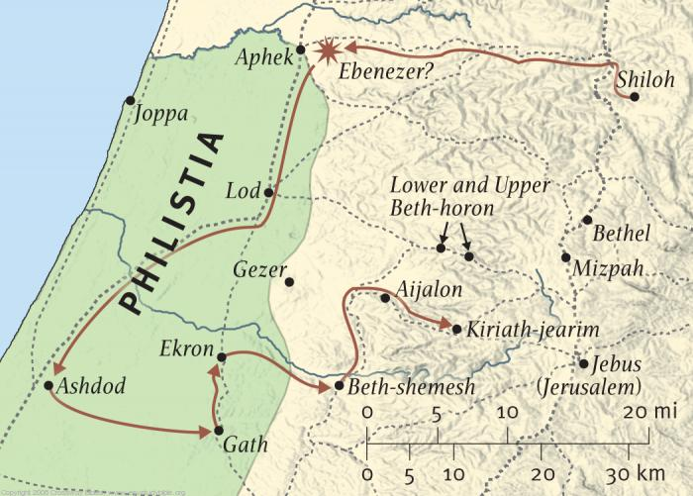
Ark’s journey

Slide 9
I. God Cannot Be Dominated II. God Cannot Be Defeated III. God Will Not Be Disgraced

Slide 10
1 Sam.6:13-21
19, ignorance and irreverence
Nu.1:50-54
Slaughter vindicated God
Philistine cart showed honor.
Judgment began at house of God; they knew better.

Slide 11
1 Sam.6:13-21
Irony: died by mercy seat
Greatest blessing → greatest danger …because of irreverence
Men still desecrate holy things
1. Bible. Mk.7:13
2. Lord’s day. Ac.20:7
3. Worship.
4. Marriage vows.
5. Prayer.

Slide 12
I. God Cannot Be Dominated II. God Cannot Be Defeated III. God Will Not Be Disgraced IV. God Will Not Be Disregarded

Slide 13
2 Sam.6:1-11
Fatal flaws . . .
New cart, 3. Nu.4:8…15
Good intentions, 4-5
Progress, 6
Did God a favor, 6-7
Ignorance (no excuse), 9
Trivializes God to ignore His law
Ac.21
Burning building

Slide 14
Is sincerity enough?
Sincerity never changes truth
Gn.27, Isaac: Jacob is Esau
Gn.37, Jacob: Joseph is dead
Ac.26:9, Paul: ought to persecute
‘Have it your way’??
A thing is never right just because we believe it is so.
A thing is right only if God’s word says so.

Slide 15
I. God Cannot Be Dominated II. God Cannot Be Defeated III. God Will Not Be Disgraced IV. God Will Not Be Disregarded V. God Will Not Be Dismissed

Slide 16
2 Sam.6:12-23
Gladness (12): why? 1 Chr.15, truth
Undignified (15-16, 20-23)
Should imitate Saul’s pride, false dignity?
‘It was before God’ – David did not care what others thought

Slide 17
Lukewarmness is blasphemy
‘God doesn’t excite us!’
Mt.21:14-16, Jewish leaders upset
Ac.3:7-8, excited over healing
In the end, there are only two kinds of people: God’s critics or God’s children

