Slide 1
Word of God, Written for Man

Slide 2
The average American believes in God, but…
Has no respect for His word
This includes most religious people
What standard do most appeal to?
Feelings
Ac.17:27
Ep.4:19
Sight
Everything except faith

Slide 3
I. Way Of Man Is Not In Himself

Slide 4
There is a difference in . . .
Opinion
Faith
Sight

Slide 5
There is a difference in . . .
[Jesus]
Opinion: Mt.16:13-14; 16:22
Faith: Mt.16:17
Sight: Mt.16:25
Opinion
Faith
Sight

Slide 6
God’s plan of salvation: What must I do?
Mystery. Guesswork is not faith (Col.1:26)
Faith (told what to do) – (Ga.3:23)
Sight (Ro.8:24-25) –
“I saw an angel”
“God talked to me”
“I’ll take my experience…”

Slide 7
I. Way Of Man Is Not In Himself
II. Way Is In The Word

Slide 8
Two choices (Mt.7:13-14)
Ac.18:25-26, narrow way
Not even one deviation
1 K.18:21. Opinions divide. . .
Jer.10:23. Mt.7:21-23
Direction
Details
Devotion

Slide 9
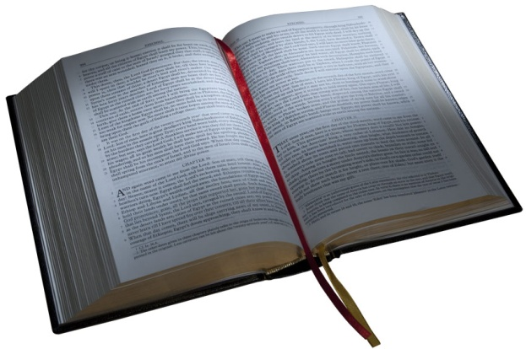
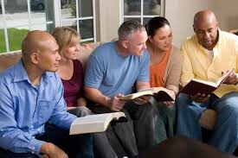
We must walk by faith
Ro.1:17, from faith to faith . . .
¹Righteousness of God (plan to make us righteous) is in the gospel.
²This righteousness is revealed to be from (by) faith.
³This revelation produces faith.
‘by faith’

Slide 10
Abraham, our example
Ro.4:11
Opinion?
“Sarai, I think God wants us to go to Egypt” – Gn.12
“Abram, I think God wants you to take Hagar for a wife” – Gn.16
“My God wants me to be happy” – Mt.19:9

Slide 11
Abraham, our example
Ro.4:11
Opinion? Gn.12 / 16 / Mt.19
Faith? Hb.11:8
Abraham fully knew God wanted him to go to Canaan.
God told him. (Ro.10:17)

Slide 12
Abraham, our example
Ro.4:11
Opinion? Gn.12 / 16 / Mt.19
Faith? Hb.11:8
Sight? Hb.11:13, 39 – future reward

Slide 13
By sight – 2 Co.5:7
What we think. Jer.18:12; 23:17
What others think. Mk.7:5
What we like. Ro.8:4
By faith – Ro.8:4-5, 12-13

Slide 14
I. Way Of Man Is Not In Himself
II. Way Is In The Word
III. Word Is Revealed In Christ

Slide 15
Hb.1:1-2
Contrasts:
Times past
Last days
Fathers
Us
Prophets
Son

Slide 16
Hb.1:1-2
Main sentence: God has spoken
During childhood age of revelation, God spoke as to children
Old revelation was perfect at kindergarten level but incomplete
GOD
HAS SPOKEN
to
us

Slide 17
All we know of God and truth: Word
Jn.8:31-32; 17:17
“But the Bible is old”
So is English
Gn.1:1

Slide 18
I. Way Of Man Is Not In Himself
II. Way Is In The Word
III. Word Is Revealed In Christ
IV. Word Both Spoken & Written

Slide 19
Spoken: Acts 2
Peter’s audience could not turn in their NT as he preached
Written: 1 Co.14:37; 2 Th.2:15
If God’s will were not written, we would need modern . . .
PROPHETS
PROOFS

Slide 20
I. Way Of Man Is Not In Himself
II. Way Is In The Word
III. Word Is Revealed In Christ
IV. Word Both Spoken & Written
V. God’s Revelation Is Complete

Slide 21
2 Tim.3:16-17
2 Peter 1:3
Ps.84:11
Sun. . .Shield
Grace. . .No good thing withheld
John 10:10
Life
Abundance

