Slide 1
The Party’s Over
Daniel 5

Slide 2
Background
Nebuchadnezzar died, 562 BC; decline
Evil-Merodach (2 K.25); 2 year reign
Neriglissar murdered Evil-M., 560; 4 years
Labashi-Marduk, a child, ruled 2 mo.; beaten to death
A conspirator, Nabonidus, ruled 17 years; married Nitocris, Nebu. daughter
Belshazzar, co-regent more than ½
Cyrus . . . came to Babylon (539-538 BC)

Slide 3
The Words on the Wall
MENE: weight of 50 shekels; mina, equal to 1¼ lbs.; from m^{e}nah, to number, to reckon
TEKEL: shekel; from t^{e}qal, to weigh. God weighed; you came up short.
1 Sm.2:3
UPHARSIN (28: PERES)

Slide 4
The Words on the Wall
MENE: weight of 50 shekels; mina, equal to 1¼ lbs.; from m^{e}nah, to number, to reckon
TEKEL: shekel; from t^{e}qal, to weigh. God weighed; you came up short.
1 Sm.2:3
UPHARSIN (28: PERES)
P R S – half mina; from p^{e}ras, to break in to, divide; given to M-Persia.

Slide 5
1. Daniel 5 is history
Nabonidus Chronicle:
  Nabonidus returns to Babylon for new year festival; almost certainly 17th year; Cyrus is closing in.
  Nabonidus flees
  Army of Cyrus enters Babylon without a battle.
Herodotus / Cyropedia

Slide 6
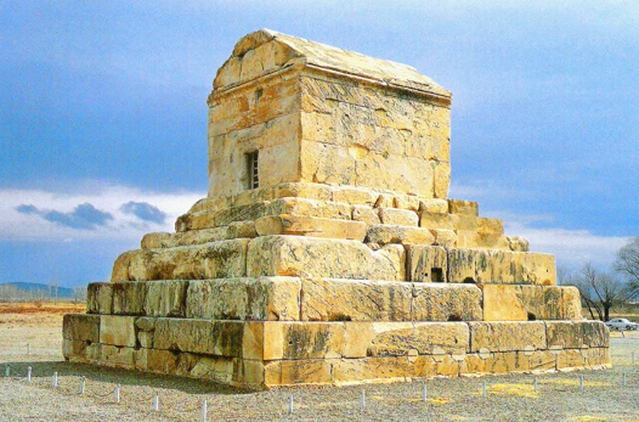
Tomb of Cyrus
(Pasargadae Iran)

Slide 7
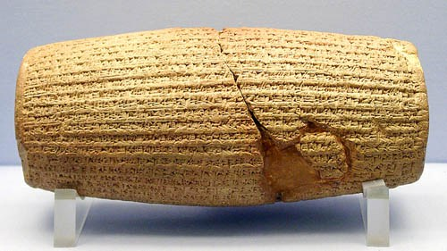
Cyrus Cylinder

Slide 8
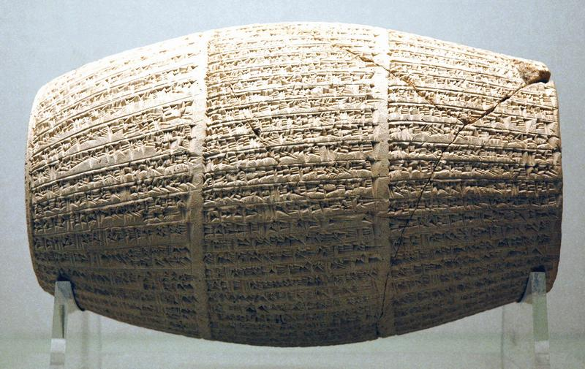
Nabonidus Cylinder

Slide 9
2. Character studies
Belshazzar [Bel-shar-usur, God protect the king]
  Real person, 1. Nabonidus cylinders (1881): ‘prayer to moon-god to guard both him and his son, Belshazzar, from wrong doing’ – British Museum
    Frequently named on contract tables; crown prince, acted as regent . . .
    Nabonidus campaigned in Arabia as long as ten years . . . Entrusted kingship to Belshazzar

Slide 10
2. Character studies
Belshazzar
  Real person, 1.
  Worldly, 1. Pr.31:4; Ec.10:17
  Irreverent, 3-4. 1 Thes.4:1-4
  Idolater, 4. In spite of signs… (Dn.1-6)

Slide 11
2. Character studies
Belshazzar
  Real person, 1.
  Worldly, 1. Pr.31:4; Ec.10:17
  Irreverent, 3-4. 1 Thes.4:1-4
  Idolater, 4. In spite of signs…
  Unprepared, 6-9.
    Why not rejoice at writing?
    Gn.3; Gn.44; Mk,6, etc.

Slide 12
2. Character studies
Belshazzar
  Real person, 1.
  Worldly, 1. Pr.31:4; Ec.10:17
  Irreverent, 3-4. 1 Thes.4:1-4
  Idolater, 4. In spite of signs…
  Unprepared, 6-9.
  Condescending, 11-13. Mk.6:3
  Secular, 13-14. No use for Daniel…
  Sentenced, 26-30. Cf. 4:27

Slide 13
2. Character studies
Wise men, 7-8 –the agony of defeat
  Chap.1: outdone
  Chap.2-4: failures
  Chap.5: could not predict most important event in Babylonian history – the limitations of secular wisdom

Slide 14
2. Character studies
Queen, 10-12 –faith in Daniel, not God
  Praised him for rescuing kings in tight spot
  Admits he has truth but does not seek it for herself

Slide 15
2. Character studies
Daniel –recognizes Father’s handwrit-ing, gives its meaning, is certain of His care
  Steadfast even to old age
  Self-denying (not covetous, 17)
  Sound preaching, 18-24

Slide 16
2. Character studies
God –
  All powerful. Used Cyrus…
  Longsuffering. Ps.9:17; Pr.14:34
  Revealed Himself to peoples, 5.
  Judge of Universe, 24-28
    MENE: our days are numbered
    TEKEL: now is trial…
    UPHARSIN: separation, 2 Th.1:9

