Slide 1
Spring Meeting – March 5-8, 2017
West Knoxville church of Christ www.wkcoc.com

Slide 2
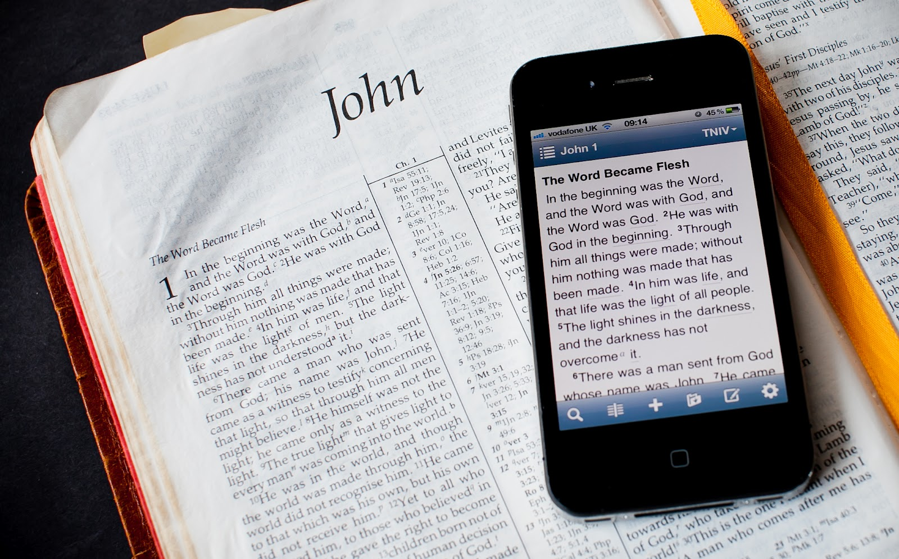
Help! Daily Bible Reading is a chore!

Slide 3
Key 1: Read on Purpose
To come to know God

Slide 4
Problem solved!
Don’t have time
Bible reading is hard
I know the story…
I’ll get around to it
I’ll just Google it

Slide 5
Key 1: Read on Purpose
To come to know God

Slide 6
Key 2: Patience
Slow and steady progress

Slide 7
Key 3: Do more than read
Consider the Word!

Slide 8
PATH the Chapter
Praise God
Admonishes me
Trust
Hope

Slide 9
Key 3: Do more than read
Consider the Word!

Slide 10
Help! Daily Bible Reading is a chore!

