Slide 1
Spring Meeting – March 5-8, 2017
West Knoxville church of Christ www.wckoc.com

Slide 2
Victory over Death
Hebrews 2:14-18

Slide 3
We are terrified of death and dying, v. 15.
Victory over Death

Slide 4
Jesus is the answer,
v. 14.
Victory over Death

Slide 5
Jesus helps us really live,
v. 18.
Victory over Death

Slide 6
We are terrified of death and dying, v. 15
Jesus is the answer, v. 14
Jesus helps us really live, v. 18.
Victory over Death

Slide 7
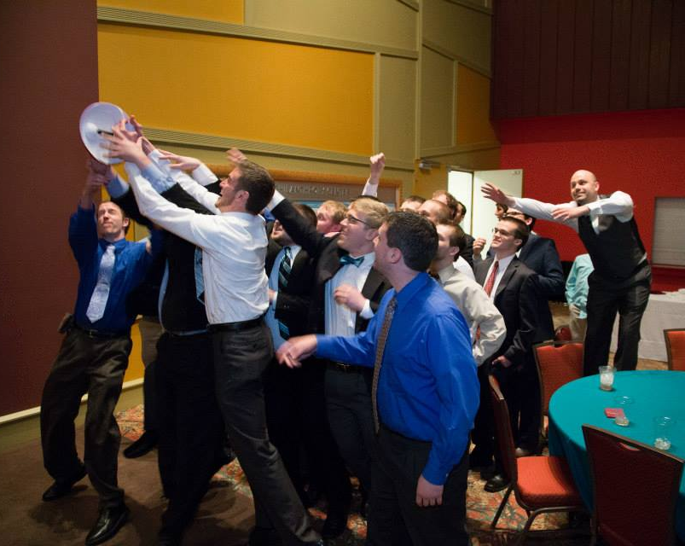
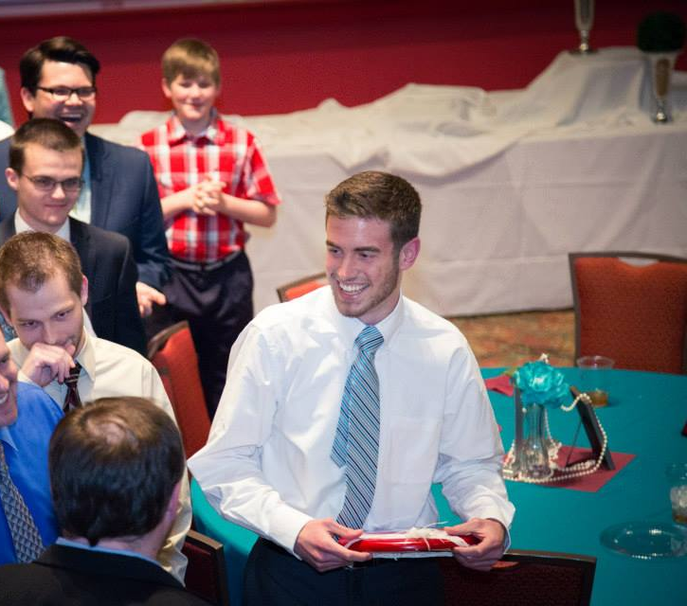
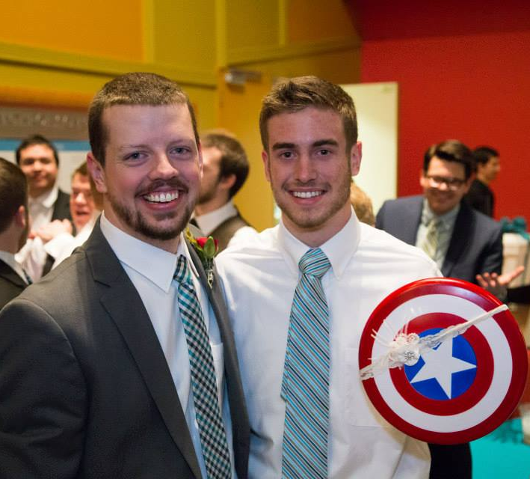
Victory over Death

Slide 8
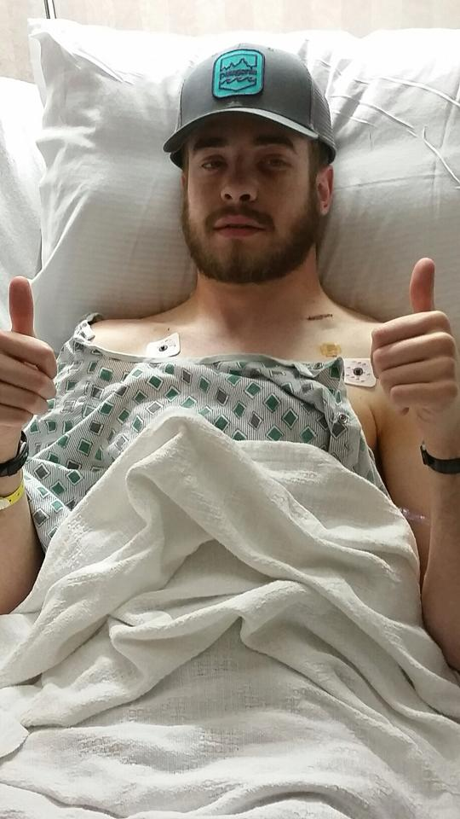
Victory over Death

Slide 9
“During his last few days on earth, Christian made it unmistakably clear to us that he knew where he was going. He wanted nothing more than to reach that promised rest, and to bring others there with him. Christian knew how many people loved him so dearly, and he anticipated this being difficult for everyone. However, he took every opportunity to remind us to dry our tears, be happy for him, and to do everything we can to one day reach that goal ourselves.”
Victory over Death

Slide 10
Victory over Death
Hebrews 2:14-18

