Slide 1
A Galaxy Of Stars Without A Superstar
Romans 16

Slide 2
Phoebe, the servant, 1-2
“The word ‘servant’ is the Greek term in feminine form that is used of deacons in the New Testament literature. Many biblical scholars believe there was a female order of deacons in the first century. Among those in our own heritage who have subscribed to this view are Alexander Campbell, Walter Scott, Moses Lard, and Robert Milligan.”

Slide 3
If Phoebe is a deaconess: 13:4; 15:8
*What qualifications? __________
*Women cannot lead men, 1 Tim.2:12
*Men serve this church, but not as deacons. (Ga.5:13)
*If deaconesses were so pervasive, why did Paul not greet them (Ph.1:1)?
*Men were charged with work of helping needy widows (Ac.6)
?

Slide 4
Receive her, 2
Urged Romans to receive her in manner worthy of saints –
*as saints should . . . Or
*as one worthy of high honor; Ph.2:29–
‘Receive him therefore in the Lord with all gladness, and hold such men in esteem’

Slide 5
Servant of the church, 1
Paul did not set Phoebe above others
Urged Romans to receive her as a servant
Mt.20:20…
Paul calls Phoebe ‘servant’ and encourages church to serve her as well – a letter of recommendation

Slide 6
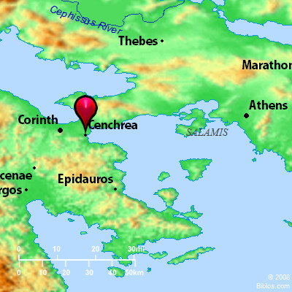
Cenchrea

Slide 7
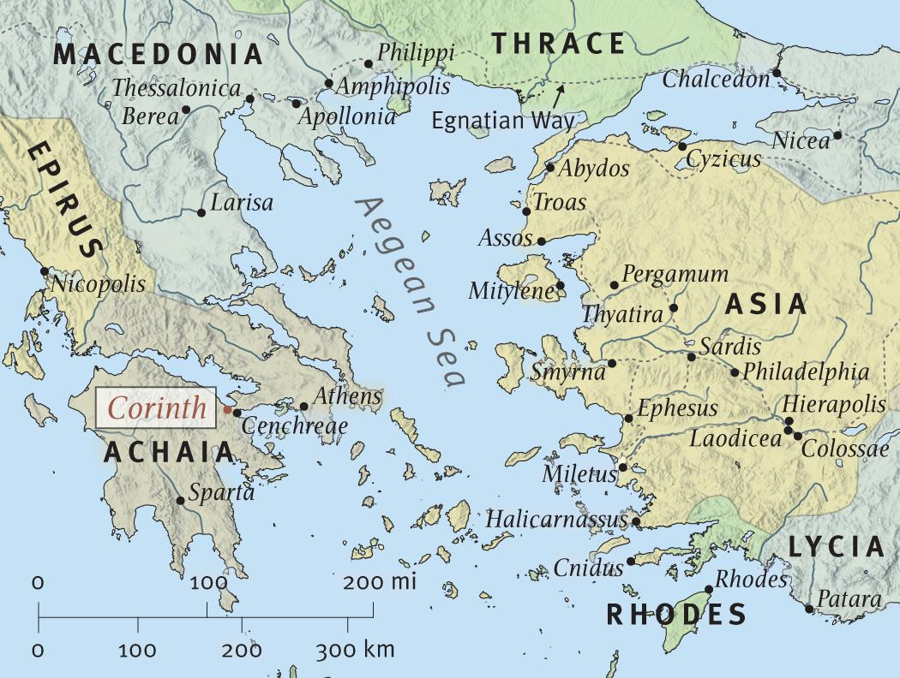
Corinth and Cenchrea

Slide 8
Assist her, 2
‘Stand by, help her’
Ro.16, nine women. What can they do?
*Visit, feed sick Ac.9:36; 1 T.5:10
*Open home for prayer, study, Ac.12:12
*Go where men cannot, Ph.4:3
*Help husband qualify for elder, 1 T.3
*Teach women, children, Tit.2:3-6
*Show hospitality, Hb.13:2

Slide 9
Helper of many
Paul was indebted to her (2)
‘Helper’
► Spouse, Gn.2:18
► Lord, Hb.13:6
► Phoebe, Ro.16:2
Active in helping. Caring for others; aiding them with her resources.

Slide 10
Priscilla & Aquila, The Brave, 3-5a
Fellow-workers (3), not in tents but teaching (Ac.18:26)
No evidence Aquila preached, but…
We need private teachers too
*Corinth, Ac.18:3
*Ephesus, Ac.18:18-21
*Rome, Ro.16:3-5
*Ephesus, 2 Tim.4:19

Slide 11
Priscilla & Aquila, The Brave, 3-5a
Fellow-workers (3), not in tents but teaching (Ac.18:26)
Risked necks for Paul (4)
Lay down neck = lay head on block to be cut off with an axe. [Acts 19?]
Paul reveals it
Paul’s Romans, Gal., Prison Epistles, Tim. / Tit. 1 Jn.3:16
By this we know love, because He laid down His life for us. And we also ought to lay down our lives for the brethren.

Slide 12
Priscilla & Aquila, The Brave, 3-5a
Fellow-workers (3), not in tents but teaching (Ac.18:26)
Risked necks for Paul (4)
Lay down neck = lay head on block to be cut off with an axe. [Acts 19?]
Church in their house, 5
Not to boast, but to serve

Slide 13
Epainetus, The First, 5b
Firstfruits of Achaia. ASV et al.: Asia.
Stephanas, first family of Achaia (1 Co.16:15)
Paul thought highly of Epainetus
He did not misuse his ‘seniority’ to become a Diotrephes

Slide 14
Mary, The Worker, 6
(Compare v. 12)
We know one thing about her:
¹She labored . . . ²Much . . . ³For us
Lord knows what she did
Some think only about what they ‘get’ out of it
Rv.14:13

Slide 15
Rufus, The Sharer, 13
Son of Simon, Mk.15:21?
Mark wrote few years after Romans
Refers to this family; expects Romans to know the sons
If so, Simon bore Jesus’ cross, voluntarily took up his own cross, dedicated his life and family to Lord
Paul’s family would have rejected him
Mt.12:47-50. Mk.10:30

Slide 16
Gaius, The Host, 23
Noted for his hospitality.
His house was Paul’s home. 3 Jn.5-8
False brethren betrayed Paul, 2 Co. 11:26

Slide 17
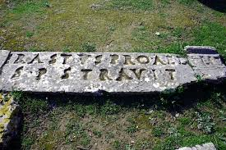
Erastus, The Noble, 23
1 Co.1:26, not many…
Treasurer – a city-manager

Slide 18
Erastus, The Noble, 23
Mentioned in Ac.19:22; 2 Tim.4:20?
His important job did not interfere with his service to God
Mt.6:33
Some don’t have time to go to heaven

Slide 19
1. All Scripture is relevant
‘Who wants to hear a list of names?’
We learn from approved examples – encourages us to do better
Assuredly, I say to you, wherever this gospel is preached in the whole world, what this woman has done will also be told as a memorial to her – Mk.14:9.

Slide 20
2. Ordinary people can do extraordinary things
“Do all the good you can, by all the means you can, in all the ways you can, in all the places you can, at all the times you can, to all the people you can, as long as ever you can”
We also can be a good example
Mt.5:13-16

Slide 21
3. They didn’t know Paul would call their names
We know God always watches us
Most important list of names: Book of Life

Slide 22
4. Paul was busy, yet remembered twenty-six names
Greet = 17 times in vv.3-16
Christians are warm
Be kindly affectionate to one another with brotherly love, in honor giving preference to one another – Romans 12:10
Loving dearly (family affection)

