Slide 1
Why Don’t You…?

Slide 2
I. Why Don’t You Use Mechanical Instruments?

Slide 3
Issue is NOT
Dollars
Dislike
Desire to be different

Slide 4
Our stand harmonizes with . . .
1. NT teaching
Mt.28:18… (Jn.16)
He taught; Apostles repeat.
Acts 2:42
NT tells us what He wants; we do it.
2 Jn.9
NT tells us where to stop; we stop.
Does NT authorize mechanical music?
Does NT authorize singing? (Ep.5:19)

Slide 5
Our stand harmonizes with . . .
1. NT Teaching
2. OT Teaching
“But OT authorized mechanical music’
How do you know?
(Read it)

Slide 6
OT taught same respect for authority as NT
OT prophecy: spiritual covenant would replace physical
You shall not add to the word which I com-mand you, nor take from it, that you may keep the commandments of the LORD your God which I command you – Dt.4:2

Slide 7
OT | NT
Animal sacrifices, Ps.66:13-15 | Living sacrifices, Ro.12:1
Aaron: priesthood, Ex.28 | Jesus: High Priest, Hb.7; 13:10-16
Harps, Ps.150 | Heart, Ep.5:19

Slide 8
Our stand harmonizes with . . .
1. NT Teaching
2. OT Teaching
3. Leaders of protestant denominations
“The Greek Church disapproves the use of organs. The Latin Church introduced it pretty generally, but not without the protest of eminent men, so that even in the Council of Trent, a motion was made though not carried, to prohibit the organ at least in the mass” – P. Schaff, History of the Christian Church, IV, 439

Slide 9
Our stand harmonizes with . . .
1. NT Teaching
2. OT Teaching
3. Leaders of protestant denominations
“I have no objection to instruments of music in our chapels, provided they are neither HEARD nor SEEN” – John Wesley
“I say the same, though I think the expense of purchase had better be spared” – Adam Clarke, IV, 686

Slide 10
Our stand harmonizes with . . .
1. NT Teaching
2. OT Teaching
3. Leaders of protestant denominations
“Musical instruments in celebrating the praises of God would be no more suitable than the burning of incense, the lighting up of lamps, and the restoration of the other shadows of the law” – John Calvin, Ps.33

Slide 11
I. Why Don’t You Use Mechanical Instruments?
II. Why Don’t You Baptize Babies?

Slide 12
To be forgiven of sins, we must obey Lord
Mt.28:18-20, must be taught
Mk.16:15-16, must be able to believe
Lk.24:47-49, able to repent
Can infants do these things?
Babies are inno-cent (safe) –Jon.4
Some “baptize” those who do not need it, discourage those who do

Slide 13
Babies are seldom (if ever) baptized
Most are sprinkled
Baptize: transliteration
Baptize translated: immerse (Ro.6)
‘Baptize’ by sprinkling?
‘Bury’ by sprinkling?
‘Run’ by riding?
John 3:23
Mt.3:16
Acts 8:35-39

Slide 14
I. Why Don’t You Use Mechanical Instruments?
II. Why Don’t You Baptize Babies?
III. Why Don’t You Abandon Baptismal Regeneration?

Slide 15
Most know only what their preachers say
Some misrepresent truth
Baptismal regeneration: ‘A sacrament of the New Law instituted by Jesus Christ, in which, as a result of washing with water accompanied by the words ‘I baptize thee in the name of the Father and of the Son and of the Holy Ghost,’ a human being is spiritually regenerated, and made capable of receiving the other sacra-ments’ –Donald Attwater, A Catholic Dictionary

Slide 16
The Truth
Baptism is not a sacrament
Baptism does not remove sin w/o faith and repentance
With faith and repentance, God’s mercy regenerates at baptism, Tit.3:5

Slide 17
‘…not by works of righteousness which we have done, but according to His mercy He saved us, through the washing of regeneration and renewing of the Holy Spirit.’
Through: ‘of the instrument used to accomplish a thing…’ – T.3:5 – Th.

Slide 18
‘…not by works of righteousness which we have done, but according to His mercy He saved us, through the washing of regeneration and renewing of the Holy Spirit.
Washing: ‘the bath that brings about regeneration’ – BDAG.
‘One washes to be clean’ … ‘this purifying effect of bathing is highlighted in Eph.5:26’ – purification carried out by means of and in the form of a bath with water…’

Slide 19
‘…not by works of righteousness which we have done, but according to His mercy He saved us, through the washing of regeneration and renewing of the Holy Spirit.
Washing: ‘the bath that brings about regeneration’ – BDAG.
‘Christ takes as his bride the church, which he has washed of its sins (cf. Acts 22:16)’
‘Born of water and the Spirit’ John 3:5
The baptized person is a new creation’ – Spicq

Slide 20
NT: Purpose of baptism
To be saved
Mk.16:16; 1 Pt.3:21
Remission of sins
Ac.2:38; Mt.26:28
Wash away sins
Ac.22:16
Get into Christ
Ro.3:3-6
Put on Christ
Gal.3:26-27

Slide 21
“But I don’t think baptism matters”
Who are you?
What does God say?
Naaman
Save
Remission
Wash away
Get into
Put on
When these words occur in context if physical illness…?
…Rescue?
…Finances?

Slide 22
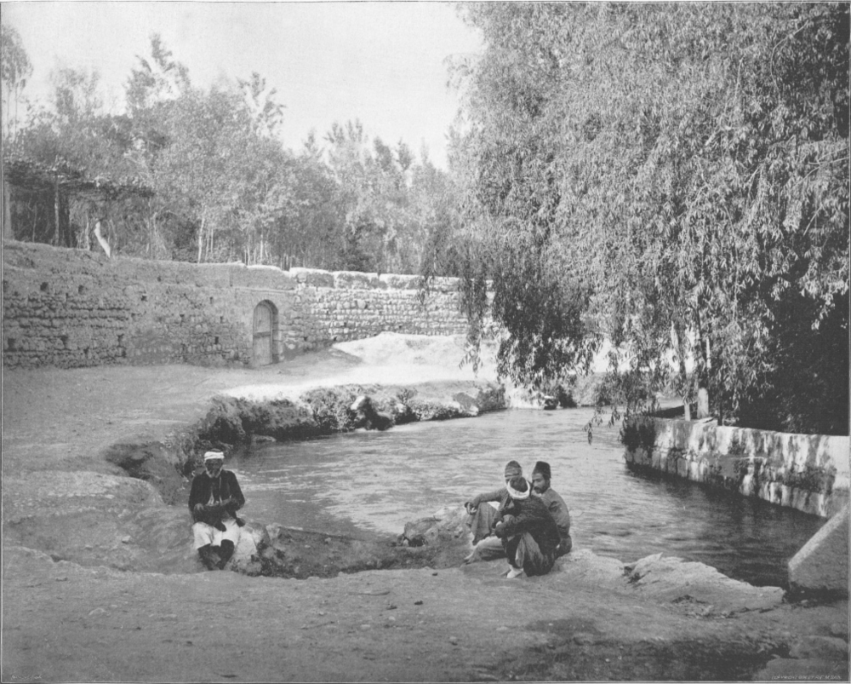
Abana River

