Slide 1
Teacher Creatures
Proverbs 30:24-28

Slide 2
Little Things Mean A Lot
Prov.27:3, sand
Prov.30, series of fours –
Unquenchable things, 15-16
Unsolvable things, 18-19
Unbearable things, 21-23
Unapproachable things, 29-31
Unimportant things, 24-28

Slide 3
I. Ants, 25

Slide 4
In two ways, ants shame the lazy person
Never ask, “Do I have to?”
Always know what time it is.
Eph.5:16

Slide 5
I. Ants, 25
II. Rock Badgers, 26

Slide 6
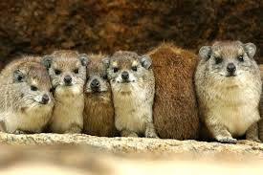
Syrian Hyrax - refuge
Ps.104:18
Sentries on lookout
Acts 20:28
Mt.7:15; Lk.17:3
First sign of danger: seek refuge –
Ps.18:2; 31:1-6…19-20

Slide 7
Syrian Hyrax - refuge
Ps.104:18
Sentries on lookout
Acts 20:28
Mt.7:15; Lk.17:3
First sign of danger: seek refuge
God is our defense, Ps.94:22
Num.35:11; Hb.6:18; 1 Co.6:18

Slide 8
I. Ants, 25
II. Rock Badgers, 26
III. Locusts, 27

Slide 9
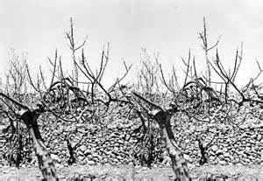
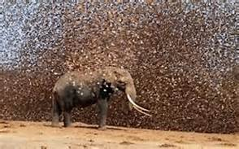
Locust Invasions - Order
Palestine, 1915
In rank. Prov.30:27
United. (Ex.10) Joel 2:3-8
Mt.12:25
1 Co.1:10 – ch.12
Ph.2:3
Disciplined. Ac.8
Self-sacrifice. Ac.21
Egypt, 2013

Slide 10
I. Ants, 25
II. Rock Badgers, 26
III. Locusts, 27
IV. Spider / Lizard, 28

Slide 11
Spider / Lizard - Perseverance
Though small, weak, she ends up in king’s palaces.
Hb.3:6 –
House: partake of Him
If: conditional
To the end: hope realized
Hold: not slip, slide, drift
Hb.11:13-16

Slide 12
Spider / Lizard - Perseverance
Though small, weak, she ends up in king’s palaces.
She is determined to advance to better things.
Moses
David
John
Paul
John Mark

Slide 13
Conclusion
1. We can learn from everyone/ everything
2. If tiny creatures can accomplish so much, what about me?
3. Little things mean a lot. Mt.10:42
A little sin can destroy souls forever.
A little deviation from truth can destroy. Gn.3; Lv.10; 2 Sm.6… Lk.16:10
A little deed may save souls for eternity.

