Slide 1
Even The World Is Strict On Some Morals

Slide 2
I. Are Christians Free To Choose Any Recreation?

Slide 3
We Must Be Careful
Ro.6:1-2, continue or stop?
Ro.12:1-2, sacrifice or indulge?
1 Co.6:18, run away or stay?
Ep.5:6, darkness or light?
Ja.1:27, spotted or unspotted?

Slide 4
I. Are Christians Free To Choose Any Recreation?
II. Arguments To Support Smoking

Slide 5
The authority argument
‘I know a doctor who smokes; he says it’s all right.’
Same one who supports drinking? …marijuana? …suicide?
Chocolate is good for teeth (?)

Slide 6
The ‘you too’ argument
‘I know a doctor who smokes.’
‘Coffee, soft drinks, candy, tea, et al. are just as bad.’
ADMITS these and tobacco are bad.
We must be wise in everything.
‘Moderation in all things’

Slide 7
The ‘long life’ argument
‘I know a doctor who smokes.’
‘Coffee, soft drinks, candy, tea, et al. are just as bad.’
‘I know a smoker who died at 95.’
Also drinkers, drug users, those who dishonor parents, plane crash survivors…
Does long life prove practice right?
Really proves how much abuse the body can take.

Slide 8
Shift the blame argument
‘I know a doctor who smokes.’
‘Coffee, soft drinks, candy, tea, et al. are just as bad.’
‘I know a smoker who died at 95.’
‘God made tobacco; it must be good.’
True
Also made dirt, marijuana, alcohol
Tobacco is good for killing things

Slide 9
Bible allows ‘all things’
‘I know a doctor who smokes.’
‘Coffee, soft drinks, candy, tea, et al. are just as bad.’
‘I know a smoker who die at 95.’
‘God made tobacco; it must be good.’
‘Tit.1:15, to pure, all things…pure.’
Context: 14-15 = Mt.15; Ro.14:14
1 Tim.4:4-5, food
Prov.31:4-9, medicine
It is not the impure thing that makes men impure, but impure men who make every pure thing impure.

Slide 10
I. Are Christians Free To Choose Any Recreation?
II. Arguments To Support Smoking
III. Applying Biblical Principles

Slide 11
1. Influence
Mt.5:16
People learn by eyes and ears, Mt.13:14-15
People are always ready to find inconsistencies in Christians
People are always ready to use inconsistencies as an excuse

Slide 12
1. Influence 2. Consider others
Mt.7:12
Love works no ill, Ro.13:10
Many studies prove harmful effects of second-hand smoke. Ph.2:4

Slide 13
1. Influence 2. Smoker must consider others 3. Smoking is addictive
1 Co.6:12, not even expedients…
1 Co.9:24-27
‘strike under the eye, give black eye to’
(bruise, discipline, subdue) keep body under complete control . . . Lk.18:5
2 Pt.1:6, self-mastery, self-restraint, self-control, continence…

Slide 14
1. Influence 2. Smoker must consider others 3. Smoking is addictive 4. Smoking harms the health
1 Co.6:19-20; Ac.16:28
Smoking contributes to 80% of lung cancer deaths in women, 90% in men.
Chas. Cameron, M.D.: ‘the heavy smoker pays with 34.6 minutes of life for each cigarette he smokes.’
‘The pack a day smoker pays with 11.5 hours for each pack.’

Slide 15
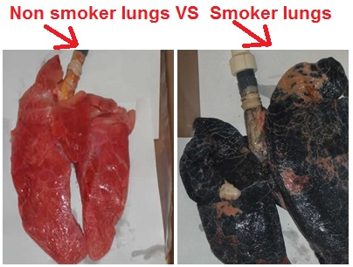

Slide 16
1. Influence 2. Smoker must consider others 3. Smoking is addictive 4. Smoking harms the health 5. Stewardship
1 Co.4:2, faithful

