Slide 2
Even God’s People Struggle with Doubt
Psalm 22:1-2 - David
1 Kings 19:4 – Elijah
Job.7:20-21 – Job

Slide 3
Absolute Certainty is not Required
2 Corinthians 5:7
Hebrews 11:1
Even if it would be unreasonable to believe anything else, faith is still necessary.

Slide 4
Atheists Cannot Offer Certainty Either
Demand Scientific Demonstration:
Prove Rationally by logic
Empirically using the five senses
Their Demand is really a Belief!

Slide 5
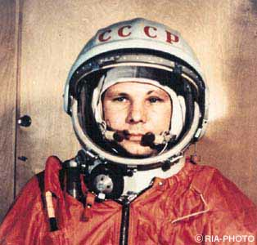
Atheists Cannot Offer Certainty Either

Slide 6
Looking for Clues
A Created Universe will behave a certain way
An Uncreated Universe will behave differently
What fits best?

Slide 7
The Universe Had a Beginning
Why is there something rather than nothing?
If the universe began, something began it. What?

Slide 8
It Appears to be Fine Tuned
It’s hard to live anywhere besides Earth
“the odds against the universe emerging from the Big Bang are enormous...” -Stephen Hawking

Slide 9
The Laws of Nature are Regular
Inductive reasoning is based on this assumption.
Science cannot prove the regularity of natural laws – it can only take it on faith!

Slide 10
Man has the Capacity for Moral Judgment
There are very few true moral relativists.
“Is there anyone, anywhere in the world, doing something they should not be doing regardless of what they think about it?”

Slide 11
Man has the Capacity for Moral Judgment

Slide 12
We All Look for Meaning and Purpose
If we are an accident, love, beauty, justice, etc. do not exist!
All our desires correspond to real needs
Hunger – Food
Thirst – Drink
Fatigue – Sleep

