Slide 1
The Half Was Not Told
1 Kings 10:1-13

Slide 2
I. What The Queen Heard, Saw, And Did

Slide 3
She heard of Solomon’s fame, 1
1 Kings 4:29-34; 9:26

Slide 4
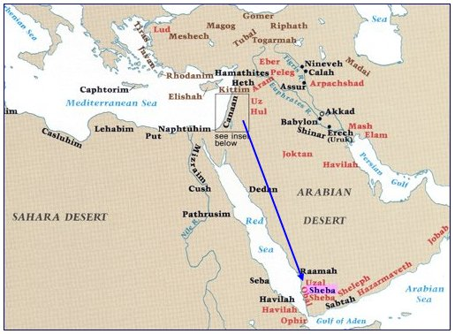
Sheba (‘South’)

Slide 5
She heard of Solomon’s fame, 1
1 Kings 4:29-34; 9:26
Heard reports
Had to know for herself
Privilege: talk to wisest man in world

Slide 6
She heard of Solomon’s LORD, 1, 6
God made Solomon what he was
1 K.3

Slide 7
Came to test Solomon, 1
Not gullible.
1 Th.5:21; 1 Jn.4:1

Slide 8
Came to Jerusalem, 1-2
Long trip: cost, fatigue; no comforts of home
Humility: no one knows everything

Slide 9
Came with gifts, 2
Knowledge is priceless

Slide 10
Came to learn, 2-3
Solomon answered all her questions
Her reaction: 4-5, ‘no more spirit…’
Her resolve: 7, see it for herself
Her realization: 6-7, reports true, but understated

Slide 11
Credits God for it all, 8-9
Pagan learns about true God

Slide 12
Her money, 10
4 ½ tons of gold
Wisdom is most valuable, Pr.8
What is soul worth? Mt.16:26

Slide 13
She asked and received, 13
Lk.11:9-13

Slide 14
She went home a changed person, 13
Listen – respect
Learn – ripen
Live – righteous
We cannot surpass God in giving

Slide 15
I. What The Queen Heard, Saw, And Did
II. What Jesus Said About The Queen, Lk.11

Slide 16
The Setting: 9-13
Yours for the asking
Mt.12:24 (Pharisees); Mk.3:22 (scribes)
Squandered their opportunity

Slide 17
The Sign: 14
Common people marveled

Slide 18
The Slander: 15-16
Could not deny the miracle
Charge Him with collusion (‘by Beelzebub’)
Challenge Him to show sign

Slide 19
The Silencing: 17-23
‘Do you need glasses?’
1. Illogical, 17-18. Satan proves Jesus supreme authority? Satan casts out satan??
2. Inconsistent, 19. ‘Your sons’
3. Inexcusable, 20-22. ‘Finger of God’ – Ex.8:15, 19.
4. Infernal (24-26). No neutrality.

Slide 20
The Support: 27-28
A Woman understands Him
Better than family relationship is hearing and obeying His word.
His brothers do not believe.

Slide 21
The Scripture: 29-32
Jonah, 29-30: sign to this generation
Queen of South, 31: judge of this generation
Hb.11:7
Imagine this evidence in court

Slide 22
Queen of Sheba | Pharisees
1200+ miles away | Truth in their midst, Lk.22:53
Solomon’s wisdom | Access to One Greater than Solomon
Merely heard reports | Many religious advantages
Gave Solomon treasures, 1 K.10:10 | Give nothing; plot to take Life
Her own initiative; no invitation | Invited, urged to accept truth, 14:15…

Slide 23
What does this mean to me?
Solomon was ‘light in world’ (6-9)
Jesus is Source of light, Jn.8:12
We reflect His light, Lk.11:33-36
People watch us. Ph.2:14-15
What can I do? Be bright

Slide 24
What does this mean to me?
2. Queen came from far off
We once were ‘far off’ – Ep.2:13
Jn.1:46

Slide 25
What does this mean to me?
3. Told Solomon all her heart, 2
We may bring all our difficulties to the Lord, Col.2:3

Slide 26
What does this mean to me?
4. She returned to Sheba a changed person, 13
We should too, Ac.4:13

Slide 27
What does this mean to me?
5. Two kinds of people
Queen: breath taken away over Solomon’s wisdom
Pharisees: foolishly yawn at Son of God
Lk.19:48

Slide 28
What does this mean to me?
6. Indifference to Lord invites judg-ment by Queen of Sheba
‘But I had to travel 15 minutes…’
‘I was too sleepy / bored to listen’
‘I have short attention span’
‘I’m too busy to study at home’

