Slide 1
Are We Under The Old Testament?

Slide 2
A quote:
‘If we keep the ten commandments and believe in Jesus, we will be saved’
Almost all Protestant churches teach that God expects everyone to observe the OT today
‘You mean we can break the ten commandments?”

Slide 3
I. The Confusion

Slide 4
To say we’re not under OT is NOT saying . . .
We don’t believe it.

Slide 5
To say we’re not under OT is NOT saying . . .
We don’t believe it.
We are not under law today.
For the law of the Spirit of life in Christ Jesus has set you free from the law of sin and death – Ro.8:2

Slide 6
To say we’re not under OT is NOT saying . . .
We don’t believe it.
We are not under law today.
…to those who are without law, as without law (not being without law toward God, but under law toward Christ), that I might win those who are without law – 1 Co.9:21

Slide 7
To say we’re not under OT is NOT saying . . .
We don’t believe it.
We are not under law today.
Bear one another’s burdens, and so fulfill the law of Christ – Gal.6:2

Slide 8
To say we’re not under OT is NOT saying . . .
We don’t believe it.
We are not under law today.
But he who looks into the perfect law of liberty and continues in it, and is not a forgetful hearer but a doer of the work, this one will be blessed in what he does – Ja.1:25

Slide 9
To say we’re not under OT is NOT saying . . .
We don’t believe it.
We are not under law today.
OT is unprofitable.
Hb.11:7 – By faith Noah, being divinely warned of things not yet seen, moved with godly fear, prepared an ark for the saving of his household, by which he condemned the world and became heir of the righteousness which is according to faith.

Slide 10
To say we’re not under OT is NOT saying . . .
We don’t believe it.
We are not under law today.
OT is unprofitable.
Hb.11:7
Ro.15:4 – Ps.110
Hb.3-4, warns Christians. Jude 5

Slide 11
To say we’re not under OT is NOT saying . . .
We don’t believe it.
We are not under law today.
OT is unprofitable.
We have right to violate NT repeats.
Ro.13:8-10
1 Tim.1:…6-11, desire to teach LOM is good (2:13-15 ↔ Gen.3)

Slide 12
1 Tim.1:6-11 – the problem: false teachers
1. They have embraced error, 6
2. They want to shine, 7 (Ro.2)
3. They are outlaws, 8 (Mt.15:3, 6)
4. They should have been crushed by Law; instead, spiritualized it, 9

Slide 13
Medieval Quadriga
Fourfold method of interpreting Bible
‘Jerusalem’
1. Literal: plain, obvious: the city
2. Moral: my soul: how should I act
3. Allegorical: Christ, the church
4. Anagogical: our ultimate fate

Slide 14
I. The Confusion
II. The Correction

Slide 15
If we are under OT today we must…
1. Celebrate Passover (by family), Ex.12:3
2. Keep sabbath, Ex.35:3 – no fire
3. Offer animal sacrifices for sin, Lv.16
4. Practice annual atonement, Lv.16
5. Go to Jerusalem three times a year, Dt.16:16

Slide 16
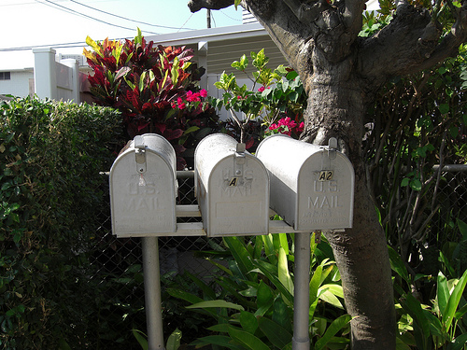
God gave OT to Israel…alone
Dt.5:1-3 [4:8; Ps.147:19-20; Ro.2:14]
Patriarchs did not have Passover, Sabbath, etc.
Christ is our Passover, 1 Co.5:6-8
P
G
I

Slide 17
Why did God give OT to Israel?
Ro.3:20, give knowledge of sin
Ga.3:24, bring people to Christ

Slide 18
God never permitted anyone to keep only part of OT
Gal.5:1-4
‘These expressions must be understood as explicit denials of salvation to those who committed themselves to the works of the law as necessary to justification’ – Hogg & Vine. [1:6-9]

Slide 19
No one is under OT today
Ro.7:1-7
Woman has two husbands:
Adulteress
Living under two laws (OT-NT) is spiritual adultery
Woman’s husband dies: free to remarry
Made dead to Law to be joined to Christ

Slide 20
No one is under OT today
Ro.7:1-7
Gal.3:23-25, schoolmaster (pedagogue) slave who conducted boy to / from school
When boy became of age, no more conductor
Law: Israel’s conductor to bring to Christ

Slide 21
No one is under OT today
Ro.7:1-7
Gal.3:23-25
Ep.2:14-15 –
Abolished: nullify, make invalid
Enmity: hostility
Law of commandments. Jn.7:49
“But this crowd that does not know the law is accursed.”

Slide 22
No one is under OT today
Ro.7:1-7
Gal.3:23-25
Ep.2:14-15
Col.2:14-17
OT ordinances nailed to cross
16: let no one judge you by law…
Nu.15:32-36
17: shadow vs reality. Cf. passover

Slide 23
No one is under OT today
Ro.7:1-7
Gal.3:23-25
Ep.2:14-15
Col.2:14-17
Hb.7:12-14, Jesus is our High Priest. Conclusion: Law changed.

Slide 24
No one is under OT today
Ro.7:1-7
Gal.3:23-25
Ep.2:14-15
Col.2:14-17
Hb.7:12-14
Hb.9:15, mediator of new covenant.

