Slide 1
Bible Study 101

Slide 2

I. First One Thing, Then Another

Slide 3
Confusing Conversations
Acts 19:…29-32
Acts 21:34
‘…most of them did not know why they had come together’ (32).
‘…and some among the multitude cried one thing and some another.’

Slide 4
Neighbors read / study together
Mk.1:1-15
‘Teaches us to be baptized; immersion’
‘No; should be baptized with Holy Spirit’
‘To me: slow down; go to woods; meet God’
‘God told me: will send HS to me as a dove’
  ‘I don’t think so’
    ‘You’re disagreeing with God’
‘This shows how rich the Bible is: it can mean so many things’

Slide 5
EVEN IF these later realize the error of this approach . . .
they are confused about
the way to repair it.
‘We need miracles’
‘We need enlightenment of Holy Spirit’ (‘lay it on my heart…’)

Slide 6
Corinth had miracles – 1 Co.1:7
Corinth embraced false teachers
(2 Co.10-13).
Spiritual gifts did not prevent
someone believing a lie.
They contradicted one another.
They are most gifted – revelations of Holy Spirit, 1 Co.14:30
1 Co.1-4, INFATUATED with preachers
1 Co.5:1, IMMORAL in public; (ch. 6)
1 Co.5:9-10, IGNORANT of passage
1 Co.15, INFIDELIC in position
1 Co.10, Israel: daily miracles.
Divine guidance, but stubborn,
faithless, disobedient. Also, Corinth.

Slide 7

Corinth had miracles – 1 Co.1:7
They are most gifted – revelations of Holy Spirit, 1 Co.14
1 Co.1-4, INFATUATED with preachers
1 Co.5:1, IMMORAL in public; (ch. 6)
1 Co.5:9-10, IGNORANT of passage
1 Co.15, INFIDELIC in position
1 Co.3:1-3; 14:20.
‘Neighbors’ have NT but prefer personal opinions over God’s revelation.

Slide 8
The Real Solution
Mt.16:13-17 . . .
13, easy question
►Claims + signs = certainty (Jn.3)
14, some . . . others confused
15-16, disciples: clarity
►17, what made them different?
AVOIDED flesh & blood…
ACCEPTED revelation of Father

Slide 9
I. First One Thing, Then Another
II. What Is Your Reading Of It?

Slide 10
Luke 10:…26
Two questions –
1) What is written?
2) How do you read [it]?
God → writer → reader (hearer)
We can understand it (Mt.15:10, 16)
We understand it alike (Mt.24:15)

Slide 11
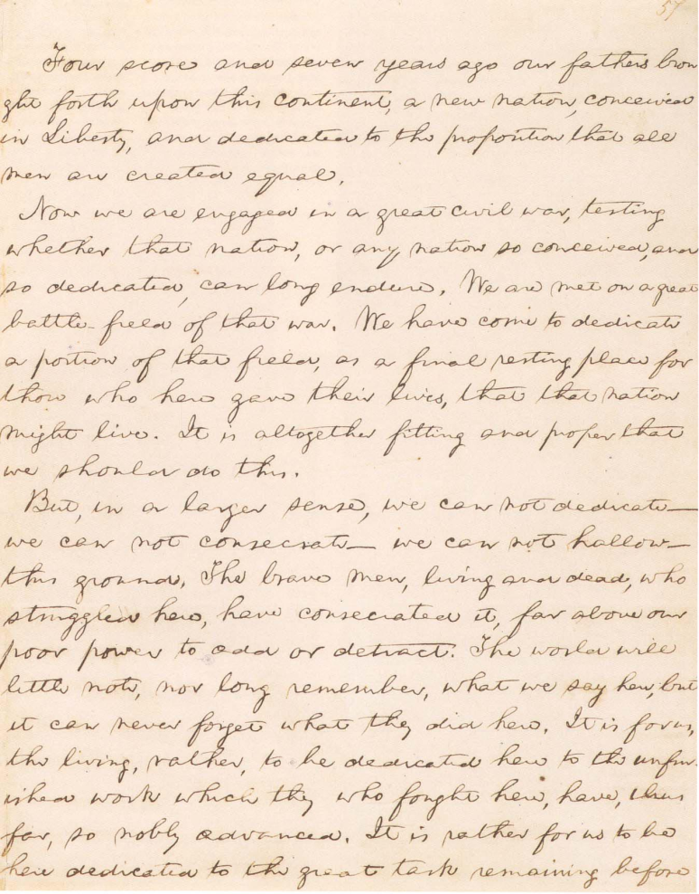
Luke 10:…26
“Four score”?
“Hallow”?

Slide 12
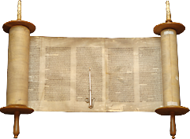
The text:
a collection of letters
The beginning of the gospel of Jesus Christ, the Son of God. As it is written in the Prophets:
"Behold, I send My messenger before Your face, Who will prepare Your way before you.”
Meaning:
result of thought

Slide 13
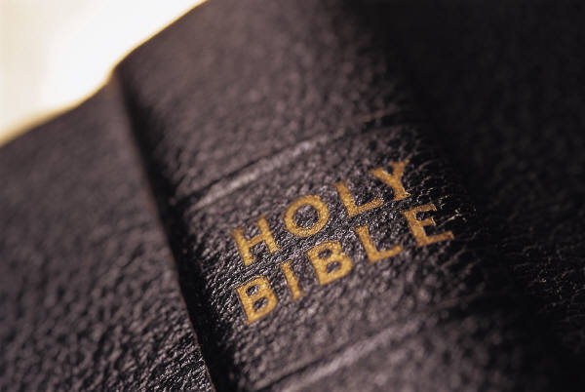
Writer, not reader, determines meaning of the text
God → writer → reader (hearer)
Ep.3:4
Inkblot test
Bork / Thomas

Slide 14
Writers imply;
readers infer
Then he read from it in the open square that was in front of the Water Gate from morning…
until midday, before the men and women and those who could understand…
–Neh.8:3
Readers discover meaning; do not create meaning

Slide 15
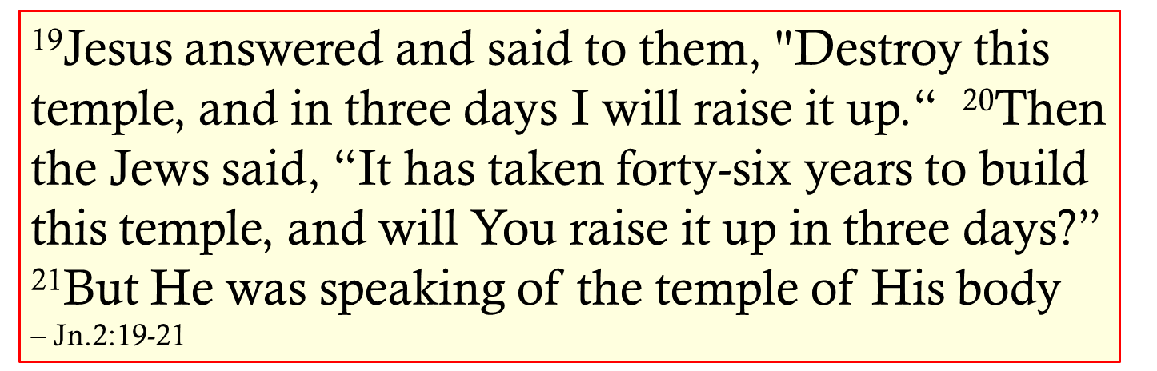


Writers explain unusual usage
Baptism < Gr. baptisma, immersion < baptizein, to plunge, immerse. 1. …the ceremony or sacrament of admitting a person into Christianity or a specific Christian church by dipping him in water, or sprink-ling water on him… – Webster, 116.

Slide 16
Writers explain unusual usage
Church: 1. building set apart or consecrated for public worship… 2. public worship … 3. All Christians. 4. A particular sect, denomination, or division of Christians… 5. The ecclesiastical government of a particular religious group… 6. the profession of the clergy. 7. group of worshippers – 262

Slide 17
Writers explain unusual usage
Saint: 1. holy person. 2. person who is exceptionally meek, charitable, patient, etc. 3. member of any of certain religious groups calling themselves Saints.
4. in certain churches, a person officially recognized as having lived an exceptionally holy life, and thus as being in heaven & capable of interceding for sinners; canonized person. – 1285

Slide 18
I. First One Thing, Then Another
II. What Is Your Reading Of It?
III. Be Not Unwise, But Understand

Slide 19

Eph.5:17
Lk.9:43-45, simple words, strong bias
Gal.1:6-9, context: Judaizers
Eph.5:18, do not get drunk on wine
‘So, I can get drunk on vodka!
To understand passage, must understand principle:
avoid drunkenness

Slide 20
I. First One Thing, Then Another
II. What Is Your Reading Of It?
III. Be Not Unwise, But Understand
IV. What Does It Mean?

Slide 21
Ep.4:9
Jg.5
Original context
Ps.68
Advanced application
Ep.4
Ultimate fulfillment

Slide 22
Acts 17:20
A great mind alone will not discover truth
Attitude is just as important
²⁵ At that time Jesus answered and said, “I thank You, Father, Lord of heaven and earth, that You have hidden these things from the wise and prudent and have revealed them to babes. ²⁶ Even so, Father, for so it seemed good in Your sight” – Matthew 11

