Slide 1
The Prophet Who Conquered Moab
2 Kings 3

Slide 2
I. The Rebellion, 1-6

Slide 3
Jehoram, son of Ahab (1)
Unlike Ahab, Jezebel, or brother Ahaziah (1:1-2…)
BUT: Jehoram clung to (Ru.1:14) sins of Jeroboam (3:3)
Father’s death, 1 K.22:…34-37
Brother’s death, 2 K.1:…16-17

Slide 4
Jehoram, son of Ahab (1)
Mesha, king of Moab - Ahab’s death 3:4-5 (stopped payments)
‘Used to pay’ – NASB
Tested new king. War! (6)

Slide 5
I. The Rebellion, 1-6
II. The Rulers, 7-9a

Slide 6
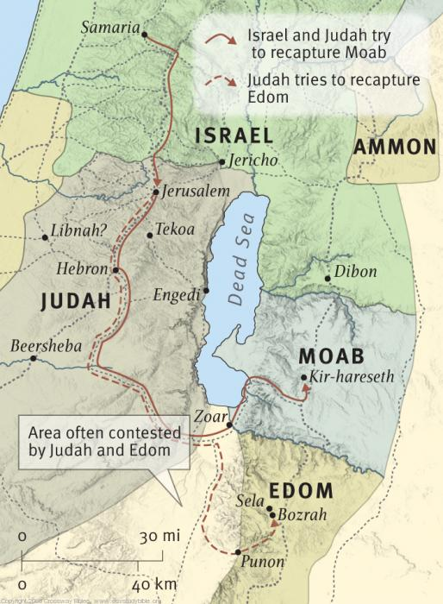
Joram wants Jehoshaphat’s help, 7
Shades of 1 K.22
Route: Wilderness of Edom (3:8)

Slide 7
Jehoshaphat – fellowship issues, 7
Taught Scripture, 2 Chr.17:7-9
Influence taught compromise
Son married Athaliah, 2 Chr.21
Ahab / Joram maintained Jero-boam’s apostasy (1 K.22:5-7)
Later fellowshipped Ahaziah, 2 Chr.20:35-37
Two Jehorams, 2 Chr.19:1-3

Slide 8
Jehoshaphat – fellowship issues, 7
2 Chr.19:1-3, Israel different in …
a. worship, 1 K.12
b. morals, 1 K.17, 19, 21
c. gods, 1 K.18:19 [3:2 – 10:19-28]
You cannot combat error by fellowshipping it and going along with it

Slide 9
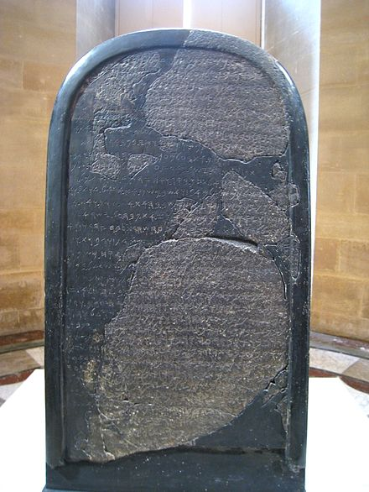
King of Edom, 9a
Vassal of Judah, 8:20-22
Moab’s army heavily defended northern approach to Moab.

Slide 11
I. The Rebellion, 1-6
II. The Rulers, 7-9a
III. The Reproof, 9b-19

Slide 12
Seven days later: no water (9)
Why not call golden calves? (cf. v.13)
11: Jehoshaphat seeks God’s guidance. 1 K.22
Servants knew Elisha – a servant.
12: three kings go to prophet.
13: to Joram: what do we have in common?
No prophet of God in Israel, 1 K.12
No worship of God in Israel, 1 K.13
No salvation of God in Israel, 1 K.14

Slide 13
Seven days later: no water (9)
Why not call golden calves? (cf. v.13)
14: only attention Joram gets is due to Jehoshaphat.
15: music: PUI
16-17: Zered valley; make ditches
18: simple / easy thing for Lord… (20:10)
19: promise: total victory…

Slide 14
I. The Rebellion, 1-6
II. The Rulers, 7-9a
III. The Reproof, 9b-19
IV. The Rout, 20-27

Slide 15
Sudden / complete provisions, 20 Water [cf. 1 K.18]
21: desperation
22-23: water . . . red as blood
24-25: destroyed Moabites / cities
26: last desperate attempt
27: assumes Chemosh is angry? Induce him to give Moab victory?

Slide 16
Burnt offering on the wall, 27
1. Bitter anger against Israel?
a. God’s anger?
b. Moab’s anger?
2. Judah against Israel?
a. Unpitying slaughter?
b. Battle itself?
3. Great indignation in Israel? [Josephus]

Slide 17
Concluding Lessons
1. Jehoram: only God of Israel can save – dehydration; enemy
Ch.6, saved; repented
Ch.8, fascinated with Elisha’s miracles
Ch.9, killed
Elisha’s reproof was act of love
Hard hearts clung to idols

Slide 18
Concluding Lessons
2. Jehoshaphat: unwise pact ended in victory without the thrill. 2 Co.6

Slide 19
Concluding Lessons
3. Moab: despair of world without God
a. He could not defeat God (true enemy)
b. Sacrificed own son. Mic.6:6-8.
Ro.8:32

Slide 20
Concluding Lessons
4. Elisha: his rebuke, like arrows of God, intended to save
“…They have turned their back to Me, and not their face. But in the time of their trouble They will say, ‘Arise and save us.’ But where are your gods that you have made for yourselves? Let them arise, If they can save you in the time of your trouble. For according to the number of your cities Are your gods, O Judah” – Jer.2:27-28.

Slide 21
Concluding Lessons
5. God:
a. worked in silence
b. saved 3 armies, destroyed 1
c. no storm
d. powerful salvation
‘Never complain of misfortune while Caesar is your friend!’

