Slide 1
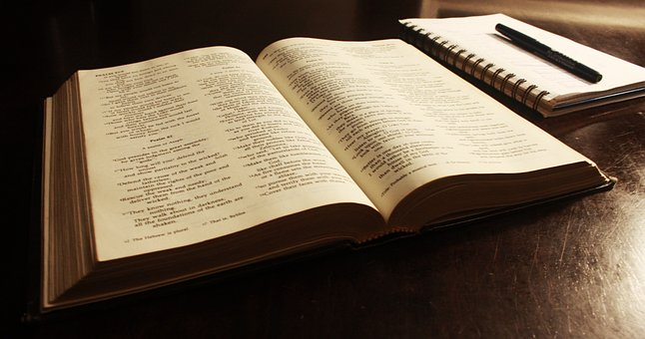

Slide 2
One map may be as good as another
Holy Bible alone gives map to heaven
Bible is unique
Beloved, while I was very diligent to write to you concerning our common salvation, I found it necessary to write to you exhorting you to contend earnestly for the faith which was once for all delivered to the saints – Jude 3

Slide 3
I. Bible Is Unique

Slide 4
1. In Moral Purity
Bible demands righteousness, condemns sin. Ro.6:23
Even heroes are exposed.
Demands true, inner righteousness.
Is.1
Mt.5, 6
Source?
1. Egypt?
2. Canaan?
3. Israelites?
4. God? Ex.20

Slide 5
1. In Moral Purity 2. In Accuracy
Writers avoided common errors of their day
Moses, Ac.7:22, Egyptian wisdom –
No spontaneous generation
Daniel, Babylon –astrology; fables
Paul–Peter, Science
O Timothy! Guard what was committed to your trust, avoiding the profane and idle babblings and contradictions of what is falsely called knowledge – 1 Tim.6:20. [2 Pt.1:16-21]

Slide 6
1. In Moral Purity 2. In Accuracy
Archaeology –
‘…it may be clearly stated categorically that no archaeological discovery has ever controverted a single biblical reference. Scores of archaeo-logical findings have been made which confirm in clear outline or exact detail historical state-ments in the Bible’ – N. Gleuck

Slide 7
1. In Moral Purity 2. In Accuracy
Archaeology –
‘…it may be clearly stated categorically that no archaeological discovery has ever controverted a single biblical reference. Scores of archaeo-logical findings have been made which confirm in clear outline or exact detail historical state-ments in the Bible’ – N. Gleuck

Slide 8
1. In Moral Purity 2. In Accuracy
Sodom
Wm. Albright – heavily fortified; others found 23-inch thick wall around city; many houses…
Outside city: thousands of skeletons unearthed.
Well populated during Bronze Age.
Massive fire destroyed city (ash…feet thick).
Fire began on roofs then spread – B. Wood.
‘There can be no doubt that archaeology has confirmed the substantial historicity of OT tradition’ – Albright.

Slide 9
1. In Moral Purity 2. In Accuracy
Hittites (Ex.3:17) – 1876
Boghazkoi texts changed world.
Greatest chariot battle in history (2500 chariots) – Hittites ambushed Egyptians.
Both sides describe the battle.

Slide 10
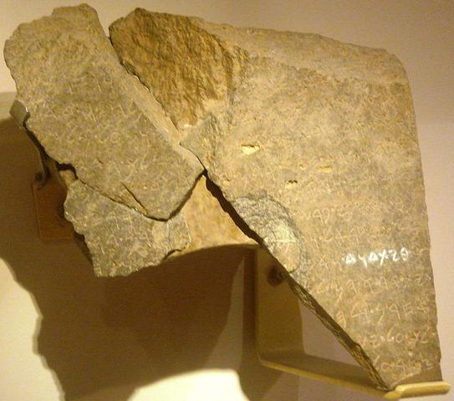
1. In Moral Purity 2. In Accuracy
1993: Stone slab (Aramaic): ‘The King of Israel’ and ‘House of David.’
1994: Inscriptions reference Jehoram, son of Ahab, & Ahaziah, of Judah (2 K.8-9).

Slide 11
1. In Moral Purity 2. In Accuracy
Contemporary confirmation. E.g.: Josephus:
Born AD 37; Jewish historian; Pharisee
Documented biblical people / events
Herod and Herodias
Eusebius on Josephus
“But some of the Jews were of the opinion that God had suffered Herod’s whole army to be destroyed as a just punishment on him for the death of John, called the Baptist” –Ant. 18

Slide 12
1. In Moral Purity 2. In Accuracy 3. In Unity
Not surprising if book of ONE man / group and ONE time is united
Bible: 40 writers, 1400 years, many places
OT – NT agree
OT predicts NT (Jer.31:31-34)
Mt.17: Moses…Elijah
OT prophecies fulfilled in NT
Jeremiah 31:31-34
Prophecy/Fulfillment
Hebrews 8:8-13

Slide 13
1. In Moral Purity 2. In Accuracy 3. In Unity 4. In Influence
No other book has incurred such hatred
Why so hated?
Draws appalling picture of us – Ec.7:29; Ro.1:29-31.
Accountable to holy God; Judgment.

Slide 14
I. Bible Is Unique
II. Bible Is Adapted To Man

Slide 15
Romans 1:16-18
Many denominations say Bible is not adequate; needs power in addition to Word.
God could not give it power?
God would not give it power?
Romans 1: He DID make it powerful enough. 2 Tim.3:16-17

Slide 16
Bible: the Book for all people
In your seed all the nations of the earth shall be blessed . . . – Gn.22:18
For the grace of God that brings salvation has appeared to all men – Tit.2:11

Slide 17
NT: arrangement adapted to man
World: three types of people:
NT addresses each division:
Unbelievers
Believers
Christians
Unbelievers
Testimony of Lord: Mt.-Jn.
Jn.20:30-31
Facts→Faith
Ac.6:7
Believers
Acts tells believers what to do
Luke–Acts
Acts 2
Christians
Epistles tell Christians how to serve God, walk by faith

