Slide 1
Jonah Runs From God
Jonah 1

Slide 2
Jonah
We usually associate doves with good things – Gn.8
Jonah, the minor prophet, was an unwilling participant in God’s plan

Slide 3
I. Jonah Runs But Cannot Hide

Slide 4
JONAH IS A REAL PERSON
He restored the territory of Israel from the entrance of Hamath to the Sea of the Arabah, according to the word of the Lord God of Israel, which He had spoken through His servant Jonah the son of Amittai, the prophet who was from Gath Hepher – 2 Kings 14:25

Slide 5
For their wickedness has come up before Me (2)
God . . .
Ruler of every nation.
Universal lawgiver; holds Nineveh accountable for sins. Ro.1, 2
Graciously sends Assyria special revelation (as with Egypt)
Will destroy them if they do not repent. Pr.14:34

Slide 6
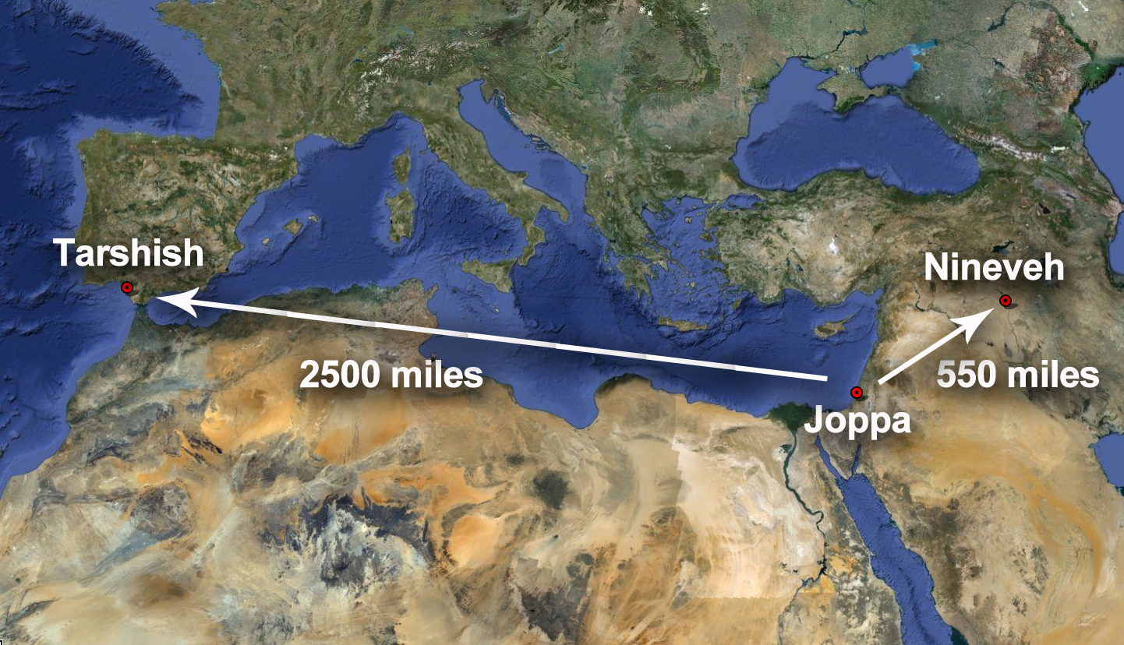
Wrong Way Jonah

Slide 7
Sea growing more tempestuous (11)
Jonah is cause of God’s wrath and their danger
This wrath will consume them too if they don’t obey
One person’s sins may affect others
Sin is serious: deadly consequences
Cannot outrun God
Storm will get worse if they do nothing (as Mk.4)

Slide 8
Please do not let us perish… (14)
More clearly we see danger, more readily we respond. Ac.2:40-41
What they did would be wrong in any other situation; here, wrong if they refuse.
Jonah’s death: incur charge of innocent blood? Mt.27:25
They know what to do (prophet of God told them).

Slide 9
Threw Jonah into the sea (15)
Proves without doubt: God of Israel is true God
These men become apostles
‘You should have been there! It was the mother of all storms. The passenger slept. We threw him in . . . and all was calm. Israel’s God is all powerful.’

Slide 10
I. Jonah Runs But Cannot Hide
II. God Knows How To Deliver The Ungodly

Slide 11
Gn.18
God delivered unrighteous Jonah
Can Jonah complain about Nineveh’s deliverance?
We warn lost, not because we are good, but because we found the way
then the Lord knows how to deliver the godly out of temptations and to reserve the unjust under punishment for the day of judgment – 2 Pt.2:9

Slide 12
Jonah failed because of criminal negligence
He knew way of God, but refused to share it with other lost people
Jonah is NOT better than other sinners (he may be worse) yet God used him
Jonah would have made a great Nahum

Slide 13
Analogies
1. Sinners, confronted with storms of life, try to save themselves.
2. Without God’s word, there is no salva-tion, 15 – sailors, Jonah, Nineveh.
3. Sailors are rescued because another was sacrificed on their behalf. Ro.5:6-8

