Slide 1
Nahum

Slide 2
Nahum: ‘comfort’
Destruction of Nineveh comforts Israel
Written between 663-612 (3:8-11).
Shalmaneser (859-824) made Nineveh an army base.
Sennacherib (705-681) invaded Judah, destroyed 46 Judean towns…but lost (2 Kings 18).

Slide 3
Why destroy Nineveh?
1. Jealous God, 1:1.
2. Avenging God, 1:1. Gn.18:25
3. Save His people, 1:12-15.

Slide 4
Sentence: Wrath of God, Nahum 1

Slide 5
Nahum: no book so forcefully displays God’s wrath 1:2-10
jealous, avenges, furious, vengeance, will not acquit wicked, indignation, fierce anger, overflowing flood, utter end, devoured

Slide 6
Sentence: Wrath of God, Nahum 1
Suffering: Weight of Gall, Nahum 2

Slide 7
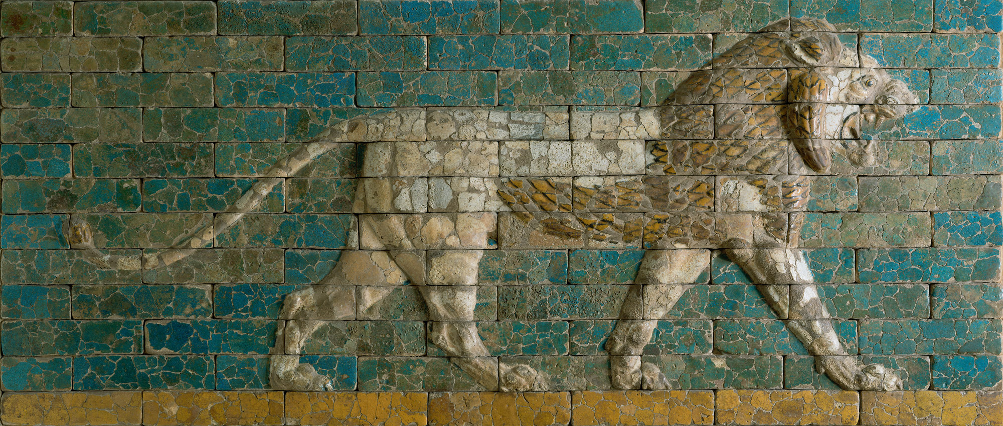

Slide 8
Sentence: Wrath of God, Nahum 1
Suffering: Weight of Gall, Nahum 2
Spoils: Woe of Guilt, Nahum 3

Slide 9
Lessons:
1. God’s word is inspired – fulfilled prophecy.
a. Assyrian fortresses surround city, 3:12
b. Ninevites prepare bricks / mortar, 3:14
c. City gates destroyed, 3:13
d. Ninevites were drunk, 1:10; 3:11
e. Nineveh destroyed by flood, 1:8; 2:6, 8
f. Nineveh destroyed by fire, 1:10; 2:13; 3:15

Slide 10
Lessons:
1. God’s word is inspired – fulfilled prophecy.
g. Capture attended by great massacre, 3:3
h. Plundering and pillaging, 2:9-10
i. People try to escape, 2:8
j. Ninevite officers weaken, flee, 3:17
k. Images and idols destroyed, 1:14
l. Destruction would be final, 1:9, 14

Slide 11
Lessons:
1. God’s word is inspired – fulfilled prophecy.
2. God controls nations. 3:1-3
a. Isaiah 40
b. Isaiah 10

Slide 12
Lessons:
1. God’s word is inspired – fulfilled prophecy.
2. God controls nations. 3:1-3
3. God punishes sin.
a. Nineveh: 100 ft.-high wall
b. 200 towers reaching another 100 ft
c. Moat 60 feet deep, 140 feet wide.
1) Wind-blown sand covered Nineveh
2) Today: Tel Kuyunjik (another mound: Nebi Yunus)

Slide 13
Lessons:
God’s word is inspired – fulfilled prophecy.
God controls nations. 3:1-3
3. God punishes sin.
Ninevite kings exulted in cruelty.

Slide 14
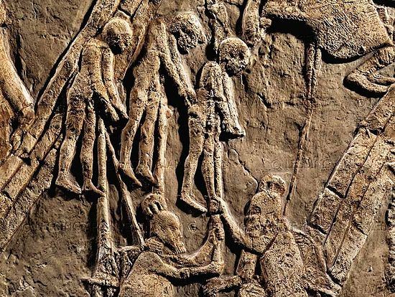
Lachish, 701 BC, Sennacherib

Slide 15
Lessons:
God’s word is inspired – fulfilled prophecy.
God controls nations. 3:1-3
3. God punishes sin.
Ninevite kings exulted in cruelty.
Assyria gets a dose of her own medicine. Isa.37:29

Slide 16
Lessons:
God’s word is inspired – fulfilled prophecy.
God controls nations. 3:1-3
God punishes sin.
4. Do not envy sinners, 3:16-19.
a. Assyria: great, rich, famous, powerful . . .
b. Yet good times passed . . . Gal.6:7-8

