Slide 1
Ancient Landmarks

Slide 2
Landmark: boundary line to mark separation of fields
Do not remove the ancient landmark, Nor enter the fields of the fatherless – Pr.23:10
You shall not remove your neighbor’s land-mark, which the men of old have set - Dt.19:14
Cursed is the one who moves his neighbor’s landmark. And all the people shall say, ‘Amen!’ – Dt.27:17

Slide 3
Landmark: boundary line to mark separation of fields
Not condemned for moving property lines – they are like those who do so
These have moved God’s spiritual boundaries
“The princes of Judah are like those who remove a landmark; I will pour out my wrath on them like water” – Hosea 5:10

Slide 4
I. Landmarks of Old Testament

Slide 5
Deut.4:2
“You shall not add to the word which I command you, nor take from it, that you may keep the commandments of the Lord your God which I command you”
Cannot improve on perfection.
Any change defiles it.
“The law of the LORD is perfect, converting the soul…” – Ps.19:7

Slide 6
Any departure from OT pattern was sinful
1. Passover, Ex.12:17-18 [2 Chr.30:5]
2. Tabernacles, Neh.8:…14
3. Love of God
“For according to the number of your cities were your gods, O Judah; and according to the number of the streets of Jerusalem you have set up altars to that shameful thing, altars to burn incense to Baal” – Jer.11:13 [6:16]

Slide 7
I. Landmarks of Old Testament
II. Landmarks of New Testament

Slide 8
Gal.1:6
Turn away, desert
Jude 4
‘Turn’ grace of God into lewdness
|| LXX: Dt.27:17; Pr.23:10; Ho.5:10

Slide 9
Col.1:23
‘Not moved away…’
|| LXX: Dt.19:14
Col.1:23
If you continue in the faith, Col.1:23
Stand fast in the faith, 1 Co.16:13
Examine yourself as to whether you are in the faith, 2 Co.13:5

Slide 10
Col.1:23 … in the faith
Individuals – Ga.6:1
Restore to former condition
Of broken bones
Mk.1:19– of fishing nets
Gal.6:1– repair broken relationship
2 Co.13:11– mend your ways: restoration, made complete, mature

Slide 11
Col.1:23 … in the faith
Individuals – Ga.6:1
Congregations –
Acts 16:5, so the churches were strengthened in the faith…
Rv.2:5, Remember therefore from where you have fallen; repent and do the first works, or else I will come to you quickly and remove your lampstand from its place—unless you repent.
Jer.2:2, 13, 32
1 Co.13

Slide 12
I. Landmarks of Old Testament
II. Landmarks of New Testament
III. New Testament: Removing Landmarks

Slide 13
Acts 20:29-30
Monarchical bishop (AD 116)
Holy water (AD 120)
Infant baptism (AD 185)
Sprinkling (AD 252)
Papacy (AD 606)
Mechanical music (AD 666)
Infallibility of pope (1870)

Slide 14
1 Tim.4:1-3, predicted by Holy Spirit
When? Last days
What? Depart from faith
How? Heed seducing spirits, doctrines of demons . . .

Slide 15
Good men became alarmed because of departure from NT
John Wyclif (d. 1384)
John Hus (d. 1415)
Jerome Savonarola (d. 1498)
Wm. Tyndale (d. 1536)

Slide 16
I. Landmarks of Old Testament
II. Landmarks of New Testament
III. NT: Removing Landmarks
IV. New Testament: Recovering Landmarks

Slide 17
Problem: most information has been lost; not newsworthy
There have been attempts throughout history to return to God’s original plan

Slide 18
Tottlebank, England
Old church building
Minute book, from 1600s: ‘church of Christ’
Non-conformist

Slide 19
Furness District, Lancashire, 1669
Group of eight churches of Christ
Old minute book:
Called by ‘church of Christ’
Baptized by immersion
Lord’s supper each Lord’s day
Elders and deacons

Slide 20
Thomas Grantham essays, 1678
Essays on Primitive Christianity
Faith, repentance, and baptism for remission of sins – ‘the way of incorporation into the Church of Christ’ (preface)

Slide 21
Benjamin Grosvenor’s book of sermons, 1728
London: urged all to be simply ‘Christians only’

Slide 22
John Davis, 1735
Young preacher in Fift District, Scot-land: preached NT Christianity 25 years before Thomas Campbell was born

Slide 23
America, as early as 1792
James O’Kelley, Methodist preacher (N. Carolina): pleading that people “put away all other books and let this [NT] be the only criterion.”
Manakintown Methodist Church: in 1794, called “Christian Church” with Bible as its only creed, Christ as its only head, “Let names and parties fall.”

Slide 24
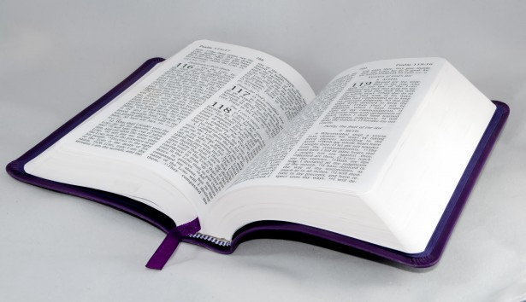
Mt.7:15-20, by their fruits…
Ro.8:16, ¹Holy Spirit with ²our spirit
NT is standard
We examine ourselves by it
Illustrated: 1 Th.2:13 . . . 1:6-9
¹ Do this . . .
² We did this

Slide 25
Loyalty to Christ, not ‘movement’
Men in a movement were not inspired
They differed among themselves

Slide 26
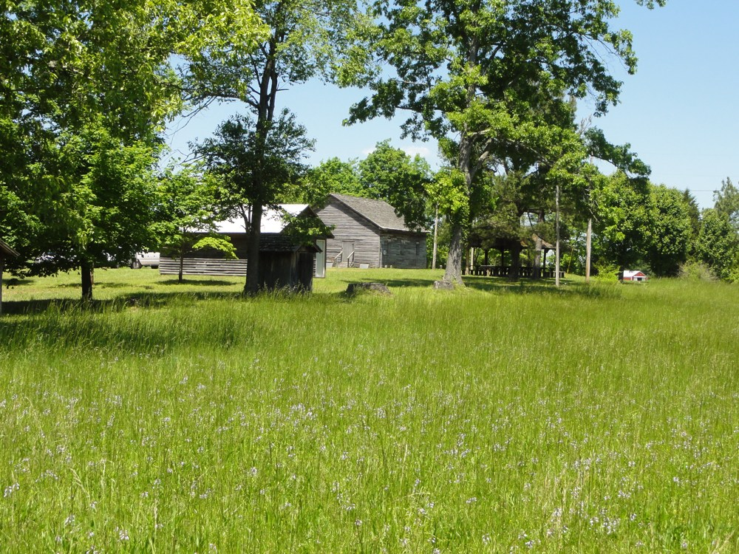

Slide 27
