Slide 1
Faith and Certainty

Slide 2
How certain are you of your faith?

Slide 4
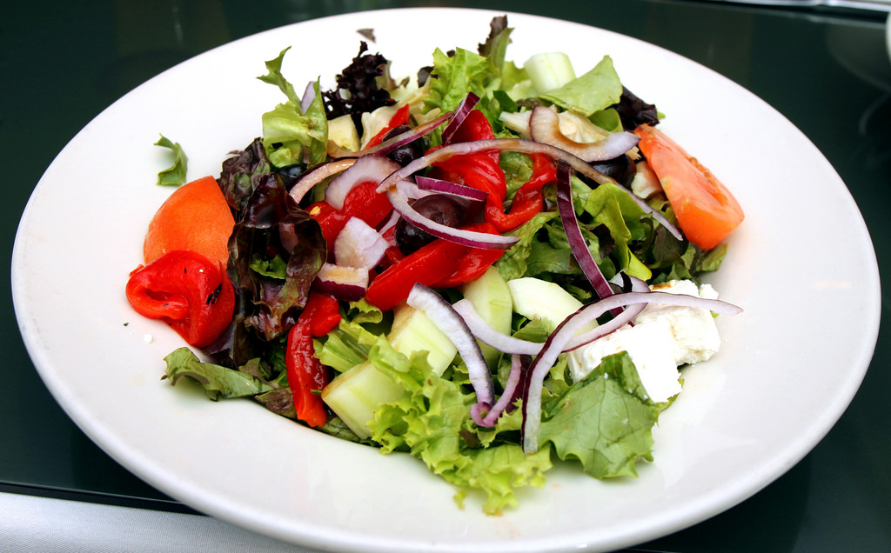
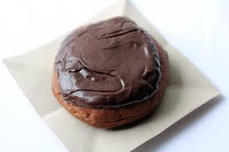

Slide 5
Having a strong and certain faith is absolutely crucial for living a godly life.
Hebrews 11:6

Slide 6
Three Main Points:
1. Faith helps us do the right thing
2. Faith helps us persist in trials
3. Faith helps us have joy in life

Slide 7
Faith Helps Us Do the Right Thing
Abstaining from sin:
Moses – Heb 11:24-26
Paul – 1 Cor 8:9-13
Choosing to do something good:
Early church – Acts 4:32-35

Slide 8
Faith Helps Us Persist in Trials
Hezekiah – 2 Kings 18-19

Slide 9
Faith Helps Us Have Joy In Life
Early church – 1 Peter 1:3-9

Slide 10
How Certain are You in Your Faith Tonight?
1. Is it helping you to do the right thing?
2. Is it helping you to persist in trials?
3. Is it helping you to have joy in life?

