Slide 1
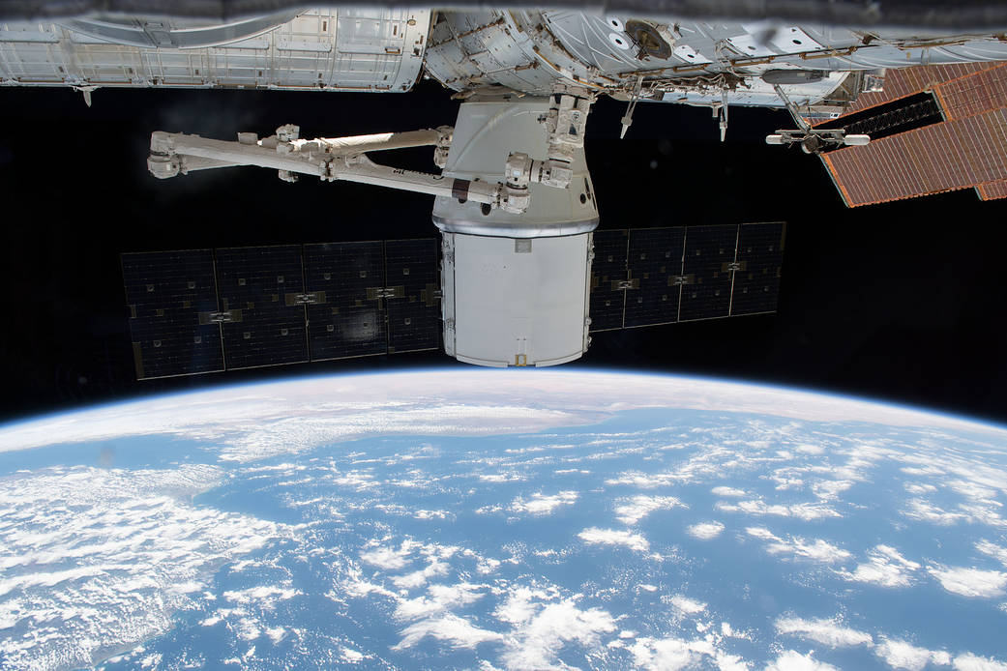

Slide 2
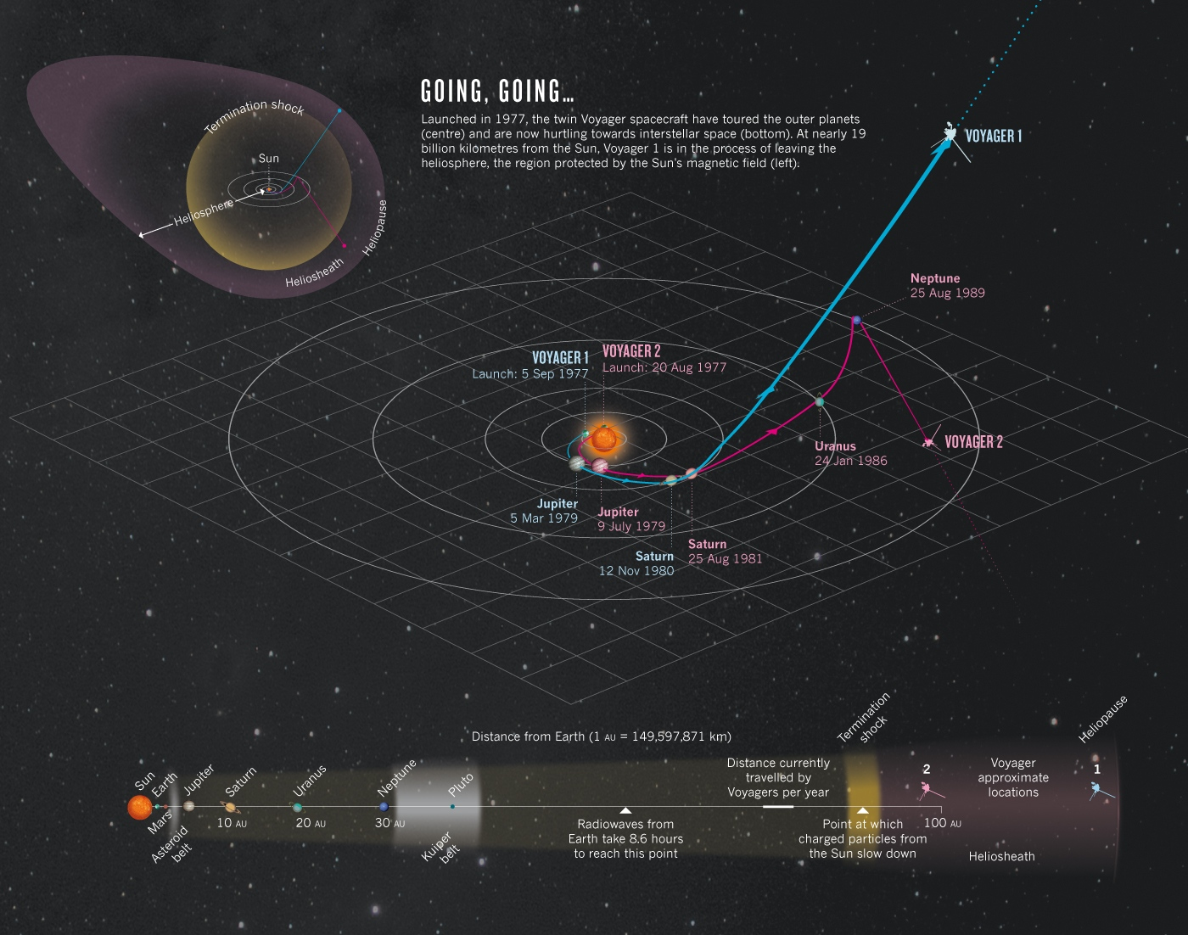
Notes:
19 Billion kilometres = almost 12 Billion miles. At current speed, it would take approx 750 million years to travel to nearest galaxy Canis Major Dwarf which is 25,000 light years away. That’s 25,000 years if we could travel the speed of light, which is 300,000 kilometers or 186,000 miles per second = 7.5 times around our equator in 1 second. We go across the continental US in an airplane at 500 miles per hour in about 4 hours.

Slide 3
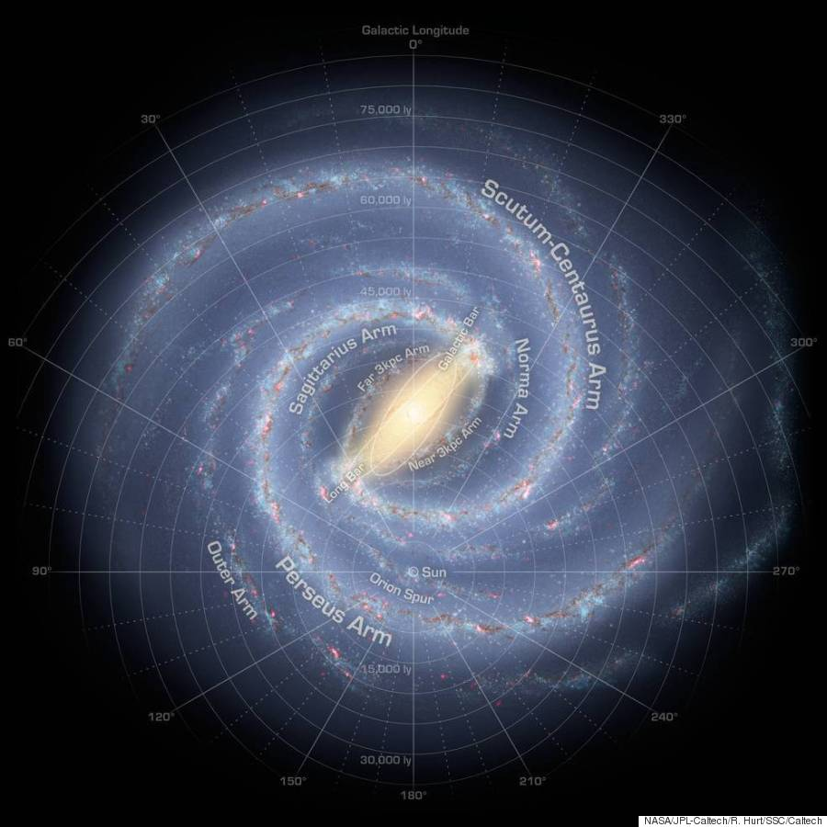
Notes:
200 to 400 billion solar systems, meaning that many suns, measuring 100,000 or so light-years across and 1,000 or so light-years thick. Our nearest large galaxy is Andromeda, 2.5 million light-years away, containing one trillion stars.

Slide 4
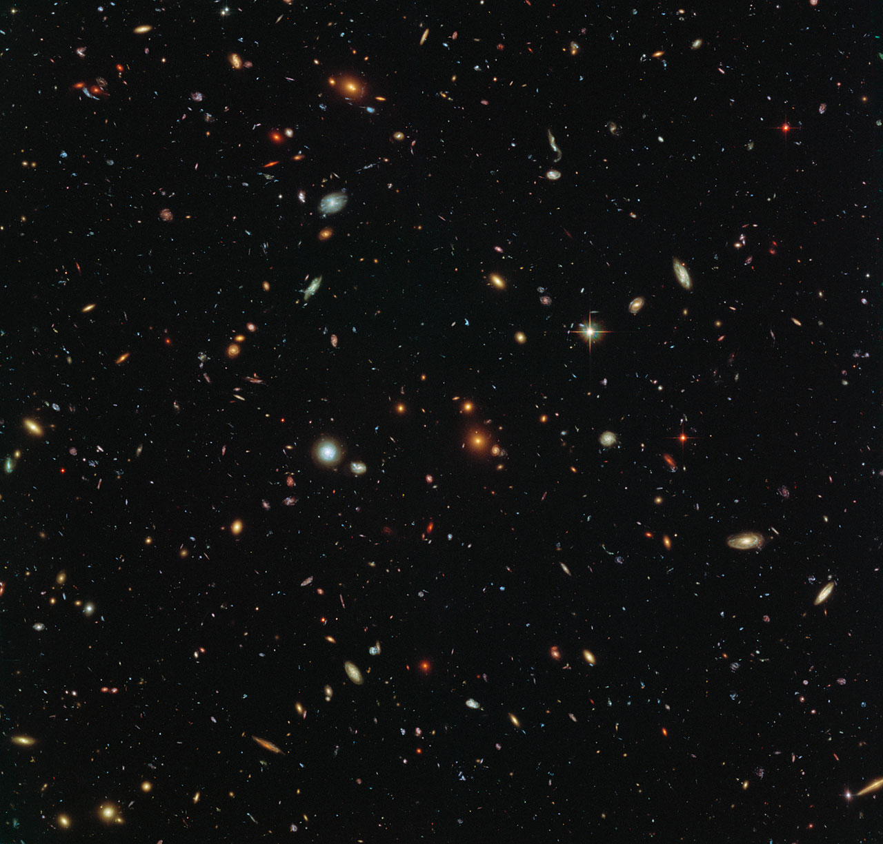
Notes:
Thousands upon thousands of galaxies of all shapes and sizes in just a small fraction of the sky with Hubble telescope’s from 350 miles above the earth deep field images. 4200 satellites in space with about 1700 or so working. Magnitude of universe is truly incomprehensible.

Slide 5
“In The Beginning, God Created…”
“The heavens declare the glory of God; and the firmament [proclaims] his handiwork.”
Notes:
Genesis 1:1 followed by Psalms 19:1

Slide 6
Now…
We’ve witnessed the scope of God’s creation, but we have not witnessed His best
It does not exist in the reaches of space, or in depths of our Earth
God’s greatest creation, made to be steward of all His handiwork:
The divinely created soul
Notes:
Genesis 1:27 followed by Psalm 8:4-8

Slide 7
“…having a form of godliness, but denying [its] power …”
2 Timothy 3:5
Holding a form of godliness, but having denied the power thereof: from these also turn away.
Form of Godliness
True Godliness
Not Denying God
The Power of God
Notes:
Man has sinned. The greatest challenge of our day is falling short. Our divine soul is blemished due to our selfishness. So, we will examine the appearance of Godliness, then True Godliness, examine not denying God, and will see the Power of God for man.

Slide 8
“…having a form of godliness, but denying [its] power …”
Form: “an image or impress, an outward semblance”
Keeping to the form of the old blasphemes God’s truth
Romans 2:17-24
Hypocrites praise the form but not the substance
Matthew 23:27-31
The danger: when we praise the corruptible form, we become it
Romans 3:13

Slide 9
“…having a form of godliness, but denying [its] power …”
Godliness: having a character “well-pleasing to Him”
Shown through actions
2 Peter 3:11
God’s doctrine is unchanging, we should be too
1 Timothy 6:3
The scope of deity is incomprehensible, but made manifest:
1 Timothy 3:16

Slide 10
“…having a form of godliness, but denying [its] power …”
Denying: “to abrogate, forsake, or renounce a thing, whether evil…or good”
Forsake the world for a higher one
Titus 2:12
Yet, he who forsakes God, is himself forsaken
Matthew 10:33
His seekers are known to Him
Revelation 2:13

Slide 11
“…having a form of godliness, but denying [its] power …”
Power: “inhering in godliness and operating upon souls”
The gospel does not give power over men and earthly things, but power to eternal life
Romans 1:16
We are given power through God’s word
Colossians 1:10-11
Our power is given from God, not to be judged by men’s standards
Matthew 25:15

Slide 12
“…having a form of godliness, but denying [its] power …”
Conclusion
The role of all His creation is to acknowledge God’s power by doing God’s will
Philippians 2:5-11
Application: consistently facing up against evil with God’s power
Notes:
If Jesus, God’s only begotten Son acknowledged God’s power and did His will even unto death on the cross, how could we his creation not do the same. If we do His will, we will not do any less than we should.

