Slide 1
Biblical Proof For Denominations?

Slide 2
A defense
‘Many that may be wrong in some aspects of their presentation or teaching, yet they still set forth Jesus in some manner’
‘Those who are not against a Biblical Jesus are still for Him, at least in some way’
‘If a man be not an open enemy to Christ, he ought to be presumed to be his friend…’
‘There is far more than one way to God’

Slide 3
I. Who Is Not Against Us Is For Us – Mk.9:38-41

Slide 4
Mark 9:38-41
Assumption and Application:
Denomination 1 is jealous over Denom. 2.
Jesus would say, ‘stop fighting; get along.’
Some commend denominations for ‘good work’ in fighting immoral agendas.
The more ‘good’ they do, the more people they deceive.
1 Kings 13; Mt.7:22-23
Jesus warns about Pharisees: Mt.6; 23

Slide 5
Mark 9:38-41
Correction: 38
The man did not stubbornly refused to join Jesus and disciples.
John rebuked Him for not following them.
John’s view: only apostles trained by Lord were permitted to serve Him?
Mk.5:19-20
Lk.10:1…17

Slide 6
Mark 9:38-41
Context
Apostles had failed, 14-18 [Lk.9:46]
33-37:
Some pervert Lord’s remarks to children to prove infant baptism.
Some pervert Mark 9 to prove denominationalism.

Slide 7
Mark 9:38-41
Miracle: 39
The man works a miracle; he must be Lord’s disciple.
Lk.9:49, exorcism: he CANNOT serve satan.
Lk.9:50, MUST be Lord’s servant (22:9-12)
Disciples relied on miracles to prove God sent them.
They reject same proof for this man.

Slide 8
Mark 9:38-41
In My name: 39
Jesus approves; man acts with His authority.
Mk.1:34 – Jesus silenced demons though they confessed truth, but not this man because he is a disciple.
Mk.16:17 – does not limit miraculous power to apostles (cf. Philip: Ac.8).
Col.3:17 – not merely saying words (as Jews, Ac.19:13-20).

Slide 9
Mark 9:38-41
Explanation: 40-41
We know this man is ‘on our side’ as we know a tree… (Mt.7:15-20).
Denominationalism is bad fruit – Mt.15:14

Slide 10
Mark 9:38-41
Conclusion:
What proves too much, proves nothing.
Those who squeeze denominations into passage make it impossible to reject any heretic.
Jews?
Mormons?
Muslims?
Watchtower?

Slide 11
Mark 9:38-41
Proper application of passage:
John opposes another disciple; Lord says ‘Stop it!’
Ph.1:15-17, they preach Christ (Ac.8) – denominations do NOT
Ct. Ph.3:2-4
Joshua showed same spirit as John – Num.11:26-29

Slide 12
I. Who Is Not Against Us Is For Us – Mk.9
II. Sailing The Seas Of Supposition – Mk.4:36

Slide 13
Mark 4:36
Supposition:
TV preacher: ‘other boats’ [people not in same boat with Jesus] proves denomina-tions scriptural.

Slide 14
Mark 4:36
Context:
Jesus had just urged others to follow Him.
His boat was too small to hold them all.
How else could they follow Him across lake?
To follow in other boats does NOT imply they believe different doctrines than disciples.
People on land follow Him in different shoes… clothes… bodies… on different donkeys…
Those who disagree do not follow (Jn.6).
Ac.27: in same boat with Paul – all rescued (?)

Slide 15
Mark 4:36
Context:
If Passage approves of denominations, it does so with silence AND contradicts other passages (e.g.: Jn.17).
If this proves Jesus accepts denominations with different doctrines…it proves there are different ways to get ‘there.’
Consequence: Jesus is NOT the way, Jn.14:6.
Consequence: all in same sea going to same place in different boats

Slide 16
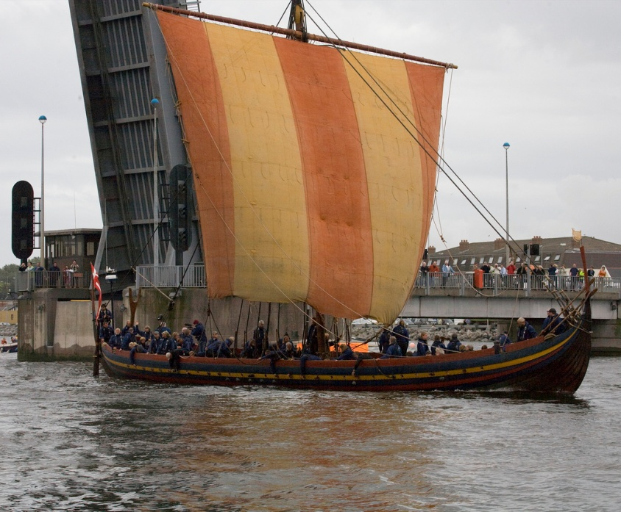
Mark 4:36
Context: different boats . . .
Mohammed?
Confucius?
Buddha?
Humanists?
Atheists & idolaters,
Ac.28:11
Paul rode in their ship. Imply agreement?
1 Co.4:17

Slide 17
Mark 4:36
Proper use of passage:
There is no neutrality with Jesus.
We either follow Him or we don’t (Mt.12:30).
Comparison
Mk.9:38 – not WITH us
Mk.4:36 – WITH Him, but believe differently

