Slide 1
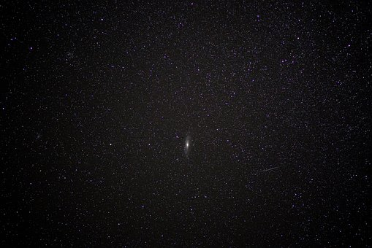
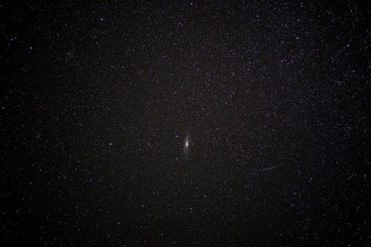
Paradise Gained
(Genesis 2:4-25)

Slide 2
Evolutionary views did not originate with Darwin
Greeks: 6th Century B.C.
a. Their ‘science’: sun traveled East to West because of wind.
b. Big bang hypothesis rejects biblical account of creation.
Genesis accounts for First Cause: eternal God.
What is first cause for big bang?

Slide 3
Genesis 2:4-6
1. History: theme of ch.2 –
a. Does not describe how people / things came into being, but what happened after they appeared.
b. Jacob, Gn.37:2, history…
2. Created: made (synonyms).
3. In the day: for details, ch.1.
4. Before plant / herb (3:18).
5. For: explanatory; no rain, but mist

Slide 4
Genesis 2:7
Man … ground: word play. (3:19)
Day six (1:24-31): God formed man; origin of human life.
Formed: of potter, Jer.18; ironsmith, Is.44:12; eye, Ps.94:9
Dust:
God breathed: dignity
Living being: 1 Co.15:45
Restrains pride, 18:27.
Reminds of physical mortality, Ec.12.
Realizes dignity, Ps.100:3.

Slide 5
Genesis 2:8-9
Garden: cultivated place of domestic plants and produce trees. Enclosure.
Every tree: ªpleasant to sight; ^{b}good for food.
Tree of life…3:22.
Tree of knowledge of good and evil. (3:3)

Slide 6
Genesis 2:10-14
River waters the garden.
Places describe pre-flood geography.

Slide 7
Genesis 2:15-17
God…man…put him… (8) …tend…keep.
In paradise – work to do. (Before Fall)
Work: ¹beneficial; ²helpful; ³rewarding
How would Adam know gardening?

Slide 8
Genesis 2:15-17
God’s first command implies . . .
1. Adam understands what God tells him
2. Adam understands prohibition
3. Right of God to command His creatures
4. Adam has capacity to distinguish good and evil
5. Punishment must follow disobedience
6. Goodness of God warned him in advance
7. Adam knows what eating is / what to eat
8. Adam understands death
9. Free will

Slide 9
Genesis 2:15-17
God…man…put him… (8)…tend…keep.
In paradise – work. Before Fall…
Work: ¹beneficial; ²helpful; ³rewarding
How would Adam know gardening?
Tree of knowledge – free will . . .
God does not place tree out of their reach
If out of reach: cannot disobey; no choice
“And the LORD commanded us to observe all these statutes, to fear the LORD our God, for our good always, that He might preserve us alive, as it is this day” – Dt.6:24

Slide 10
Genesis 2:18-20
It is not good – a first!
Alone – incomplete
Make . . . helper comparable
Matching. Counterpart. Corresponds to him. Complements him.

Slide 11
Genesis 2:18-20
Ug?
English:
Bug
Dug
Hug
Jug
Lug
Mug
Pug
Rug
Tug
It is not good – a first!
Alone – incomplete
Make . . . helper comparable
Formed every beast… – flashback.
Logical, not chronological.
Typical in history narratives.
Adam … call them.
No helper comparable to him.
Brought them to Adam…
Did not find…
Every beast of the field (not earth)
Every bird of the air (not fish)

Slide 12
Genesis 2:21-22
Deep sleep. Anesthesia
Took rib. Surgery … Transplant … Closed
Taken from man. Kinship
Made (built). Ro.5:18
Woman – last creature named in ch.2.
Man
Brought to man. Marriage. Adam met his...
superior in the Creator
inferiors in the animals
equal in the woman

Slide 13
Genesis 2:23
Now … at last
Flesh of my flesh. 29:14

Slide 14
Genesis 2:24-25
Therefore: precedent
Leave: for our benefit
Joined: cling to, stick to, join fast, cleave, stay close
Wife: (sg.; female); ct. 4:19
One flesh: two can be one; more than two cannot
Not ashamed: only time it is so. Ct. 3:7

Slide 15
I. Does Chapter 2 Contradict Chapter 1?

Slide 16
Genesis 1 | Genesis 2
Chronological history: 1st day . . . 6th day | Topical history: 2:4 -2:7, man; 19, animals -2:8, 15, two gardens?
‘Man’ 1:27: generic (M-F); ‘them’ | Details, 2:21-25
Marriage – multiply, 1:28 | Details, 2:21-25
1:31 – 6th day 5:1-2 – day when ‘they’ were created | No reference to day.

Slide 17
Genesis 2 illustrates God’s goodness to man
Created in divine image.
Blessed with perfect physical body, sound mind
Placed in beautiful environment.
Furnished every physical necessity / luxury.
Meaningful, satisfying work to do.
Warned of danger to avoid.
Fellowship and lovingkindness … easy to obey.

Slide 18
I. Does Chapter 2 Contradict Chapter 1?
II. Do Other Passages Confirm Genesis Account?

Slide 19
III. Paradise Lost
(Genesis 3:4-25)

Slide 20
The serpent’s strike, 3:1-5
Serpent: did not work through duress
Cunning (shrewd): blames God in Eden!
Woman: caught Eve by herself
Has God said… (leading question)
You shall not eat of every tree of the garden? – exaggeration; cast doubt
You will not surely die: contradiction
God knows… attacks God’s goodness
Doubt God’s goodness . . . wickedness of sin

Slide 21
The fall, 3:6-10
Woman saw . . .
1. Good food: lust of flesh
2. Pleasant to eyes: lust of eyes
3. Make wise: pride in possessions
Eyes opened (v.5) . . .
Gave to husband…
Shame, fear, broken fellowship, death (7-8)
knew
sewed
made
heard
hid
afraid

Slide 22
The domino effect, 3:11-13
A Man blames woman. Ct. 2:23
B Woman blames snake.
X Snake is judged first (14-15)
B’ Woman is judged, 16
A’ Man is judged, 17-19

Slide 23
IV. Lessons

Slide 24
Eve’s wrong view of God let her into sin
If God is cruel, unjust, indifferent, unloving, He is not good and disobedience comes easy
Satan’s first attack is against God’s word

Slide 25
All that we can know of God’s will comes through His word, 7, 17
Command to avoid eating of tree implies…
Man’s ability to understand what God says
God’s right to command
Capacity of man to distinguish right / wrong
Punishment follows disobedience to God
God’s warnings are great blessings
Not left alone to discover consequences of sin
Only two choices: personal desire or God’s law
Reject Creation…: why believe rest of Genesis?

Slide 26
God speaks clearly in His word.
Eve’s problem was not a difficulty in understanding what God had spoken

Slide 27
We, not God, are to blame for the mess we’re in, 17-19, 22-23

Slide 28
God, not man, deserves credit for way out of world’s madness, 15
Even in judgment, God remembers mercy.
He could have destroyed them on the spot.
¹² “What do you think? If a man has a hundred sheep, and one of them goes astray, does he not leave the ninety-nine and go to the moun-tains to seek the one that is straying? ¹³ And if he should find it, assuredly, I say to you, he rejoices more over that sheep than over the ninety-nine that did not go astray… – Mt.8

Slide 29
IV. But What About The Talking Snake?

Slide 30
Think about it . . .
1. Is Gn.3 stranger than spontaneous genera.?
2. Should we reject Numbers because of 22:28?
3. What satan can do? Lk.4:4-8
4. Satan can work through people, Lk.8; Ac.5.
5. Reject Jesus too? Jn.8:44.
6. Ro.16:20, direct allusion to Gn.3:15.
7. 2 Co.11:3 – direct link to Gn.3, serpent...
8. 1 Tim.2:13-14 endorses Gn.3; applies it.
9. Rv.12:3, 9, symbolism places satan in Gn.3

Slide 31
Consistency
Cannot consistently reject Genesis 3 because of a talking snake and then accept the rest of the Bible.
It all stands or falls together.

