Slide 1
Family Feud
(Obadiah)

Slide 2
Explanation: Family Feud
Ancient struggle between two brother nations
Struggle began before brothers’ birth – Gn.25:21-23, 28
  Birthright, Gn.25:29-34
  Blessing, Gn.27:…34-36, 41
Jacob escaped to Haran; 20 years
Personal reconciliation (Gn.33:4)
Nations: 1200 year cold war
Nu.20:14-21; 2 Sm.8:14; 2 K.8:20-22

Slide 3
Obadiah
Shortest book in OT
Exposé of Edom’s crimes, coming judgment
1: vision
  ‘thus says LORD’ . . . ‘report’
  Pictures military action

Slide 4

I. The Problem: Pride, 2-9

Slide 5
Pride and Associates
2: divine dues. Dn.4:17
3: deception. 1 Co.4:7
3-4: daring.
5: done and done.
6: defense: cannot run or hide. Zeph.1:12
7: deliverers (confederacy)… Eat your bread…
8: discernment, yet useless
9: dominion, yet dismayed

Slide 6
I. The Problem: Pride, 2-9
II. The Charges: Cruelty, 10-14

Slide 7
No way to treat a brother…
10: violence. Enmity, Ga.5:20
11: indifference; neutrality impossible. Mt.12:30; 27:24. Lk.10
12: gloat over pain. Pr.17:5; 24:17
12: trash talk. Pr.16:18
13: take advantage.
14: block his way of escape.

Slide 8
I. The Problem: Pride, 2-9
II. The Charges: Cruelty, 10-14
III. The Judgment: Just, 15-16

Slide 9
15: as…so
Fitting, fair, fearful.
  Day of LORD upon all nations…is near.
  As you have done, done to you. Payday.
Gal.6:7-8
Reprisal: return,
turn back, recompense

Slide 10
16: as…so
The nation that disappeared.
Where are they now?

Slide 11
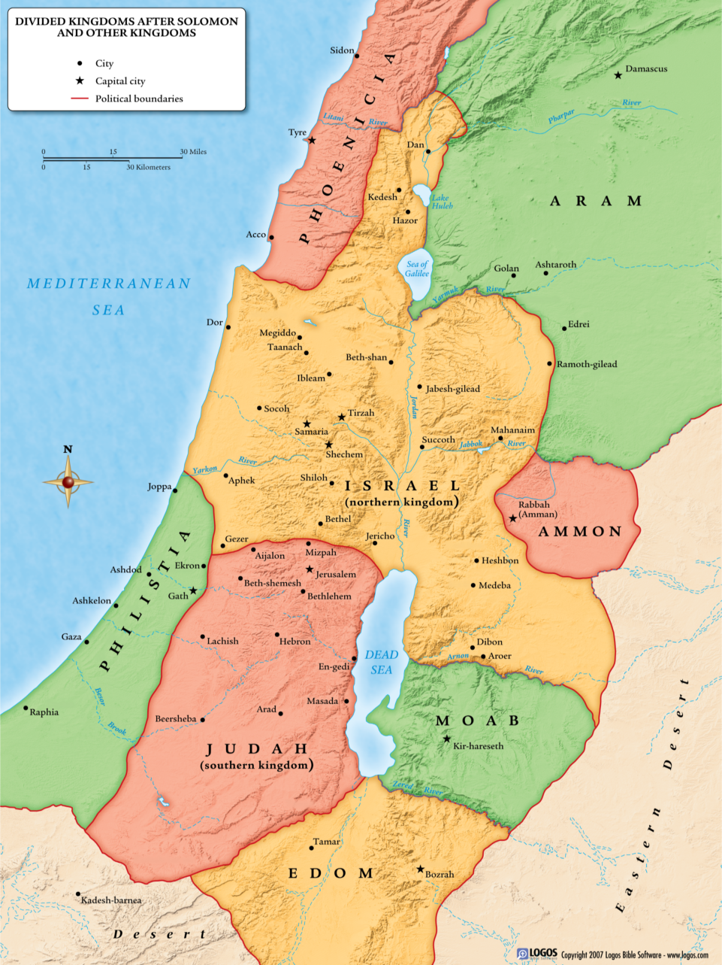
Edom

Slide 12
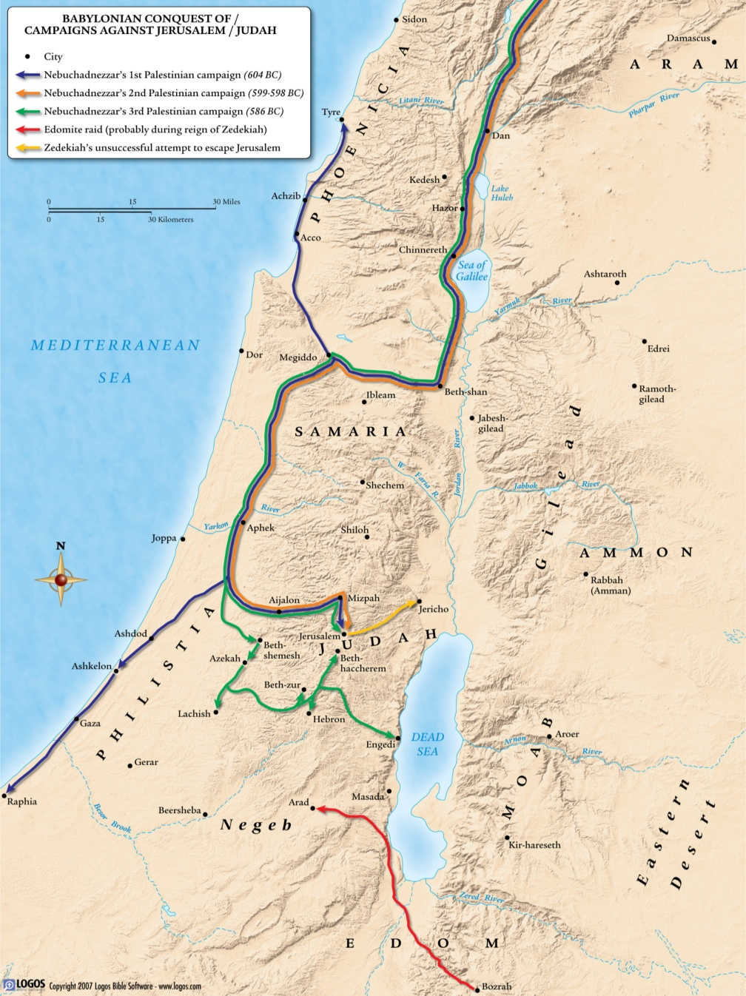
Edom – Babylon

Slide 13
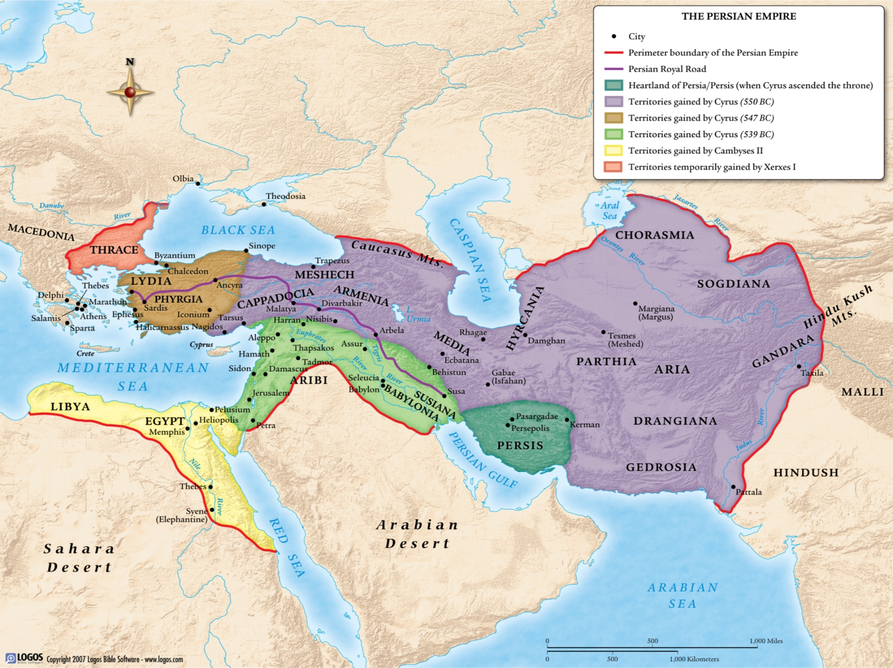
Edom – Persia
Edom: a province, becomes Idumea

Slide 14
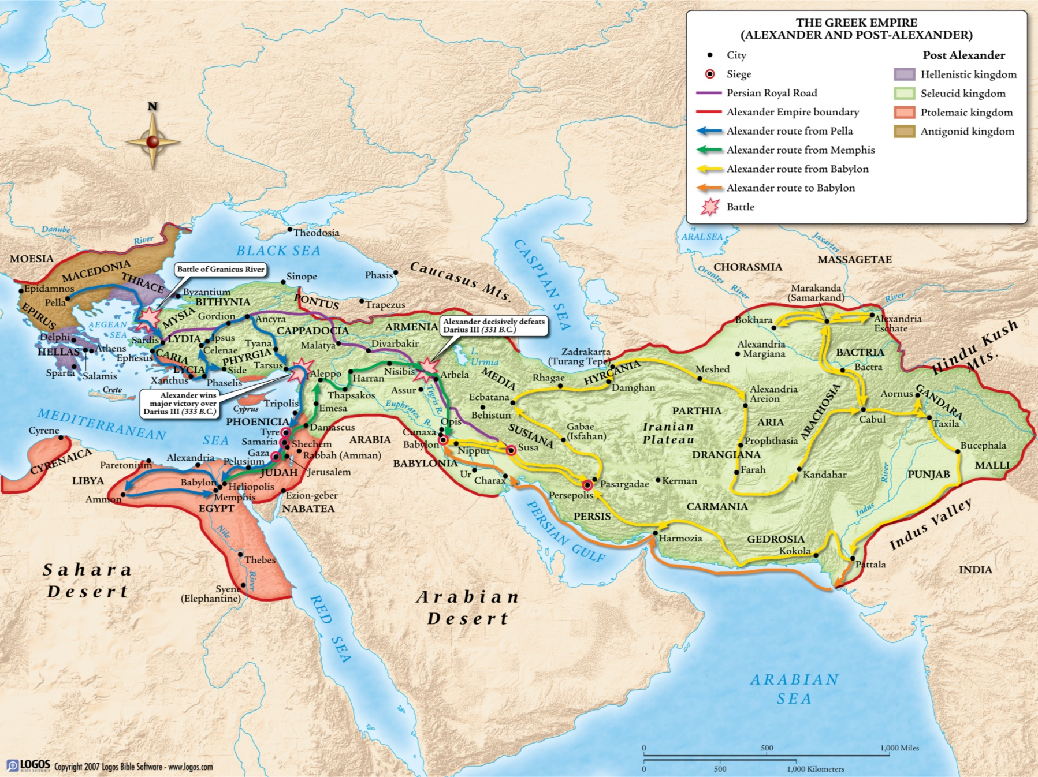
Greece

Slide 15
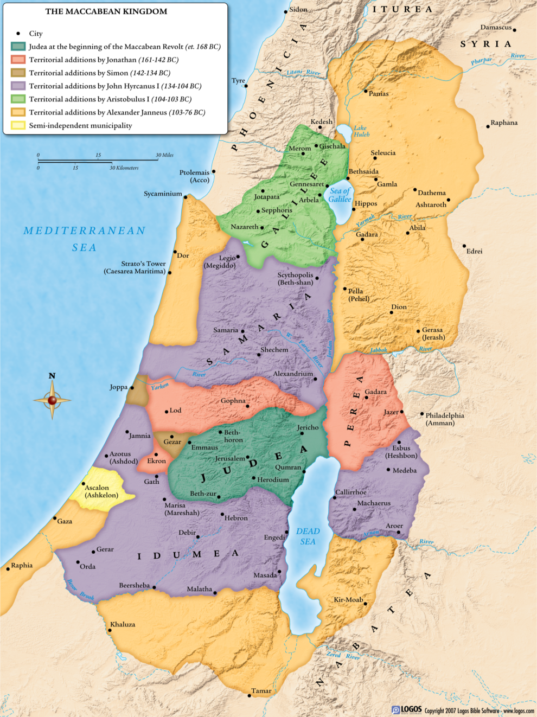
Maccabean Kingdom
Judas Maccabeus slew 20,000, 2nd Cen.
John Hyrcanus sub-dued Idumea, forced them to accept Juda-ism, 134-104 BC.
Included Antipater…
After AD 70, Edom disappeared.
Dn.4:17

Slide 16
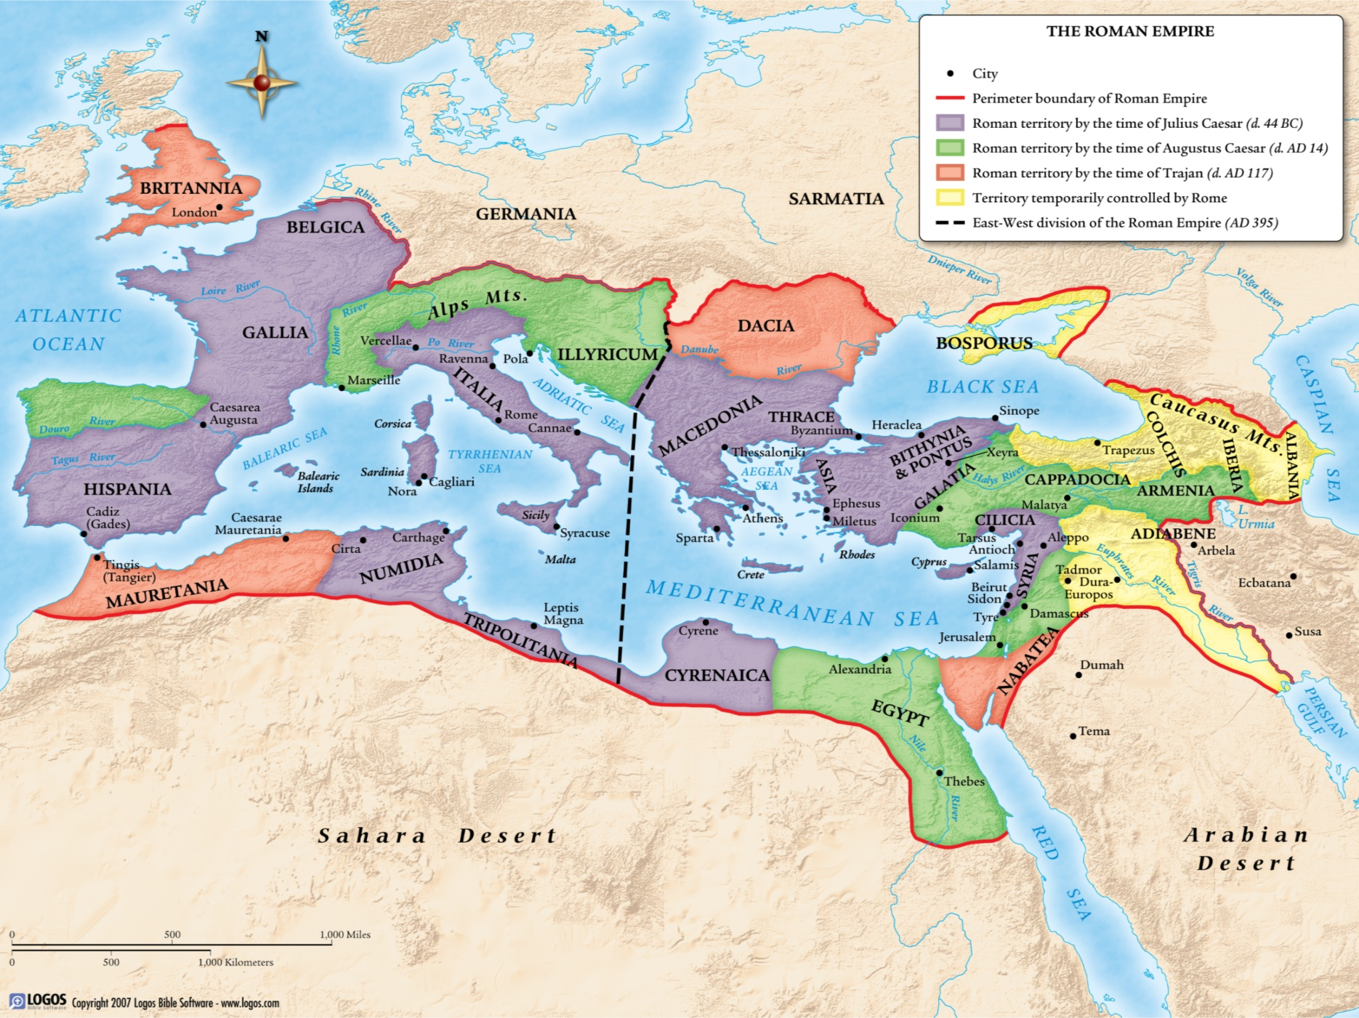
Rome

Slide 17
I. The Problem: Pride, 2-9
II. The Charges: Cruelty, 10-14
III. The Judgment: Just, 15-16
IV. The Repossession:
Israel, 17-21

Slide 18
17: ‘But’ – different message for
Mt. Zion’s deliverance
    18: tables will turn; Zion would recover more than it lost. Flame to destroy enemies.
    19: South (negev) to possess mountains of Esau
    20: former captives blessed beyond measure
    21: saviors (deliverers) come to Mt. Zion.
    2 Macc.10

Slide 19
Conclusion: 21
    And the kingdom shall be the LORD’S
    Isaiah 2 – Daniel 2 – Joel 2
    Edom attacked Israel; may as well challenge God directly.
Edom – choices matter for eternity.

