Slide 1
A Study Of The Bible
A Study Of Bible Study

Slide 2
I. The Need For This Study

Slide 3
Bible study:
Hosea 4:6
Amos 8:1-12
“We’re at a point in Christianity where people don’t care if you can back it up with Bible. Their feelings, desires, and emotions override what Scripture says. They don’t follow Christ. They follow self.”

Slide 4
Bible study:
Hosea 4:6
Amos 8:1-12
Hebrews 5:12-6:3 –
1: don’t keep laying the foundation
1-2: writer wants to serve meat; babies cannot eat it. [Repentance, faith, etc.]
3: this we will do… (v.1, perfection)
Spiritual growth is exciting; stunted growth, disturbing

Slide 5
Bible study:
Hosea 4:6
Amos 8:1-12
Hebrews 5:12-6:3
2 Pt.2, the ignorant are prey to predators
1: label – false prophets / false teachers
1: lies – heresies; deny Lord
2-3: leadership – many will follow
3-9: loss – judgment
20-22: learn to avoid tragedy – knowledge

Slide 6
I. The Need For This Study
II. How To Read The Bible

Slide 7
Read . . .
Regularly: Dt.6:6-7
Humbly: Is.66:2 . . . Ph.2:12
Obediently: Jn.7:17
Comparatively: Ac.17:11
Persistently: 1 Tim.4:13-16
Earnestly: Hb.2:1
Inquiringly: Ac.8:28, 30-31 … 34

Slide 8
I. The Need For This Study
II. How To Read The Bible
III. Illustrated: topical study of prayer

Slide 9
Mt.6:5-8 . . . 9-13
◊ Hypocrites pray to be seen, 5. Lk.18:9…
◊ Talk to God in private, 6. Mk.1
◊ Do not babble just to be heard, 7
◊ Pray in trust; God knows our needs, 8
◊ Model, 9-13, 14-15

Slide 10
Mt.6:5
“And when you pray, you must not be like the
hypocrites. For they love to stand and pray in the
synagogues and at the street corners, that they may
be seen by others. Truly, I say to you, they have
received their reward.
Connector
Talk to God
Actors; show
Expectation
Prohibition
Connector
Motive: be seen, praised
Performance
Purpose

Slide 11
Tools (Mt.6:5-8 . . . 9-13)
1. Concordances – Cruden’s, Young’s, Strong’s
Mt.5:44
6:5
6:6
6:7
6:9
9:38
14:23
19:13
24:20
26:36, 41, 53

Slide 12
Tools (Mt.6:5-8 . . . 9-13)
1. Concordances – Cruden’s, Young’s, Strong’s
Multiple word searches –
“when you pray” –
Mt.6:5
6
7
Mk.11:24
Lk.11:2

Slide 13
Tools (Mt.6:5-8 . . . 9-13)
1. Concordances – Cruden’s, Young’s, Strong’s
2. Word dictionaries. Vine’s – ‘pray’ 2.
proseuchomai (προσεύχομαι, 4336), “to pray,” is always used of “prayer” to God, and is the most frequent word in this respect, especially in the Synoptists and Acts, once in Romans, 8:26; in Ephesians, 6:18; in Philippians, 1:9; in 1 Timothy, 2:8; in Hebrews, 13:18; in Jude, v. 20. For the injunction in 1 Thess. 5:17, see cease, C.

Slide 14
Tools (Mt.6:5-8 . . . 9-13)
1. Concordances – Cruden’s, Young’s, Strong’s
2. Word dictionaries. Vine’s
3. Bible dictionaries. Smith, Zondervan, Nelson…
Easton: Prayer presupposes a belief in the personality of God, his ability and willingness to hold intercourse with us, his personal control of all things and of all his creatures and all their actions.
Acceptable prayer must be sincere (Heb. 10:22), offered with reverence and godly fear, with a humble sense of our own insignificance as creatures and of our own unworthiness as sinners, with earnest importunity . . .

Slide 15
Tools (Mt.6:5-8 . . . 9-13)
1. Concordances – Cruden’s, Young’s, Strong’s
2. Word dictionaries. Vine’s
3. Bible dictionaries. Smith, Zondervan, Nelson…
4. Versions
a. Helps in study, comparison
b. Hinders memorization
Topical lessons include expositional elements.
Expository lessons include topical thoughts.

Slide 16
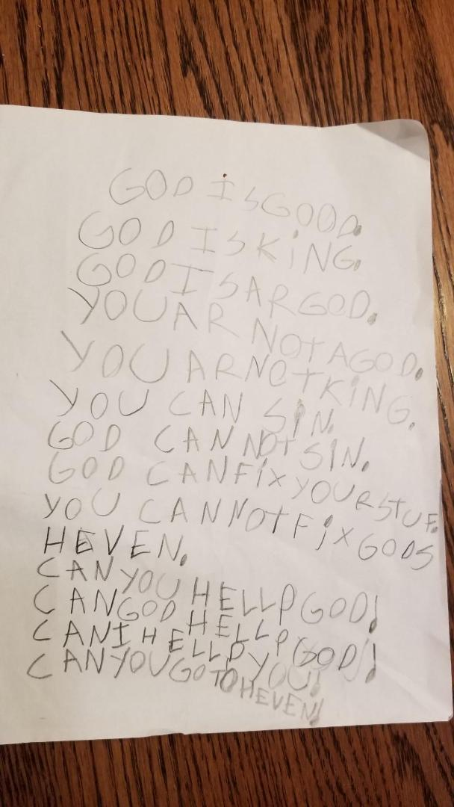
Even the young can learn

Slide 17
Flyleaf of Bible
“Either this Book will keep you from sin, or sin will keep you from this Book.”

