Slide 1
Selective Hearing
Luke 12

Slide 2
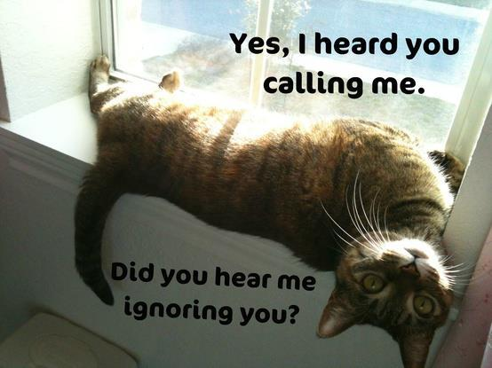
Selective hearing
Choose or reject information at will

Slide 3
I. The Listener’s Problem, 13

Slide 4
Distracted by content and style? Ezk.33
Sermon fitter?
Brotherly hatred?
Did not examine himself? Ac.2:37 . . . 5:33
Preoccupied with inheritance? Jn.6:15…26
Thought hearing is enough? Ja.1
No urgency for soul? 13:25…
Tunnel vision?
“Cheater!” || “Covetous!”
So easy to see brother’s faults; not own.

Slide 5
I. The Listener’s Problem, 13
II. The Listener’s Parable, 16-21

Slide 6
Prosperity, 16. Lk.18:24-27
Possessions have needs, 16-17. Lk.14:16-20
Preoccupied with work, possessions, success
Personal pronouns, 17-19.
Plans only for present, temporal things,18-19.
Pleasure, 18-19: good things / many years…
Protective, 19.
Proud, 16-19. Talks to himself, about himself.

Slide 7
Proud, 16-19. Talks to himself, about himself.
God introduces new consideration
If this rich man had come to Jesus, what would He tell him? [18:18-23]
This rich man was even worse than RYR – (RYR wanted God and money…).
Rich man:
“I have many goods, many years; live it up.”
God:
“This night it’s over.”
The greatest loser.
Ps.14:1; Ja.1:10

Slide 8
I. The Listener’s Problem, 13
II. The Listener’s Parable, 16-21
III. The Listener’s Peril, 14-15

Slide 9
14: Jesus excludes brother from conversation
1. Wrong view of Jesus and gospel soured everything.
Is Jesus “not a judge”? V.58.
Wants Jesus to be his miracle-genie
Ex.2:14
Is Jesus “not an arbitrator”? Divider.
No Savior?
Even if brother is sinner…so is this man.

Slide 10
14: Jesus excludes brother from conversation
2. Wrong view of soul.
Focuses on here, not hereafter.
Jesus describes the man his questioner wants to become (16-21)
What direction attracts him?

Slide 11
14: Jesus excludes brother from conversation
3. Wrong view of brother.
Satan’s distraction. Gn.4…
Rich man resembles Nabal. 1 Sm.25
Innocent in getting
Greedy in keeping
Deadly in hoarding

Slide 12
14: Jesus excludes brother from conversation
4. Wrong view of riches.
Epicureans (1 Co.15:32)
Some covet by . . .
Squeezing possessions too tightly.
Seeking for more and more.

Slide 13
15: Jesus exposes the dangers of his wrong turn
YOU take heed (be alert / on guard) 18:24
YOU beware: be a sentinel; ‘look out!’
Covetousness: greedy desire for more.
More he got, more he wanted
Selfꞏish Childꞏish
Beware ‘all’ covetousness (ASV)

Slide 14
15: Jesus exposes the dangers of his wrong turn
YOU take heed (be alert / on guard) 18:24
YOU beware: be a sentinel; ‘look out!’
Covetousness: greedy desire for more.
His goal is NOT…
1. Salvation, spiritual growth.
2. Set good example, save family…
3. Heaven

Slide 15
15: Jesus explains purpose of life
YOUR LIFE…not based on abundance of things you possess

Slide 16
15-16: Jesus expands lesson for benefit of all
14: He said to “him”
15: He said to “them” (16)
Man becomes object lesson for others

Slide 17
Summary
14: Jesus excludes brother from conversation
15: Jesus exposes the dangers of wrong turn
15: Jesus explains purpose of life.
15-16: Jesus expands lesson for benefit of all

Slide 18
Reminders
1. Lord does not condemn farmer for making a living, good profits, or setting goals … but for money mania.
2. We know people by company they keep. Also true of words. 1 Co.6:9-10
3. Worldliness is misery to the thoughtful.
How Much Land Does a Man Need? – Tolstoy

