Slide 1
Work Of The Church (VII)
Sponsoring Church

Slide 2
A single congregation
2 Co.4⁷ But we have this treasure in earthen vessels, that the excellence of the power may be of God and not of us.
A single congregation cannot do what …
many congregations can do.
a denomination can do.
brunt force can do.
an angel can do.
human government can do.
Should we become denominations…?

Slide 3
Missionary society vs God’s wisdom
Ep.3¹⁰ to the intent that now the manifold wisdom of God might be made known by the church to the principalities and powers in the heavenly places, ¹¹ according to the eternal purpose which He accomplished in Christ Jesus our Lord…
Ep.3²⁰ Now to Him who is able to do exceed-ingly abundantly above all that we ask or think, according to the power that works in us, ²¹ to Him be glory in the church by Christ Jesus to all generations, forever and ever…

Slide 4
Missionary society vs God’s wisdom
Ep.1²² And He put all things under His feet, and gave Him to be head over all things to the church, ²³ which is His body, the fullness of Him who fills all in all.
2 Pt.1³ as His divine power has given to us all things that pertain to life and godliness, through the knowledge of Him who called us by glory and virtue…

Slide 5
I. No Authority For Sponsoring Churches

Slide 6
NT pattern for evangelism
Acts 13¹ Now in the church that was at Antioch there were certain prophets and teachers: Barnabas, Simeon who was called Niger, Lucius of Cyrene, Manaen who had been brought up with Herod the tetrarch, and Saul. ² As they ministered to the Lord and fasted, the Holy Spirit said, “Now separate to Me Barnabas and Saul for the work to which I have called them.” ³ Then, having fasted and prayed, and laid hands on them, they sent them away.

Slide 7
NT pattern for evangelism
Phil.4¹⁵ Now you Philippians know also that in the beginning of the gospel, when I departed from Macedonia, no church shared with me concerning giving and receiving but you only. ¹⁶ For even in Thessalonica you sent aid once and again for my necessities. ¹⁷ Not that I seek the gift, but I seek the fruit that abounds to your account. ¹⁸ Indeed I have all and abound. I am full, having received from Epaphroditus the things sent from you, a sweet-smelling aroma, an acceptable sacrifice, well pleasing to God.

Slide 8
NT pattern for evangelism
2 Cor.11⁸ I robbed other churches, taking wages from them to minister to you.
Churches…
Sent wages…
To Paul…
As he worked in Corinth

Slide 9
I. No Authority For Sponsoring Churches
II. Sponsoring Churches Violate Autonomy

Slide 10
Autonomy matters
Ac.14²³ So when they had appointed elders in every church, and prayed with fasting, they commended them to the Lord in whom they had believed.
Ac.20²⁸ Therefore take heed to yourselves and to all the flock, among which the Holy Spirit has made you overseers, to shepherd the church of God which He purchased with His own blood.

Slide 11
Autonomy matters
1 Pt.5² Shepherd the flock of God which is among you, serving as overseers, not by compulsion but willingly, not for dishonest gain but eagerly.

Slide 12
Autonomy protects
Laod.
Smy.
Eph.
This Photo by Unknown Author is licensed under CC BY-NC-ND

Slide 13
I. No Authority For Sponsoring Churches
II. No Authority For Sponsoring Churches
III. Sponsoring Churches Violate God’s Design

Slide 14
God’s design
2 Co.8¹³ For I do not mean that others should be eased and you burdened; ¹⁴ but by an equality, that now at this time your abun-dance may supply their lack, that their abun-dance also may supply your lack—that there may be equality.

Slide 15
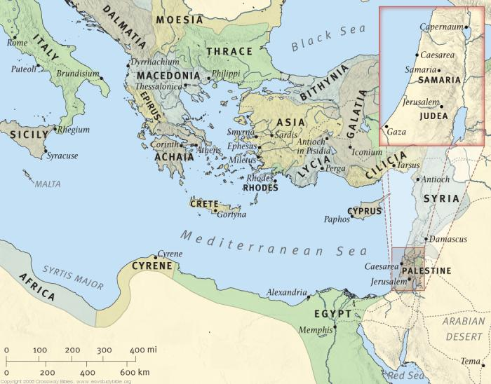
Illustrated: Jerusalem–Samaria (Ac.2; 8)

Slide 16
Illustrated: Jerusalem–Antioch (Ac.2; 11)

Slide 17
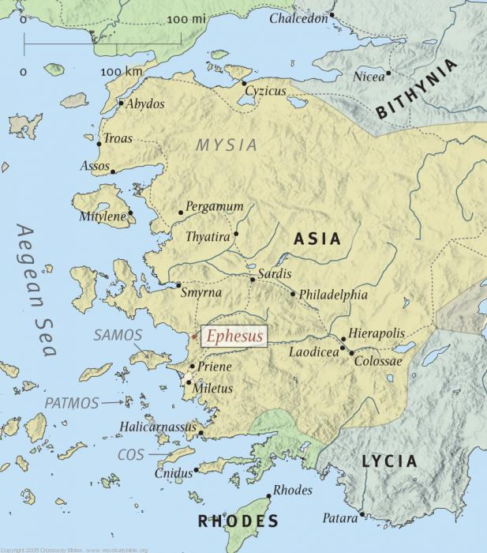
Illustrated: Ephesus (Ac.19; Col.1-2,4)

Slide 18
God’s design
Ro.1⁸ First, I thank my God through Jesus Christ for you all, that your faith is spoken of throughout the whole world.
1 Th.1⁸ For from you the word of the Lord has sounded forth, not only in Macedonia and Achaia, but also in every place. Your faith toward God has gone out, so that we do not need to say anything.

Slide 19
I. No Authority For Sponsoring Churches
II. No Authority For Sponsoring Churches
III. Sponsoring Churches Violate Design
IV. Sponsoring Church Elders Become M. Society

Slide 20
Elders – 1 Peter 5:1-4
Words
Elders [Presbyters] 1-2
Shepherd [Pastor] 2
Overseers [Bishop] 2
Work
Shepherd 2
Overseers 2
Where
Flock 2 (sg.)
Among you 2
Words
Archbishop?
Cardinal?
Pope?
Work
No marriage
Power over life/death
Where
Diocese
World

Slide 21
Ability
2 Co.8³ [churches of Macedonia] For I bear witness that according to their ability, yes, and beyond their ability, they were freely willing…

Slide 22
Ability
Ac.11²⁷ And in these days prophets came from Jerusalem to Antioch. ²⁸ Then one of them, named Agabus, stood up and showed by the Spirit that there was going to be a great famine throughout all the world, which also happened in the days of Claudius Caesar. ²⁹ Then the disciples, each according to his ability, determined to send relief to the brethren dwelling in Judea. ³⁰ This they also did, and sent it to the elders by the hands of Barnabas and Saul. [Cf. Mt.25]
The New King James Version. (1982). (Ac 11:27–30). Nashville: Thomas Nelson.

Slide 23
Reviving The Ancient Faith, Richard T. Hughes, 1996
WWII: articles in Gospel Advocate and Firm Foundation stirred interest in foreign evangelism.
BUT: how could hundreds of congregations, all autonomous and independent, undertake such a task without some form of coopera-tion?

Slide 24
Reviving The Ancient Faith, Richard T. Hughes
1943: G. C. Brewer revealed that the Broadway church in Lubbock, TX, would ‘sponsor the plan’ for cooperative evangelism of postwar Europe.
Cled Wallace asked, “Just what authority does…the Broadway congregation have to ‘sponsor’ a ‘Plan’ for somebody else?’ [p.234].

Slide 25
Reviving The Ancient Faith, Richard T. Hughes
Broadway sponsored the German work; Union Ave. in Memphis, similar work in Japan.
By 1967, 724 preachers were sent out.

Slide 26
Reviving The Ancient Faith, Richard T. Hughes
Roy Cogdill wrote: ‘if the Broadway elders at Lubbock can supervise the ‘mission’ work in Germany for two congregations could they not supervise it for two hundred? Or for all the churches throughout the world? Why don’t we just elect them our ‘missionary society…’ [236].
It was only a matter of time before the mainstream would effectively expel the anti-institutional people from their ranks…’

Slide 27
Reviving The Ancient Faith, Richard T. Hughes
By 1954: B. C. Goodpasture with his own commendation, published a letter calling for a ‘quarantine’ ag. the anti-institutional people.
Yellow tag of quarantine…
Churches were divided; preachers had their meetings cancelled.

Slide 28
Reviving The Ancient Faith, Richard T. Hughes
1952: Herald of Truth national radio broadcast began. 1954: TV.
They knew this would require a ‘sponsoring congregation’ arrangement.

Slide 29
Reviving The Ancient Faith, Richard T. Hughes
The ‘greater significance’ of the HOT lay in the changes in the content of its preaching between 1952 and 1970s.
In early years, speakers focused on false doctrines of Protestants and Catholics, plan of salvation, et al. Late 1950s brought changes in sermon content. [They felt need to compete in the denominational free market. This meant embracing the ‘peace-of-mind’ piety that denominations preached.] [241]

Slide 30
Reviving The Ancient Faith, Richard T. Hughes
B. B. Baxter introduced subtle shifts in emphasis, speaking on how to achieve spiritual growth & peace of mind, how to develop healthy family relationships, how to cope w. anxiety and fear, or w. the various stages along life’s way [241].

Slide 31
Reviving The Ancient Faith, Richard T. Hughes
‘By the late 1970s, esp. in large congrega-tions in urban centers, one could listen to preachers in Churches of Christ for weeks and months on end and never hear anything remotely approaching the traditional sectarian message that had defined the tradition for a century and a half’ [243].

Slide 32
Reviving The Ancient Faith, Richard T. Hughes
By the mid-1970s…the message of ‘Herald of Truth’ had become almost indistinguishable from messages being presented by a variety of other conservative and/or evangelical radio and television ministries.’
The ‘electronic bishops sowed the seed of their own destruction. By the 1980s they were gone.’
NB: History repeated; it was 1849 all over again.

