Slide 1
Tychicus

Slide 2
Tychicus
1. Name: chance, fortuitous
2. People are examples of what can be done
3. No record of human examples is complete. Hb.11:32

Slide 3
Tychicus could inform us . . .
1. Paul, Luke…
2. Reconciliation between Paul and Mark…
3. Churches: Ro.16; Colosse; Laodicea…
4. Persecutions – profiles in courage…
5. Miracles.
6. Travels (2 Co.11). Work ethic…for gospel.
Deuteronomy 29:29
2 Peter 1:3

Slide 4
I. Acts 20:4 – Messenger Of Churches

Slide 5
Acts 20
Name of Tychicus in lists of messengers of churches . . . (2 Co.8-9)
Time: end of third preaching journey
Acts 24:17 . . . Acts 27-28
2 Corinthians 9:16-24, highest qualities
Acts 20:4, Troas (7-12)

Slide 6
I. Acts 20:4 – Messenger Of Churches
II. Eph.6:21-22 – Paul’s Mailman

Slide 7
Tychicus (Eph.6:21-22)
1. Reliable reporter (21).
2. Paul’s circumstances.
3. Beloved (Gn.22:2; 1 Co.4:14)
4. Brother. Automatic bond.
5. Faithful. Ep.1:1, all; 6:21, Tychicus (Col.1:2, 7; 4:7…)
6. Minister – delivered gospel to churches.
7. In Lord – relation to Lord.
8. I have sent. Humility.
9. Comfort / Encourage, 22.

Slide 8
I. Acts 20:4 – Messenger Of Churches
II. Eph.6:21-22 – Paul’s Mailman
III. Col.4:7-9 –
Tychicus and Onesimus

Slide 9
Tychicus . . .
Beloved brother.
Faithful minister.
Fellow servant in the Lord.
I am sending…

Slide 10
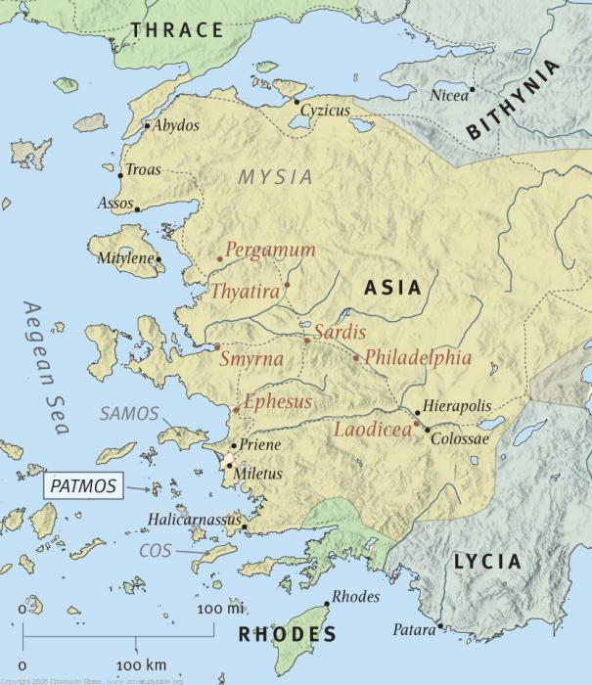
Colosse

Slide 11
Tychicus . . .
Beloved brother.
Faithful minister.
Fellow servant in the Lord.
I am sending…
Purpose:
¹that you may know how we are
²that he may comfort / encourage hearts

Slide 12
Tychicus . . . With Onesimus (9)
Faithful, beloved brother – one of you
“They” will tell you what is happening
Epaphras was with Paul, 12; 1:7-8. Philemon 23, fellow prisoner . . .
Onesimus also served Paul
Tychicus protects Onesimus

Slide 13
I. Acts 20:4 – Messenger Of Churches
II. Eph.6:21-22 – Paul’s Mailman
III. Col.4:7-9 – Tychicus And Onesimus
IV. Titus 3:12
Tychicus With Paul

Slide 14
Paul’s release - journeys
Paul at Nicopolis, sends for Titus [Crete]
Titus cannot leave Crete without preacher
Send Artemas or Tychicus?
This shows that Tychicus is . . .
mature; able to go wherever Paul sends.
ready to incur dangers of travel (2 Co.11).
zealous. He never says no, or tires of work, deprivation, sacrifice.

Slide 15
I. Acts 20:4 – Messenger Of Churches
II. Eph.6:21-22 – Paul’s Mailman
III. Col.4:7-9 – Tychicus and Onesimus
IV. Titus 3:12 – Tychicus With Paul
V. 2 Timothy 4:12
Tychicus To Ephesus

Slide 16
Paul will soon die (2 Tim.4:6-8)
Paul’s concern: for brethren, not himself.
Paul knows Ephesian church is in good hands with Tychicus. Implies Tychicus is . . .
1. filled with knowledge of Scripture.
2. able to teach, exhort. 2 Tim.2:2.
3. able to work with people.
4. good example (1 Tim.4:12).
5. concerned for them.
6. wise in counsel.
7. humble. 2 Tim.4:20 (Ac.20:4)

Slide 17
Tychicus Lessons
1. Pride has no place in our life.
2. God’s word gives us what we need.
able to work with people.
He serves as our example
He encourages others
He is always zealously working and serving
He is striving for heaven
He can help congregations in spiritual growth

Slide 18
Tychicus Lessons
1. Pride has no place in our life.
2. God’s word gives us what we need.
3. A devoted Christian. Mt.25
4. A willing servant. Mt.20
5. Not an apostle, yet became arms, legs, mouth of one who is (Paul).
6. Trustworthy.
7. Strong. Difficulties / danger did not stop him
8. Steadfast.

Slide 19
Steadfast Tychicus and Paul
1. Before imprisonment (Ac.20): easy times.
2. Paul in prison (Ephesians / Colossians).
3. Paul released (1 Timothy / Titus).
4. Paul in prison (2 Timothy).
Paul’s lot may fall to Tychicus.
Tychicus stays the course.
Acts 20:22-25; 21:10-14
Rv.2:10

