Slide 1
A ‘Mere Death’ Experience

Slide 2
I. Test Of Faith
(Mk.5:21-43)

Slide 3
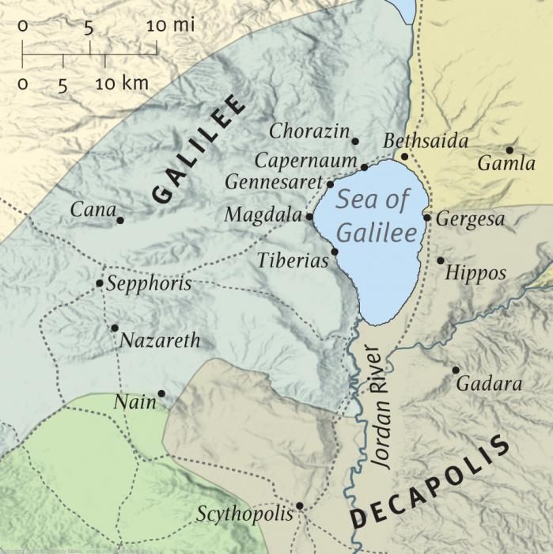
Mk.5:21
5:3, asked to leave; place of death
NW side of Galilee: multitude waits for Him

Slide 4
Mk.5:22
Ruler: power, respect, influence . . .
Falls at Jesus’ feet in presence of crowd. [Ac.10]

Slide 5
Mk.5:23
Begged earnestly [fervently, urgently].
Little daughter at point of death.
Knows Jesus’ hands can heal her.
Not His voice? [cf. Mt.8:13]
An only child, Lk.8:42 [7:12]
Timing: before she dies (irreversible).

Slide 6
Mk.5:24
Son of God
Creator
Ruler of universe
Yet, cares about lowly Jew with sick daughter . . . as great crowd jostles Him.

Slide 7
Interruption: Mk.5:25-34, woman (1/2)
Both she and Jairus’ daughter . . .
Reveal Jesus helping women . . .
Need help that only He can give . . .
Described by “twelve”
Involve faith (woman’s own’; father’s)
Involve touch (garment; hand, 41)
Unclean (blood; death)

Slide 8
Interruption: Mk.5:25-34, woman (2/2)
25-26: twelve years; many doctors; worse. Lk.8:43, Luke the physician…
27-28: timid woman; touches garment.
29-30: dried up; healthy!
31-33: requires her to confess her faith and her cure.
34: peace.
Twelve years: one touch

Slide 9
Resumption: Mk.5:35
“Your daughter is dead…”
Worst fears…
Death reigns.
Why bother Jesus? (v.23)

Slide 10
Mk.5:36
What Jesus could have said:
“I’m sorry”
“I’ve done all I can do”
“If only you had come earlier”
“She’s in a better place”
What Jesus did say:
Do not fear . . . Only believe.

Slide 11
Mk.5:36
1. Do not fear . . .
Where faith lives, fear dies.
Only One is undeterred by the news.
2. Only believe [present imperative].
Faith brought him to Jesus… (healer)
Next level: Jesus… (death killer)
Daughter not required to believe; only the father.

Slide 12
Mk.5:37-38
Three witnesses. 1 Pt.5:13
House: weeping / wailing…

Slide 13
Mk.5:39
Death is a nap!
Mk.5:40
Ridiculed Him –
Probably professionals
¹⁷ Thus says the Lord of hosts: “Consider and call for the mourning women, That they may come; And send for skillful wailing women, That they may come. ¹⁸ Let them make haste And take up a wailing for us, That our eyes may run with tears, And our eyelids gush with water” – Jeremiah 9

Slide 14
Mk.5:39
Death is a nap!
Mk.5:40
Ridiculed Him –
Probably professionals
¹⁶ Therefore the Lord God of hosts, the Lord, says this: “There shall be wailing in all streets, And they shall say in all the highways, ‘Alas! Alas!’ They shall call the farmer to mourning, And skillful lamenters to wailing” – Amos 5

Slide 15
Mk.5:41
How could an imposter survive this?
Lk.8:53-54
Talitha, cumi.
Death understands Aramaic
Recalls His exact words
Unclean tombs / blood / death

Slide 16
Mk.5:42
Power of Jesus’ word: immediate / amazing response.
Arose . . . began walking
Spirit returned (Lk.8:53-55)
Age 12: bat mitzvah – 12 years, 1 day
bar mitzvah – 13 years, 1 day
Amazement

Slide 17
Mk.5:43
No one should know it [gives Him time to get away?]
Not possible in Lk.7, or Jn.11.
Time to eat!

Slide 18
I. Test Of Faith
II. Teaching Of Faith

Slide 19
1. Tragedy often strikes when all seems well
Death may come when we least expect it.
Jairus thought he would die before his daughter. (Job)

Slide 20
2. Jesus, undisputed master of death
Daughter of ruler … Lazarus … Jesus
Jesus is Supreme …
Physician of physicians
Preacher of preachers
Prince of kings
Judge of judges
Conqueror of death . . .

Slide 21
3. Jesus rules demons, raging seas, disease, death
Jesus is Lord of death and life
Jesus is commentary on Ps.23:4
Ps.116:15
Fate of death, 1 Co.15
Sleep, 1 Th.4
On verge of victory – no time to mourn

Slide 22
4. Be prepared
Live now for then
Ac.9:40, Tabitha, arise

Slide 23
5. Lord expects us to learn lessons from tragedies.
Lk.13
Jn.9, 11

Slide 24
6. Some claim to have died and returned…
Jairus’ daughter says nothing about what she saw or experienced in death.
Also: Lk.7; Jn.11-12
2 Co.12, Paul

Slide 25
7. What a friend we have in Jesus.
He mercifully goes with Jairus
Compassion for parents, tenderness to child
Power over death
Concern for her (feed her)
Jesus loved common people

Slide 26
8. Lord’s disciples cannot lose
If His compassion on parents restores daughter to life, they are thankful.
If His compassion on child leaves her in glory . . . she is thankful.
“Do not be afraid; just keep on believing”

Slide 27
Funeral philosophy
1. Do what you can with what you have.
2. Do what you have to do.
3. Enjoy every day . . .

