Slide 1
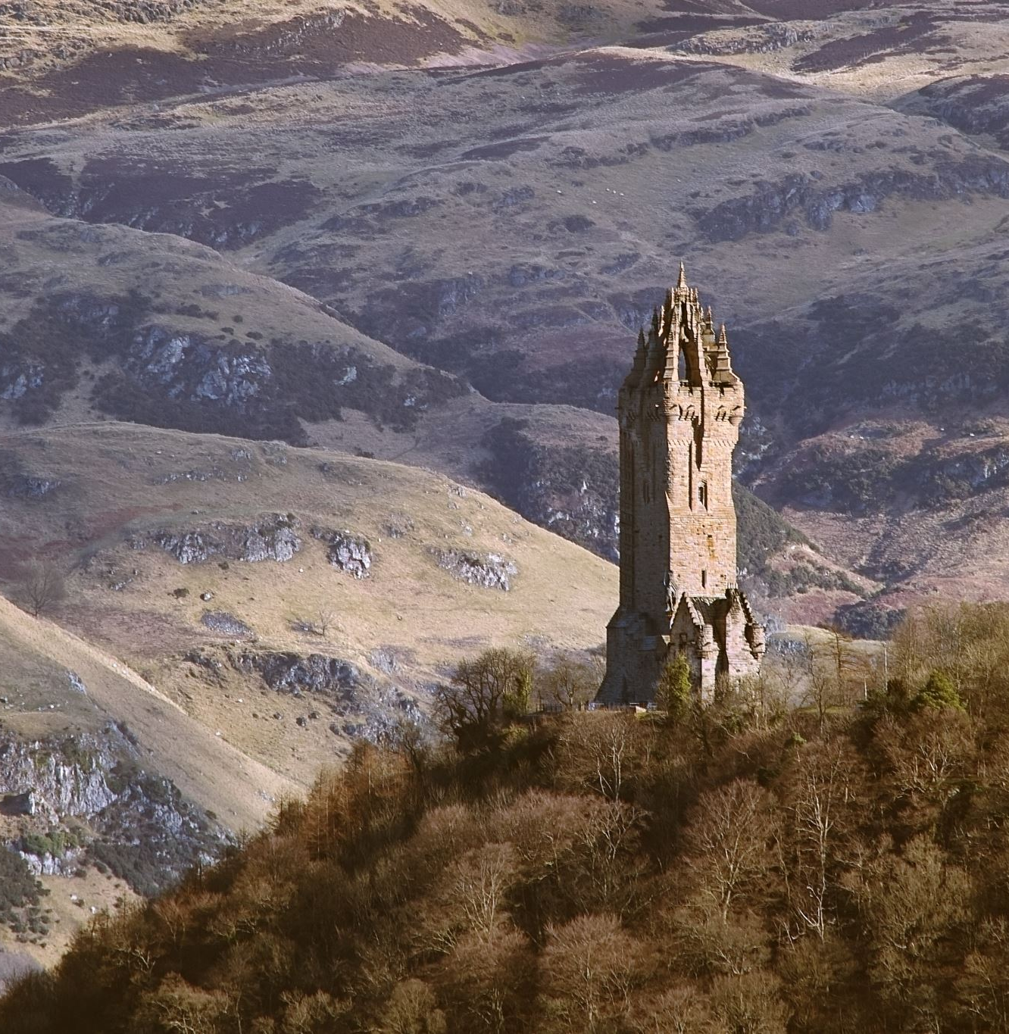
Naaman 2 Kings 5:1-14
Desperation
Pride
Obedience

Slide 2
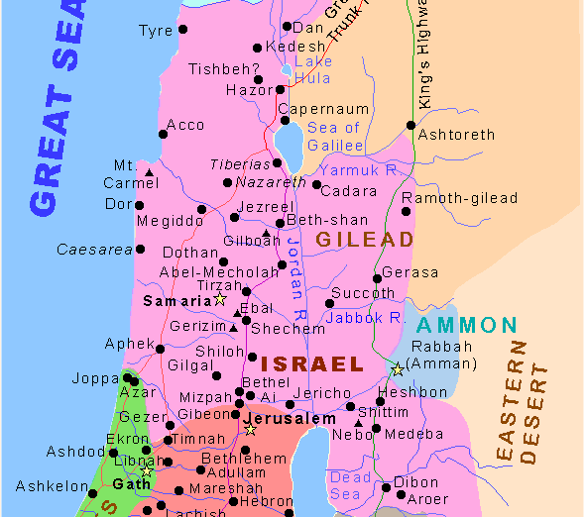
Background
Disputed Territory
Israel and Aram (Syria) had been at war continually since the time of Solomon (1 Kings 11:25, 22:1-3)
During the time of the story of Naaman, Aram has been oppressing Israel since the death of Ahab (2 Kings 5: 1a)
During the story of Naaman the names of the Kings of Israel and Aram are not revealed. However, it is most likely Jehoram (Israel) and Ben-Hadad (Aram) (2 Kings 3:1-2; 6:24)

Slide 3
1. Desperation vs 1-8
V1-4 Who is Naaman
Captain of the army of the King of Aram V1
Valiant Warrior and successful in battle against Israel (God had given Israel into his hand) V1
A good master V2-4
Listens to the council of those under his charge, even a servant girl
But he had a physical ailment bringing everything he had down V1

Slide 4
1. Desperation vs 1-8 Continued
V5-6 Naaman was desperate enough to go to Aram's mortal enemy for help. Also shows his value to the king of Aram.
V7 King of Israel's unwillingness to trust God, only concerned with physical things
V8 Elisha "don’t worry send him to me"

Slide 5
2. Pride v9-12
V9-Naaman arrives en masse
Chariots, money and clothes (5:23)
V10-Elisha or rather his servant gives a cure
Elisha sends a servant to tell Naaman
Dip in the Jordan River 7 times

Slide 6
2. Pride v9-12 Continued
V11-12-Naamans excuses
It wasn’t what Naaman was expecting
No fan fare
Naaman's pride made him feel disrespected
The Jordan River is too dirty, not a body of water to wash one-self
"Better rivers in Damascus" - Pride overcomes desperation

Slide 7
2. Pride v9-12 Continued
V12-Went away enraged
He was blind to the reason he was even there
If he stays in this mindset, he will die from his leprosy
Pride had completely taken control.

Slide 8
3. Obediance V13-14
V13-Wisdom Prevails, Naamans servants come to his aid
Servants "don’t you want to be healed? Is your pride worth dying from leprosy?"
The whole reason he is in Israel is because of slave girl, why wouldn’t he listen to his other servants
V14-Naaman Obeys
Naaman dips 7 times – flesh healed better than someone else his age, like a little child’s skin

Slide 9
Application-Desperation
Naaman had an incurable physical disease, without Christ we have an incurable spiritual disease (Rom 3:23,Rom 6:23, Jam. 1:15)
How desperate are we to be healed? (Mark 9:45,47)
How much money and goods will we give up to be healed
Would we ask our mortal enemy for help?
Would we listen to someone who we might not expect to have the answers?
Would we call in all our favors?

Slide 10
Application-Pride
What will keep us from putting off sin? (Rom. 8:6-8)
Money? (Rich young ruler, Mark 10:17-22)
Time? (parable of the feast, Luke 14:16-24)
Expectations? (Pharisees & Gentiles, I Cor. 1:22)
Our own pride? (Pride of Life, 1 John 2:16)

Slide 11
Application-Obedience
Obedience-When God commands, we ought to listen and do
Obeying is how we access the Grace of God (1 John 1:6-7,9)
Obedience is a change of action that leads to a change of heart (Rom. 12:2)
Obedience is more important than "good things"(Saul-I Sam 15:21-23)
Our salvation makes us into something this world can't produce (I John 5:11-12)

