Slide 1
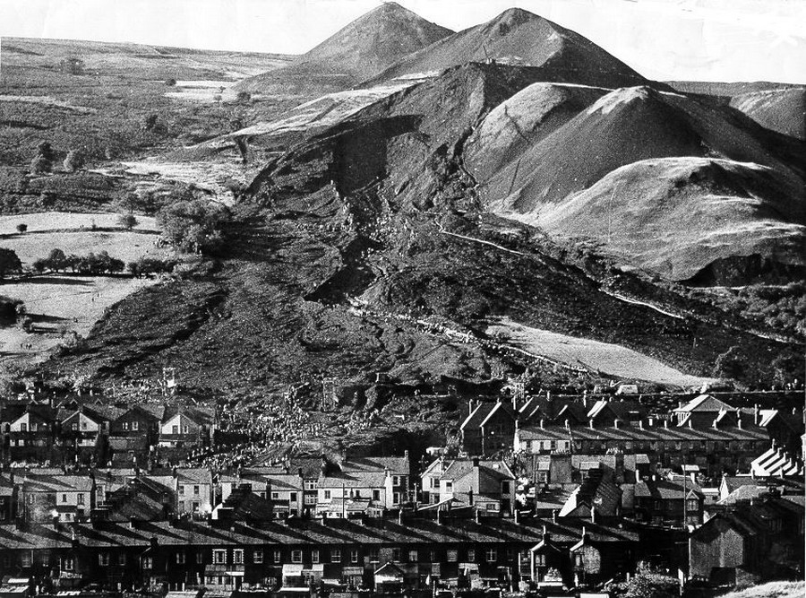

Slide 2
Regulatory Capture

Slide 3
Definition
An industry gains control of the governing body that regulates it, and then uses that body in order to regulate for its own benefit.

Slide 4
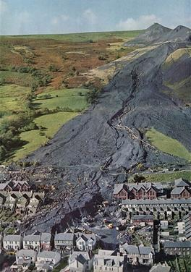
Results
Use Regulatory Power for Profit
Provide a False Sense of Security
Pay no price for Mistakes/Harm

Slide 5
1 John 5:19
We know that we are of God, and the whole world lies under the sway of the wicked one.

Slide 6
1 Corinthians 1:18-23
For the message of the cross is foolishness to those who are perishing, but to us who are being saved it is the power of God. For it is written: “I will destroy the wisdom of the wise, And bring to nothing the understanding of the prudent.” Where is the wise? Where is the scribe? Where is the disputer of this age? Has not God made foolish the wisdom of this world? For since, in the wisdom of God, the world through wisdom did not know God, it pleased God through the foolishness of the message preached to save those who believe. For Jews request a sign, and Greeks seek after wisdom; but we preach Christ crucified, to the Jews a stumbling block and to the Greeks foolishness,

Slide 7
Ephesians 2:1-3
And you He made alive, who were dead in trespasses and sins, in which you once walked according to the course of this world, according to the prince of the power of the air, the spirit who now works in the sons of disobedience, among whom also we all once conducted ourselves in the lusts of our flesh, fulfilling the desires of the flesh and of the mind, and were by nature children of wrath, just as the others.

Slide 8
2 Corinthians 4:3-4
But even if our gospel is veiled, it is veiled to those who are perishing, whose minds the god of this age has blinded, who do not believe, lest the light of the gospel of the glory of Christ, who is the image of God, should shine on them.

Slide 9
Revelation 12:17
And the dragon was enraged with the woman, and he went to make war with the rest of her offspring, who keep the commandments of God and have the testimony of Jesus Christ.

Slide 10
Sources of Authority
Science
Psychology

Slide 11
Proverbs 23:13-14
Proverbs 13:24
He who spares his rod hates his son,
But he who loves him disciplines him promptly.
Do not withhold correction from a child,
For if you beat him with a rod, he will not die.
You shall beat him with a rod,
And deliver his soul from hell..

Slide 12
Sources of Authority
Science
Psychology
Society

Slide 13
1 Samuel 8:5-7
…Look, you are old, and your sons do not walk in your ways. Now make us a king to judge us like all the nations.” But the thing displeased Samuel when they said, “Give us a king to judge us.” So Samuel prayed to the Lord. And the Lord said to Samuel, “Heed the voice of the people in all that they say to you; for they have not rejected you, but they have rejected Me, that I should not reign over them.

Slide 14
Matthew 7:13-14
Enter by the narrow gate; for wide is the gate and broad is the way that leads to destruction, and there are many who go in by it. Because narrow is the gate and difficult is the way which leads to life, and there are few who find it.

Slide 15
Sources of Authority Default Rules
What’s Polite… Acceptable

Slide 16
Acts 18:24-26
Now a certain Jew named Apollos, born at Alexandria, an eloquent man and mighty in the Scriptures, came to Ephesus. This man had been instructed in the way of the Lord; and being fervent in spirit, he spoke and taught accurately the things of the Lord, though he knew only the baptism of John. So he began to speak boldly in the synagogue. When Aquila and Priscilla heard him, they took him aside and explained to him the way of God more accurately.

Slide 17
Sources of Authority Default Rules
What’s Polite… Acceptable
Definition of Terms

Slide 18
Sources of Authority Default Rules Culture
Music
Entertainment
Social Media

Slide 19
Ephesians 4:29
Let no corrupt word proceed out of your mouth, but what is good for necessary edification, that it may impart grace to the hearers.

Slide 20
Sources of Authority Default Rules Culture
Music
Entertainment
Social Media
Dress
Vacations
Celebrations

Slide 21
Sources of Authority Default Rules Culture Dating & Marriage

Slide 22
Judges 14:1-3
Now Samson went down to Timnah, and saw a woman in Timnah of the daughters of the Philistines. So he went up and told his father and mother, saying, “I have seen a woman in Timnah of the daughters of the Philistines; now therefore, get her for me as a wife.”
Then his father and mother said to him, “Is there no woman among the daughters of your brethren, or among all my people, that you must go and get a wife from the uncircumcised Philistines?”
And Samson said to his father, “Get her for me, for she pleases me well.”

Slide 23
1 Peter 3:3-4
Do not let your adornment be merely outward—arranging the hair, wearing gold, or putting on fine apparel— rather let it be the hidden person of the heart, with the incorruptible beauty of a gentle and quiet spirit, which is very precious in the sight of God.

Slide 24
Sources of Authority Default Rules Culture Dating & Marriage Education & Employment

Slide 25
Genesis 13:10-13
And Lot lifted his eyes and saw all the plain of Jordan, that it was well watered everywhere (before the Lord destroyed Sodom and Gomorrah) like the garden of the Lord, like the land of Egypt as you go toward Zoar. Then Lot chose for himself all the plain of Jordan, and Lot journeyed east. And they separated from each other. Abram dwelt in the land of Canaan, and Lot dwelt in the cities of the plain and pitched his tent even as far as Sodom. But the men of Sodom were exceedingly wicked and sinful against the Lord.

Slide 26
1 Timothy 6:10
For the love of money is a root of all kinds of evil, for which some have strayed from the faith in their greediness, and pierced themselves through with many sorrows.

Slide 27
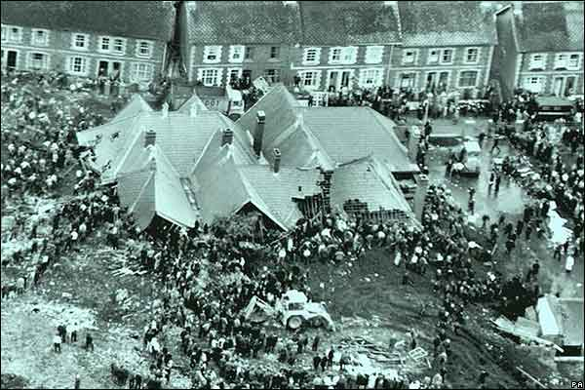
Sources of Authority Default Rules Culture Dating & Marriage Education & Employment

