Slide 1
What Do You Think Of Christ?
Matthew 16:13-20

Slide 2
I. The Incomparable Question, 13

Slide 3
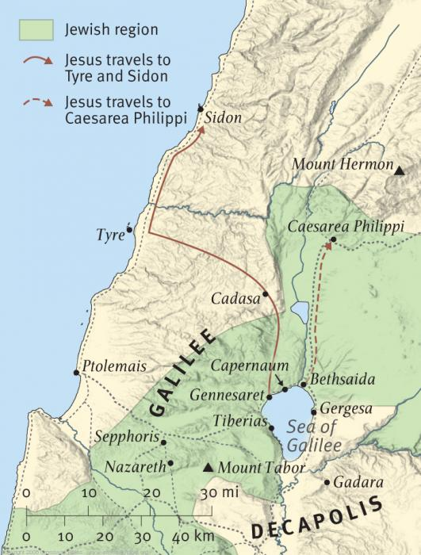
Caesarea Philippi
Mk.8:22
Area of Paneas
Philip rebuilt city; renamed it:
Caesarea [Augustus]
Philippi [himself]
Mt. Hermon: 9232 ft.

Slide 4
Lk.9:18, And it happened, as He was alone praying, that His disciples joined Him, and He asked them, saying, “Who do the crowds say that I am?”
“Who am I?” – a poll
Son of Man –
Used of mere men, Ps.8:4; Ezk.2:1
Used of Messiah, Dn.7:13; Mt.26:64

Slide 5
I. The Incomparable Question, 13
II. The Inevitable Response, 14

Slide 6
Each views Him as a spokesman for God
They compare Him to the finest men who ever lived – spiritual giants of the past
“Some say…”: public opinion is not reliable
Shifts with winds of change, Mt.26
Multiple replies
John, 14:2
Elijah, Mal.4; Mt.17
Jeremiah, or another prophet
Today: good man, religious leader, prophet

Slide 7
I. The Incomparable Question, 13
II. The Inevitable Response, 14
III. The Inescapable Challenge, 15

Slide 8
They will be challenged to confess…
Mt.10:32-33
Do they grasp the truth?
Mt.14:33, “…Truly, You are the Son of God”
Those who knew Him best confess Him in the highest degree.
Jesus never corrects or modifies this confession (16-17)

Slide 9
I. The Incomparable Question, 13
II. The Inevitable Response, 14
III. The Inescapable Challenge, 15
IV. The Indisputable Conclusion, 16

Slide 10
How does Peter know that Jesus is more than a prophet?
His baptism? (Mt.3:17)
His teaching / miracles? (Lk.5:…8)

Slide 11
Peter’s double confession (he answers for each apostle, v.15)
1. Christ: Anointed One (Messiah – His office)
Chief Prophet, Dt.18:15, 18 … compared to Moses – the long expected Messiah
High Priest, Ps.110:4 … compared to Melchizedek – perfect sacrifice
Eternal King, Ps.2:6-7 … compared to David – all power
2. Son of Living God (v.13: deity). Jn.1:14

Slide 12
I. The Incomparable Question, 13
II. The Inevitable Response, 14
III. The Inescapable Challenge, 15
IV. The Indisputable Conclusion, 16
V. The Infallible Revelation, 17

Slide 13
Blessed: same verdict as Mt.5:3-12 (enjoys approval of God)
Flesh and Blood: five times
Flesh and blood cannot . . .
Determine will of God. 2 K.5:11
Nullify truth. 1 Pt.3:20. Ac.2
Father: only way to know the truth.

Slide 14
I. The Incomparable Question, 13
II. The Inevitable Response, 14
III. The Inescapable Challenge, 15
IV. The Indisputable Conclusion, 16
V. The Infallible Revelation, 17
VI. The Indestructible Foundation, 18

Slide 15
Roman Catholicism: “Peter is the rock, the first pope” ? ?
²¹From that time Jesus began to show His disciples that he must go to Jerusalem and suffer many things from the elders and chief priests and scribes, and be killed, and be raised the third day. ²²Then Peter took him aside and began to rebuke him, saying, “Far be it from you, Lord; this shall not happen to you.” ²³But he turned and said to Peter, “Get behind me, Satan! You are an offense to Me, for you are not mindful of the things of God, but the things of man” – Mt.16

Slide 16
Roman Catholicism: “Peter is the rock, the first pope” ? ?
¹At that time the disciples came to Jesus, say-ing, “Who then is greatest in the kingdom of heaven?” ² Then Jesus called a little child to Him, and said, he put him in the midst of them ³ and said, “Assuredly, I say to you, unless you are converted and become as little children, you will by no means enter the kingdom of heaven. ⁴ Therefore whoever humbles himself as this little child is the greatest in the kingdom of heaven” – Mt.18

Slide 17
Roman Catholicism: “Peter is the rock, the first pope” ? ?
¹⁸ Assuredly, I say to you, whatever you bind on earth will be bound in heaven, and whatever you loose on earth will be loosed in heaven. ¹⁹ Again I say to you that if two of you agree on earth concerning anything they ask, it will be done for them by my Father in heaven. ²⁰ For where two or three are gathered together in My name, I am there in the midst of them” – Mt.18

Slide 18
Roman Catholicism: “Peter is the rock, the first pope” ? ?
²⁸ Jesus said to them, “Assuredly I say to you, that in the regeneration, when the Son of Man sits on the throne of His glory, you who have followed me will also sit on twelve thrones, judging the twelve tribes of Israel” – Mt.19

Slide 19
Roman Catholicism: “Peter is the rock, the first pope” ? ?
²⁰⁻²¹ Mother of Zebedee’s sons . . . “Grant that these two sons of mine may sit, one on Your right hand and the other on the left, in Your kingdom…” ²⁴ And when the ten heard it, they were greatly displeased with the two brothers … ²⁶ …whoever desires to become great among you, let him be your servant. ²⁷ And whoever desires to be first among you, let him be your slave…” – Mt.20

Slide 20
Roman Catholicism: “Peter is the rock, the first pope” ? ?
¹⁴ Now when the apostles who were at Jeru-salem heard that Samaria had received the word of God, they sent Peter and John to them… –Ac.8

Slide 21
Roman Catholicism: “Peter is the rock, the first pope” ? ?
¹¹ For no other foundation can anyone lay than that which is laid, which is Jesus Christ –1 Co.3

Slide 22
Roman Catholicism: “Peter is the rock, the first pope” ? ?
⁹ and when James, Cephas, and John, who seemed to be pillars, perceived the grace that had been given to me, they gave me and Barnabas the right hand of fellowship, that we should go to the Gentiles and they to the circumcised… ¹¹ Now when Peter had come to Antioch, I withstood him to his face, because he was to be blamed… ¹³ And the rest of the Jews also played the hypocrite with him… –Gal.2

Slide 23
Roman Catholicism: “Peter is the rock, the first pope” ? ?
⁴ Coming to Him as to a living stone, rejected indeed by men, but chosen by God and precious, ⁵ you also, as living stones, are being built up a spiritual house, a holy priesthood, to offer up spiritual sacrifices acceptable to God through Jesus Christ. ⁶ Therefore it is also contained in the Scripture, “Behold, I lay in Zion A chief cornerstone, elect, precious, And he who believes on Him will by no means be put to shame” –1 Pt.2 . . .

Slide 24
Roman Catholicism: “Peter is the rock, the first pope” ? ?
⁷ Therefore, to you who believe, He is precious; but to those who are disobedient,
“The stone which the builders rejected
Has become the chief cornerstone,”
⁸ and “A stone of stumbling And a rock of offense…” –1 Pt.2 . . .
² …be mindful of the words which were spoken before by the holy prophets, and of the commandment of us, the apostles of the Lord and Savior . . . – 2 Pt.3

Slide 25
Roman Catholicism: “Peter is the rock, the first pope” ? ?
16:21-23??
18:1, why did other apostles miss it?
18:18, you (plural). Why?
19:28, why twelve thrones?
20:20-28, James/John? Open to lowest?
Ac.8:14, Peter and John sent…?
1 Co.3:11, …no other foundation
Ga.2:9…11-13, authority over Paul??
1 Pt.2:4-8, Peter did not know? (2 Pt.3:2)

Slide 26
Roman Catholicism: “Peter is the rock, the first pope” ? ?
OT evidence (prophets):
Ps.118:22, The stone which the builders rejected Has become the chief corner-stone. [Mt.21:42]
Is.28:16, Therefore thus says the Lord GOD: “Behold, I lay in Zion a stone for a foundation, A tried stone, a precious cornerstone, a sure foundation; Whoever believes will not act hastily. [Ro.9:32-33]

Slide 27
Roman Catholicism: “Peter is the rock, the first pope” ? ?
Logic: why would Jesus ask about Himself (13-15) then apply it to Peter?
Chrysostom: [upon this rock…build My church]: “on the faith of his confession.”
Mt.7:24-25 – Peter?

Slide 28
Roman Catholicism: “Peter is the rock, the first pope” ? ?
Fulfillment: what happened?
Ac.2:42, And they continued steadfastly in the apostles’ doctrine and fellowship, in the breaking of bread, and in prayers
Jesus built His church on the inspired preaching of His apostles and unanimous confession of all apostles…and prophets

Slide 29
Roman Catholicism: “Peter is the rock, the first pope” ? ?
Eph.2:20-22 . . . 3:1-5
Peter:
1 Pt.1:1, apostle
1 Pt.5:1, elder
2 Pt.1:1, servant and apostle
No mention of successors (Ac.1:21-22)

Slide 30
Roman Catholicism: “Peter is the rock, the first pope” ? ?
“I will build My church” – first reference; future
My church: possessive, emphatic (18)
Church: people, Ep.1:22-23
Who is Head??

Slide 31
Roman Catholicism: “Peter is the rock, the first pope” ? ?
“Gates of Hades” triumph over all human activity.
NOT the church.
Death defeats most projects. Ac.2:24, 27
Satan’s kingdom wars against Lord’s kingdom; he will never prevail…

Slide 32
I. The Incomparable Question, 13
II. The Inevitable Response, 14
III. The Inescapable Challenge, 15
IV. The Indisputable Conclusion, 16
V. The Infallible Revelation, 17
VI. The Indestructible Foundation, 18
VII. The Inherent Duty, 19

Slide 33
Keys: instrument of admission
Peter, a small stone, would receive keys of kingdom, Ac.2:36-38. Cf. 11:14.
1 Pt.2:5, as living stones…
Bind…loose
Bind: to constrain (compel) by law, duty. Ro.7:2.
Loose: permit, allow (not binding).

Slide 34
Key:
The recognized badge of office of a constituted teacher, and the symbol used in the appointment of a Jewish rabbi is said to have been the delivery to him of a key, with words similar to these: ‘Take authority to bind and to loose…’
Isa.22:22
Rv.3:7, Jesus uses words of Himself
Lk.11:52

Slide 35
20: ‘Know and not tell”
“Messiah” could be misunderstood as a political reference (involve armies, rebellion against Rome…).
Jesus wants no one to call Him Messiah in a political sense (14). Jn.18:36
And…the apostles were not ready (Mt.16:21-23)

