Slide 1
The Avengers
Judges 19-21

Slide 2
Judges 17-21 – an epilogue?
Events must have taken place early
20:28, Phinehas, grandson of Aaron (Nu.25:7)
Hosea 9:9, They are deeply corrupted, As in the days of Gibeah. He will remember their iniquity; He will punish their sins.
Hosea 10:9, O Israel, you have sinned from the days of Gibeah; There they stood. The battle in Gibeah against the children of iniquity Did not overtake them.

Slide 3
I. The Setting, ch.19

Slide 4
1: no king. “No rules” (Benjamites).
2-3: consequence of husband-wife problems
4-13: Jebus / Jebusites. Gibeah

Slide 6
Travel in ancient world:
Lk.2:44, safer in groups
Gn.18, no fast food
2 Co.11²⁶ in journeys often, in perils of waters, in perils of robbers, in perils of my own countrymen, in perils of the Gentiles, in perils in the city, in perils in the wilder-ness, in perils in the sea, in perils among false brethren; ²⁷ in weariness and toil, in sleeplessness often, in hunger and thirst, in fastings often, in cold and nakedness…

Slide 7
14-15 . . . no hospitality
16-21 . . . hospitality . . . for some
22-26, sodomy / inexcusable cowardice
Gn.19, Israel sank to Sodom’s status

Slide 8
27-30: cut into twelve parts
When people shun law, morals…evil fills the vacuum. Mt.12:43-45
Israelite criminals were . . .
Perverted, 22
Immoral, 22. Slouching Towards Gomorrah (collapse of American culture). 2 Pt.2:7-8

Slide 10
27-30: cut into twelve parts
When people shun law, morals…evil fills the vacuum. Mt.12:43-45
Israelite criminals were . . .
Perverted, 22
Immoral, 22. Slouching toward Gomorrah (collapse of American culture). 2 Pt.2:7-8
Aided by cowards, 24 [1 Sm.30; Mal.2]

Slide 11
I. The Setting, ch.19
II. The Sword, ch.20

Slide 12
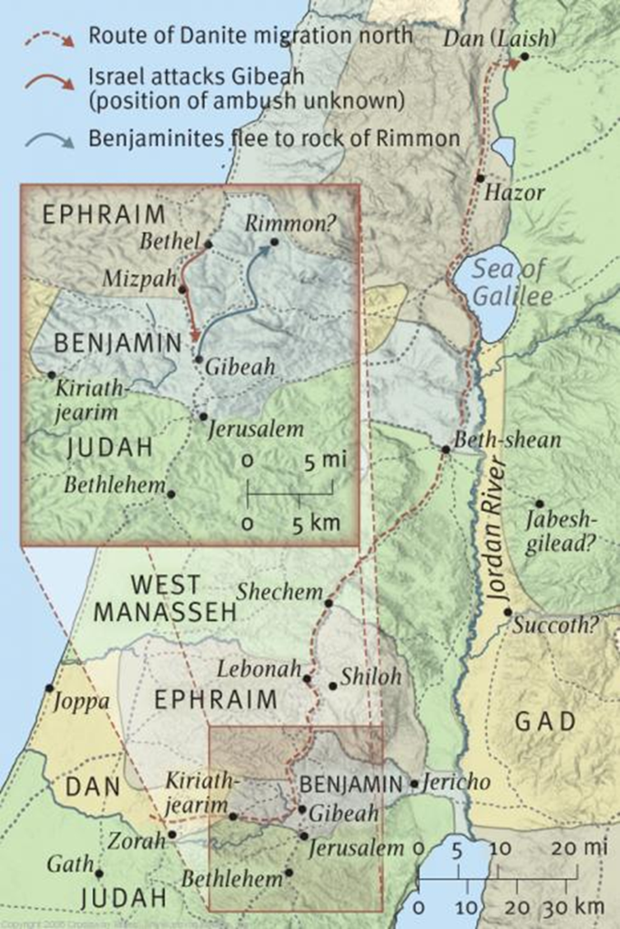
From Dan to Beersheba (1)

Slide 13
From Dan to Beersheba (2)
Congregation…as one man (1, 8, 11)
Before LORD – ¹righteous cause; ²punish sinners; ³remove curse from nation. Nu.35
War: time, effort; lives … to obey God
2: 400,000 soldiers (shows importance of task)

Slide 14
From Dan to Beersheba (3)
3-11: just the facts
Determination to finish job; punish evil
United as one man (allies)
Knew God’s law
1 Co.5; 2 Co.12; 2 Th.3…

Slide 15
How could this happen? (12-13)
Hand over sons of wickedness
Benjamin refused:
Pride? Protect own? Confess nothing? (15-16)
Problem: no king [not even God]; law of the jungle; no right or wrong
God’s people must do right thing even if all others do wrong

Slide 16
Last resort: prepare for battle (14)
16: Ben▪jamin
Many hours of practice, dedication
Helpful in defense of tribe
Pride in being ‘the best’
Overcame many failures (misses)
Greatest miss: blessings of God

Slide 17
To the battlefield (17-21)
21-25: Judah’s losses
26a: united despite severe losses
26b: wept [obedience can be costly]. Ac.7
27: inquired of God
28-35: trust + perseverance
47: 600 Benjamites flee to wilderness
48: burned cities, killed men, animals

Slide 18
I. The Setting, ch.19
II. The Sword, ch.20
III. The Success

Slide 19
Their attitude toward God
Humbly submitted to God’s commands
Continued to fight after suffering losses
Kept fighting till justice was served
After fighting, pursued peace

Slide 20
Their attitude toward God Their attitude toward fellow soldiers
Unity is precious (Ps.133)
No unity with impenitent sinners. 1 Co.5:1

Slide 21
Their attitude toward God Their attitude toward fellow soldiers Their attitude toward the enemy (1)
At first, sinful? (Their losses may imply it)
When correcting others, must first con-sider self. Ga.6:1
If they were negligent during this time, they were in poor shape to correct others, 19:1. Mt.7:5
If motivated by personal revenge… 20:48
If proud (Jg.7:2-3) they need a reminder

Slide 22
Their attitude toward God Their attitude toward fellow soldiers Their attitude toward the enemy (2)
Desire for massacre turned to mercy.
Willing to forgive, restore the tribe.
There were a thousand men of Benjamin with him, and Ziba the servant of the house of Saul, and his fifteen sons and his twenty servants with him; and they went over the Jordan before the king – 2 Sm.19:17

Slide 23
Conclusion: attitudes
1. Ex.1:20. Egypt, powerful nation…
2. 2 Co.12:…10 (13:4)

Slide 24
I asked God for strength that I might achieve. I was made weak that I might learn humbly to obey.
I asked for health that I might do greater things. I was given infirmity that I might do better things.
I asked for riches that I might be happy. I was given poverty that I might be wise.
I asked for power that I might have the praise of men. I was given weakness that I might feel the need of God.
I asked for all things that I might enjoy life. I was given life that I might enjoy all things.
I got nothing I asked for, but everything I hoped for.
Almost despite myself, my unspoken prayers were answered.
I am, among all men, most richly blessed.

Slide 25
Conclusion: attitudes
1. Ex.1:20. Egypt, powerful nation…
2. 2 Co.12:…10 (13:4)
3. Ph.4:13.
Paul’s strength came not from his commission as an apostle, but from his faith as a saint.

