Slide 1
Mary’s Memorial

Slide 2
Biblical compliments to women
Deborah
Ruth
Hannah
Esther
Prov.31
Syro-Phoenician
Mary, mother of Jesus
Poor widow
Dorcas
Mary, sister of Martha and Lazarus

Slide 3
Three memorials
Matthew 26 and Mark 14
John 12

Slide 4
I. Matthew and Mark

Slide 5
Mt.26:6
Bethany – modern el’ Azariyeh – place of Lazarus
Simon – leper, now healed (or dead)
Jesus – reclining

Slide 6
Mt.26:7; Mk.14:3
Matthew and Mark: “a woman” not named
Pour oil on His head: Ps.23:5
Guests expected oil for head (Lk.7:46)
This is very costly, fragrant oil

Slide 7
Mt.26:8; Mk.14:4
Disciples: don’t get it (not unusual)
Indignant: angry, displeased

Slide 8
Mt.26:9; Mk.14:5
More than 300 denarii
Poor people: shocked at extravagance
Criticize her sharply: scolded, censured

Slide 9
Mt.26:10; Mk.14:6
Jesus rebukes disciples, defends woman
“Trouble”: bothering, criticizing
“Good work for Me”: “beautiful” expression of devotion
Leave her alone: unconstructive criticism troubles good people

Slide 10
Mt.26:11; Mk.14:7
Her act did not interfere with charity; He urged it (Mt.25:31-46)
Lord’s time is running out . . . The woman’s loving devotion for Him is time sensitive

Slide 11
Mt.26:12; Mk.14:8
For…she is preparing My body for burial
“This anointing prepared Him for His burial after dying the death of a criminal, for only in that circumstance would the customary anointing of the body be omitted” – Daube
Jesus knew that in days He would hang on a cross
Mary must have had the same insight
“She, and she first, believes that Christ would die…” (and be raised?)
Beforehand

Slide 12
Mt.26:13
Jesus knew this gospel would circle the globe
“Gospel”: His death would not end the divine plan (1 Co.15:1-4)
This woman would be remembered (her memorial)
History would treat her with more respect than the disciples had

Slide 13
I. Matthew and Mark
II. John

Slide 14
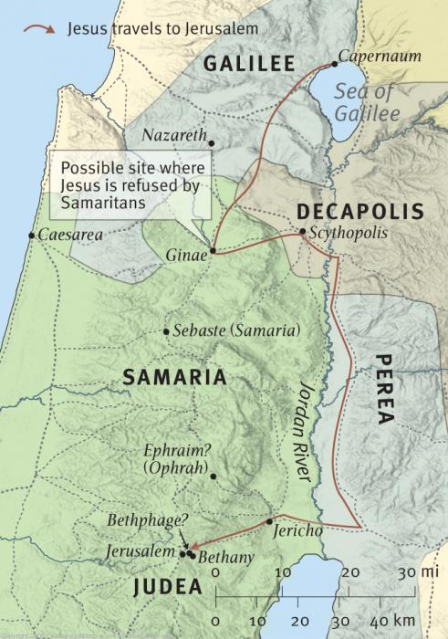
John 12:1
Then: resumes narrative from 11:55
This is Saturday evening
Passover begins on Thursday (13:1)
Bethany

Slide 15
John 12:2
Made Him a supper; Martha served
She is not worried and troubled as in Lk.10
Lazarus lives (9-11)

Slide 16
John 12:3 (1)
“Then” = verse 2: because Lazarus is here
Woman of Mt.26 / Mk.12 is Mary
Roman pound: 12 oz. (about one pint)
Spikenard: aromatic oil of spike
Spike: ear of plant
Nard: root of plant
Oil: from herb imported from India in alabaster (marble flasks)
ASV: pure (genuine, authentic): Mary’s extravagant gift

Slide 17
John 12:3 (2)
Matt. / Mark: poured on His head (Ps.133)
John: poured on His feet
Mt.26:12; Mk.14:7, anointed His body
To unbind her hair in public was a disgrace to Jewish woman
Illustrates her love and humility
She owes Jesus for salvation, and for resurrection of Lazarus

Slide 18
John 12:4-5
One disciple (Judas) –
Mt.26:8 – a waste
Judas objected – “Why was this money wasted on Jesus . . .?”
300 denarii illustrates Mary’s generosity
Year’s wages. Contrast Judas’ greed
He hides covetousness behind mask of charity (could have given it to the poor)

Slide 19
John 12:6
Thief: steal, similar to our shop-lifting
Judas “used to take” (pilfer, steal) from the money box

Slide 20
John 12:7
Judas will betray Him; Mary will embalm
Judas is a hypocrite; Mary is pure

Slide 21
John 12:8
Opportunity to show gratitude to Jesus – time was running out

Slide 22
I. Matthew and Mark
II. John
III. Lessons From Mary

Slide 23
Unusual for one act to be recorded in three NT books
Emphatic repetition
Fix this in your memory – why?
We need to be like Mary
We need to be unlike Judas

Slide 24
Do I give Jesus alabaster boxes of…
1. Attention to His word?
Why did Mary know about Jesus’ death (and resurrection?) but disciples did not?
Mt.16:21; Mt.17:22-23; Mt.20:17-19
Lk.10:38-42, Mary, always at His feet
Learned,
Lk.10
Leaned,
Jn.11
Loved,
Jn.12

Slide 25
Do I give Jesus alabaster boxes of…
1. Attention to His word?
Six days before He dies
Influenced by listening to His words …
Indebted to His miracle …
Insistent upon His anointing…
If she had waited for disciples’ approval, there would have been no anointing
Learned,
Lk.10
Leaned,
Jn.11
Loved,
Jn.12

Slide 26
Do I give Jesus alabaster boxes of…
2. Attachment to His work?
Do I make best of my opportunities?
Way I treat His disciples? Mt.25:…40
Hypocrites always find fault in others. How did Mary respond? Do I…?
She did what she could (Mk.14:8). Do I?

Slide 27
Do I give Jesus alabaster boxes of…
3. Adoration in His worship?
Do I give Him “my best”? Mt.26:10
Alabaster box of study, faith, praise?
My time, money, energy, prayers…?

Slide 28
Do I give Jesus alabaster boxes of…
4. Appreciation?
Simon: cured from leprosy
Lazarus: raised from the dead
We: salvation

Slide 29
Do I give Jesus alabaster boxes of…
5. Abasement of self
Mary spared no expense; humbly let hair down to wipe feet (3).
Talmud: duty of maid-servants
Gave her best in spite of disapproval (4).
Ph.4:12-13
Ph.2:8

Slide 30
Judas
Preferred money in his pocked over the Savior in his heart.
Judas who stole money would betray the Lord for money.
Judas is the real “waster” (not Mary)
If he had not scolded Mary, we would not know the costliness of her gift

Slide 31
Lazarus
Reclined at the table with Jesus (12:2)
Everyone He saves from sin is made… “to sit together in the heavenly places in Christ Jesus” (Ep.2:6)

Slide 32
Mary’s memorial
U.S. known for famous memorials
Mary’s memorial is most beneficial –
Her example reminds us to give Him our best

Slide 33
Lord
Died to save me from my sins
What do I bring Him?

