Slide 1
Due to a recording error, the sermon audio begins about ten minutes after the lesson started.
The sermon audio starts at the 11th slide.

Slide 2
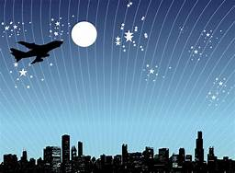

Slide 3
There Is A God In Heaven
“…but there is a God in heaven who reveals mysteries, and he has made known to King Nebuchadnezzar what will be in the latter days” – Daniel 2:28

Slide 4
God, the Creator
I. Complexity

Slide 5
Some claim earth / life / humans came from nothing
“It is not sufficient merely to say, ‘you can’t get something from nothing.’ While every-day experience and common sense seem to support this principle, if there is anything that we have learned from 20th century physics, it is this: common sense is often wrong, and our normal experiences are but a tiny fraction of reality” –Stenger.
.
If true, we can’t know anything

Slide 6
Some claim earth / life / humans came from nothing
“It is not sufficient merely to say, ‘you can’t get something from nothing.’ While everyday experience and common sense seem to support this principle, if there is anything that we have learned from 20th century physics, it is this: common sense is often wrong, and our normal experiences are but a tiny fraction of reality” –Stenger.
.
Where did matter come from in first place?
Does scientific method observe
something coming from nothing?
How do skeptics react to Lord’s miracles?

Slide 7
Complexity of human cell (1/2)
Professor Michael Denton, Evolution: A Theory In Crisis…
“To grasp the reality of life as it has been revealed by molecular biology, we must magnify a cell a thousand million times until it is twenty kilometers in diameter and resembles a giant airship large enough to cover a great city like London or New York.
What we would then see would be an object of unparalleled complexity and adaptive design.

Slide 8
Complexity of human cell (2/2)
On the surface of the cell we would see millions of openings, like port holes of a vast space ship, opening and closing to allow a continual stream of materials to flow in and out. If we were to enter one of these openings we would find ourselves in a world of supreme technology and bewildering complexity... (a complexity) beyond our own creative capa-cities, a reality which is the very antithesis of chance, which excels in every sense anything produced by the intelligence of man...
Chance did this … but men built the cities??

Slide 9
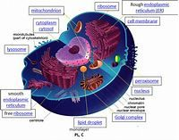
Complexity of human cell
“Multiple thousands of scientists accept the Bible’s message that there is a Creator Who planned the creation, designed the intricate engineering efficiencies into that creation, etc.” – Jeffrey Tomkins, The Design and Complexity of the Cell.

Slide 10
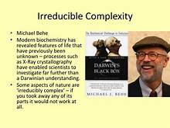
Some aspects of nature are
“irreducibly complex”
Michael Behe
Some aspects of nature are “irreducibly complex” – if you took away any of its parts it would not work at all.

Slide 11
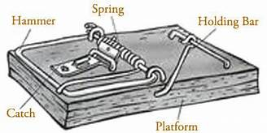
Some aspects of nature are
“irreducibly complex” – Michael Behe
Some aspects of nature are “irreducibly complex” – if you took away any of its
parts it would not work at all.
.

Slide 12
Some aspects of nature are
“irreducibly complex” – Michael Behe
Complexity of human body
“If a human being’s DNA were uncoiled, it would stretch 10 billion miles, from Earth to Pluto and back.”
“Your DNA is arranged as a coil of coils of coils of coils of coils. If you stretched the DNA in one cell all the way out, it would be about two miles long and all the DNA in your cells put together would be about twice the diameter of the Solar System . . . about ten billion miles.”
.

Slide 13
Systems
1. Digestive
2. Muscular
3. Integumentary
4. Lymphatic
5. Endocrine
6. Nervous
7. Skeletal
8. Reproductive
9. Respiratory
10. Circulatory
“I will praise You, for I am fearfully and wonderfully made;
Marvelous are Your works,
And that my soul knows very well”
– Ps.139:14.
Awesomely wonderful; awe inspiring
.

Slide 14
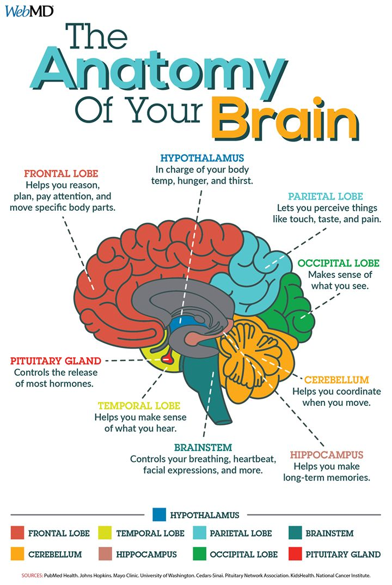
Some aspects of nature are
“irreducibly complex” – Michael Behe
Complexity of human brain
“The most complex
biological structure
in the universe”
Gn.1:27
Job 38:36
Pr.2:6
Ja.1:5
.

Slide 15
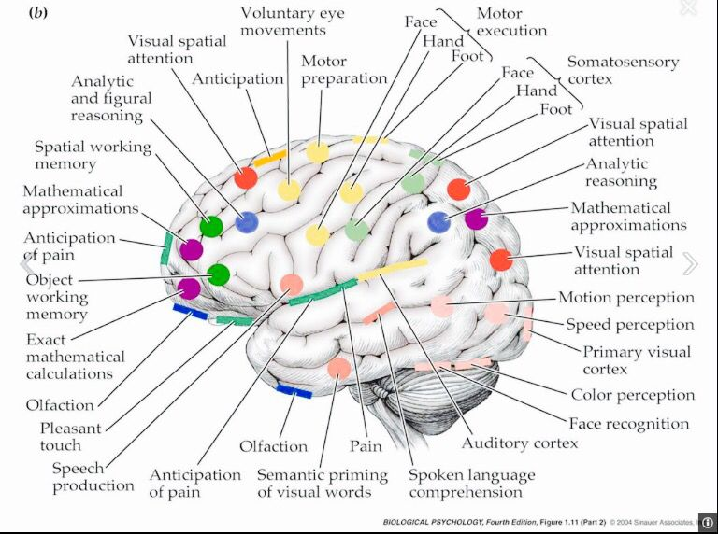
Mk.5:…15

Slide 16
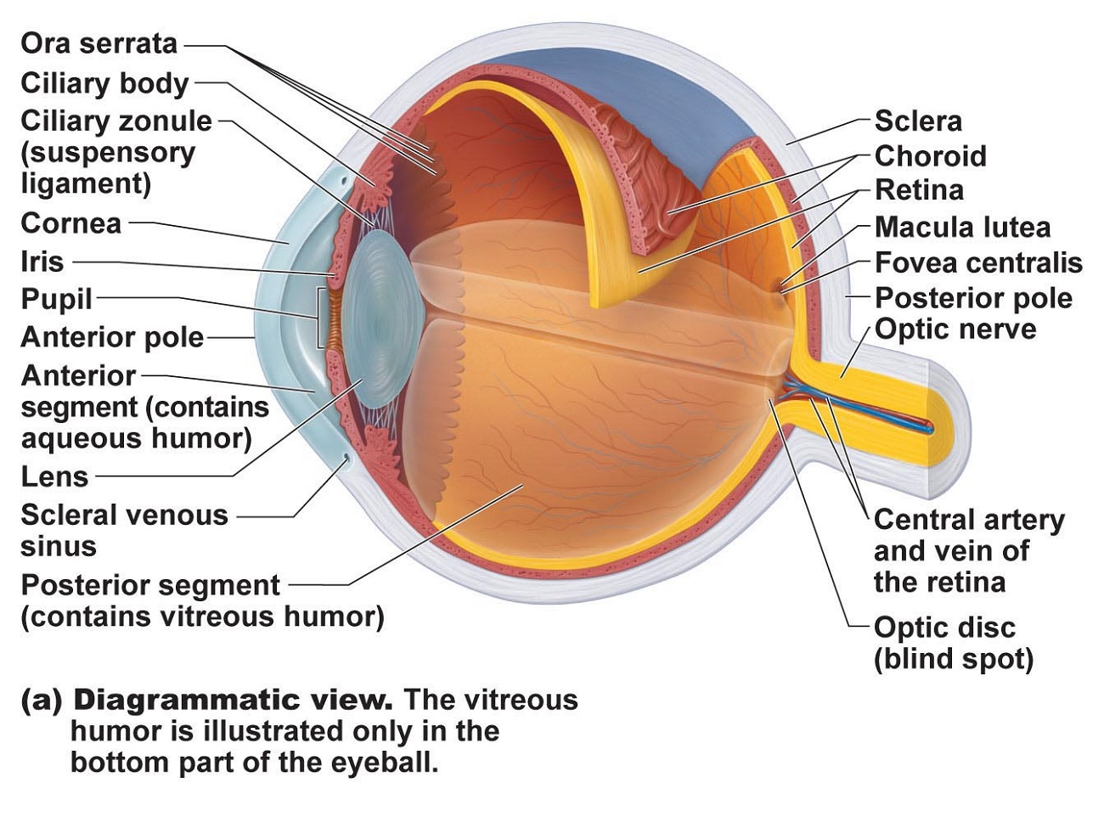
Contrast: camera and eye
.

Slide 17




Modern evolution
1. No observers
2. Multiplied millions of years
3. Cannot be repeated
4. Therefore, matter of ‘faith’
?

Slide 18
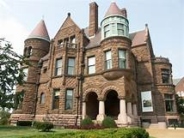
House
1. Illusion?
2. Eternal, self-existent?
3. Create itself?
4. Intelligent design?
Hb.3:4
Hb.11:3
Ps.8:1-4
[Ex.8:19]

Slide 19
God, the Creator
I. Complexity
II. Choices

Slide 20
God’s Design
Choices:
1. Something either is or is not.
2. What is, is either created or eternal.
3. Creator is either intelligent or unintelligent.
Is.40:26
Col.1:16
Job 38:1-4 – earth
Job 38:16 – sea
Job 38:19-21 – light
Job 38:31-33 – stars

Slide 21
God’s Anthropic Principle
Oxygen level
Atmospheric transparency
Moon-earth gravitational interaction
Carbon dioxide level
Gravity
If gravitational force were altered by 0.00000000000000000000000000000000000001% the sun would not exist, and neither would we…

Slide 22
Intelligent Design
Plane with lights . . . stars
Statue . . . Man who posed for it
Computer . . . human brain
City water system, food stores, people cars, bridges . . . cell

Slide 23
Conclusion (1/2)
No God = no morals
“If there is no god – and there isn’t – then we made up morality. And I’m very impressed” – Jennifer Michael Hecht.
“If there is no God, everything is permitted” – Fyodor Dostoevsky.

Slide 24
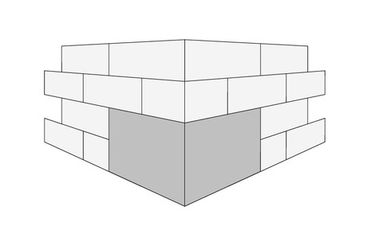
Conclusion (1/2)
Without God, we have no explanation for being, no morality to embrace, no purpose in life, and no hope beyond the grave.
Creation is foundation of meaning . . .
meaning
marriage
standard
Creation

Slide 25
Conclusion (2/2)
Ro.1:20
Jesus . . .
  Created (Jn.1:3)
  Endorsed OT creation account (historical, authoritative)
  Mk.10:6, But from the beginning of the creation, God ‘made them male and female’

