Slide 1
Zephaniah’s Zeal

Slide 2
Zephaniah –
God’s judgment is coming!
Zephaniah: Israel is not only sinful nation
2:4-7 – Philistia
  Noon (4): when least expected…
  God’s word “against you” (fierce storm)
  No survivors (5)
  WEST

Slide 3
Zephaniah –
God’s judgment is coming!
2:8-11 – Moab / Ammon
  Surely (8): a sure thing…as Sodom/Gomorrah
  Perpetual desolation (9)
  Reduced to nothing (11)
    Archaeology: hundreds of ruins of cities
  EAST

Slide 4
Zephaniah –
God’s judgment is coming!
2:12 – Ethiopia
  Egypt: wages for Nebuchadnezzar, Ezk.29:17-30:5
  SOUTH

Slide 5
Zephaniah –
God’s judgment is coming!
2:13-15 – Assyria
  Most powerful nation as Zephaniah wrote.
  NORTH

Slide 6
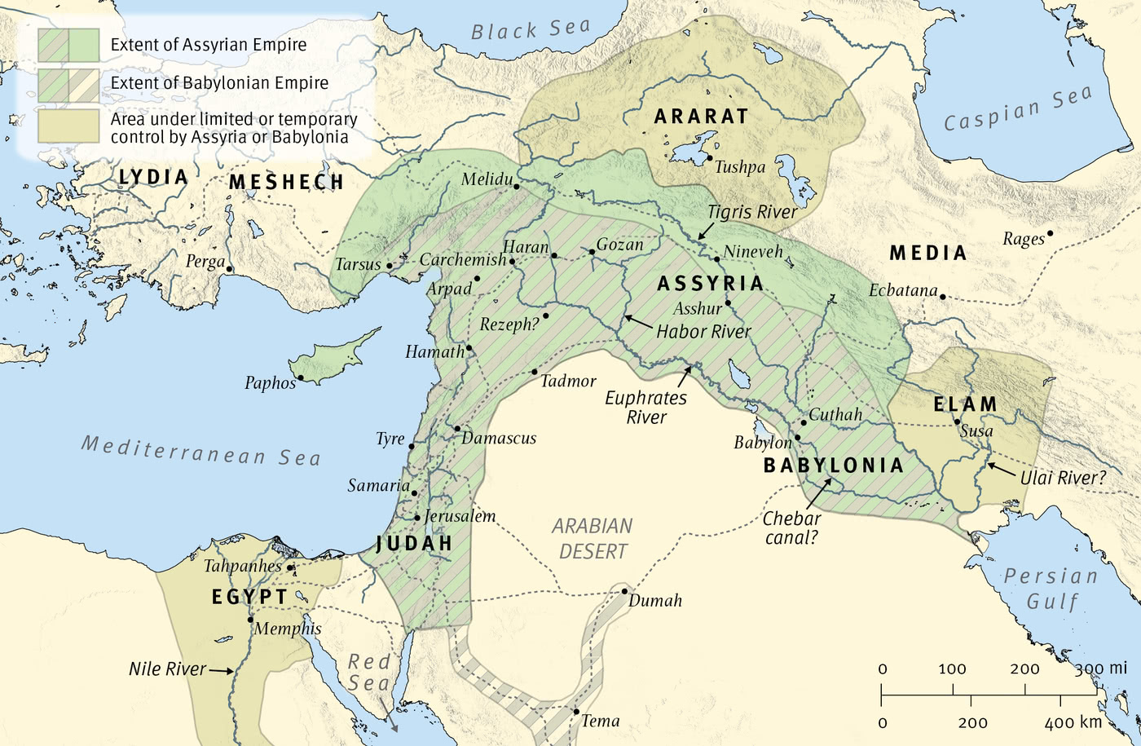
God punished foreign sinners

Slide 7
God punished Jerusalem too, 3:1-7. [Ezk.9]
1: sounds like continuation of Assyria
2: four charges: rebellious; stubborn; faithless; distant
3-4: the four guides . . . full of sin
  Princes – civil leaders are uncivil; devour prey
  Judges – dirty dogs
  Prophets – religious guides: insolent; faithless
  Priests – religious pollution (profanity); violently oppose the Law

Slide 8
God punished Jerusalem too, 3:1-7
5: LORD is righteous. So what?
  Righteous God cannot overlook sins [Gn.18]
  He will do NO unrighteousness [Gn.18]
  Every morning He brings justice to light (fair)
  He never fails (no one overthrows His plans)
  The unjust knows no shame (= Jer.6:15)
Huldah, 2 Kings 22:…15-20
Zephaniah does not mention
these outward reforms…

Slide 9
God punished Jerusalem too, 3:1-7
6: object lesson
  Cut off nations . . . Desolate streets…
  Lv.26; Dt.28
7: “Surely you will fear me…receive instruction” –
  They rose early (eager!)
  They corrupted all their deeds. Gn.6
    God does not bring universal judgment
    (as Flood) until the end, but on nations.
    Ps.9:17; Pr.14:34
    If God does not judge our sins…

Slide 10
I. Timing of Judgment:
1:1, days of Josiah
Sin is accepted
Evil dominates
Timid folks jump on bandwagon
BUT…it’s not all bad
Ruth – Judges

Slide 11
I. Timing of Judgment:
1:1, days of Josiah
II. Terror of Judgment:
1:2-4, reversal of creation

Slide 12
Judah
2, Judah must be totaled.
  Creator becomes Destroyer
  Cosmos becomes chaos
    3:6, sound of silence
      Lamentations 1:1, 3, 4, 5; 4:4, 6, 9-10

Slide 13
Judah
3-4, God’s outstretched hand (as Egypt, Ex.3:20 – 122x of God, Moses, Aaron, Joshua) …
    Ex.6:6 [God’s outstretched arm: 16x]
  No power in universe could draw it back.
  His hand saved Israel from Egypt; now it cuts off man (1:3) and baal (1:4).
  No idol, no ally could rescue them.

Slide 14
I. Timing of Judgment:
1:1, days of Josiah
II. Terror of Judgment:
1:2-4, reversal of creation
III. Targets of Judgment:
1:5-3:7, main focus: God’s people

Slide 15
God’s power once protected Judah
Now His power will pulverize them. Ro.8:31
Blessings impose great responsibilities (Mt.25).
  Family
  Church
  Word of God

Slide 16
Indictment against Judah (God’s people)
“Welcome to Jerusalem”
3:1-2, rebels, stubborn, faithless, spiritually aloof
  2: Judged for what she has not done (4x)
3:7, favorite pastime: sin

Slide 17
I. Timing of Judgment:
1:1, days of Josiah
II. Terror of Judgment:
1:2-4, reversal of creation
III. Targets of Judgment:
1:2-4, reversal of creation
IV. Termination of Judgment:
Only refuge is in God

Slide 18
Plea:
2:1-3, ray of hope: “It may be…” (2:3)
3:6-7, either learn from history or be doomed to repeat it
  We face same choices – Lk.13:1-5
Judgment forces us to face our mortality,
in hope that we will prepare for immortality, by repenting of immorality

Slide 19
Plan:
3:8-9, doomsday . . . BUT 3:9, His supreme purpose: salvation. No more idol talk
3:10-11, after judgment, meek are ‘in My holy mountain’ (Isa.2, 11).
3:12-15, faithful few rejoice in God: King.
3:16-17, Father rejoices over prodigal’s return (Lk.15). [He will quiet you with His love.] V.17
3:18-20, “I will” (6x) – ct. 1:3-4

Slide 20
Lesson: U.S.
We are autonomous / independent. We need no one.
We no longer need God. We have science.
Our greatest hope lies in living the ‘good life’ here and now.
Truth is relative. [Is this ‘truth’ relative?]
There is no sin or judgment, so relax and enjoy life.
[Mistake God’s longsuffering for leniency.]

