Slide 1
September 9-10-11, 2022

Slide 2
Friday – I Believe in Hope
Saturday – Hope When Life Disappoints
Sun Bible class – Hope for Overcoming Sin
Sunday A.M. – It’s Hard to be Lost: Our Hope of Heaven
Sunday night – New Hope in Evangelism
“We have this as a sure and steadfast anchor of the soul”

Slide 3
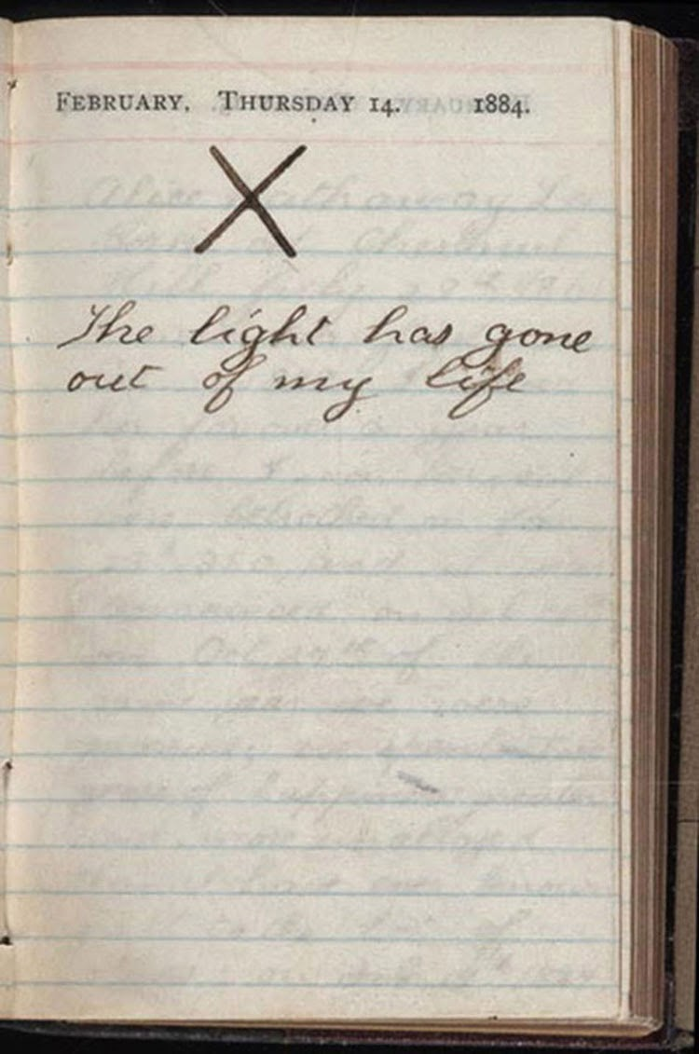

Slide 4
Why can’t we go to Bithynia?
Hope When Life Disappoints

Slide 5
Why Can’t we Go To Bithynia?
I will hope

Slide 6
Why Can’t we Go To Bithynia?
I will hope
because some things are out of my control

Slide 7
Why Can’t we Go To Bithynia?
I will hope
because some things are out of my control,
and second chances can glorify God

Slide 8
Why Can’t we Go To Bithynia?
I will hope
because some things are out of my control,
and second chances can glorify God
so I will be content where I am.

Slide 9
Why can’t we go to Bithynia?
Hope When Life Disappoints

