Slide 2
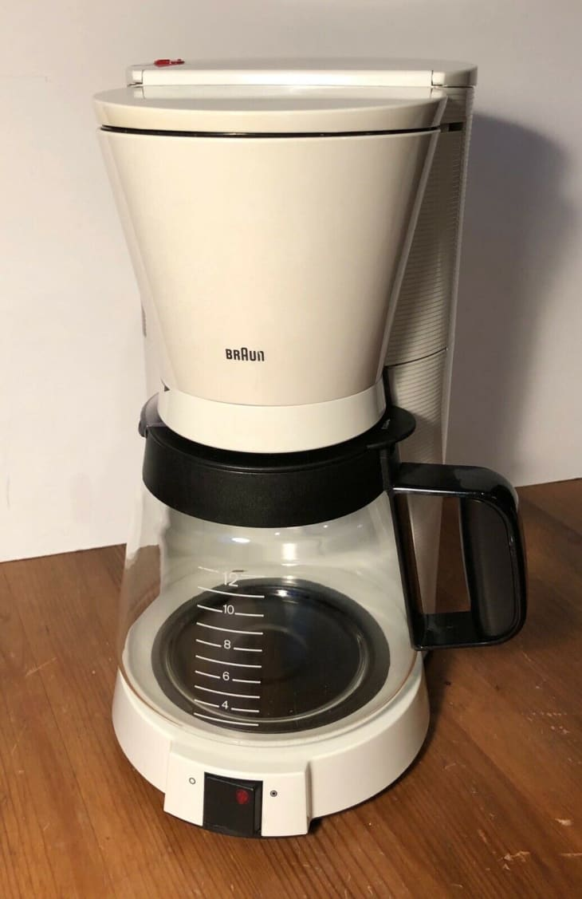

Slide 3
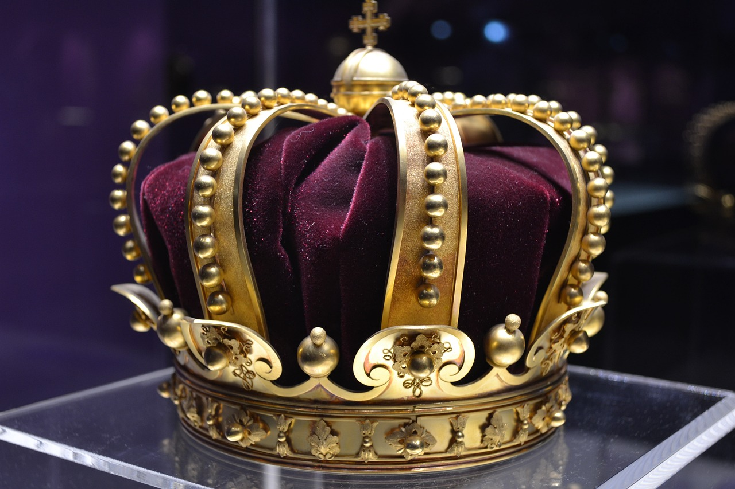
Showing
HONOR
Romans 12:10

Slide 4
Love one another with brotherly affection.
Outdo one another in showing honor.
ROMANS 12:10

Slide 5
1. Something that is weighty
1st Chronicles 29:28; Exodus 24:16
HONOR
2. Assigning value to someone
John 4:44; Hebrews 2:7
3. Demonstrating respect
Acts 28:10; 1st Peter 3:7

Slide 6
Be a leader in seeing the inherent value in people and demonstrating it.

Slide 7
HONOR
Your Father and Mother

Slide 8
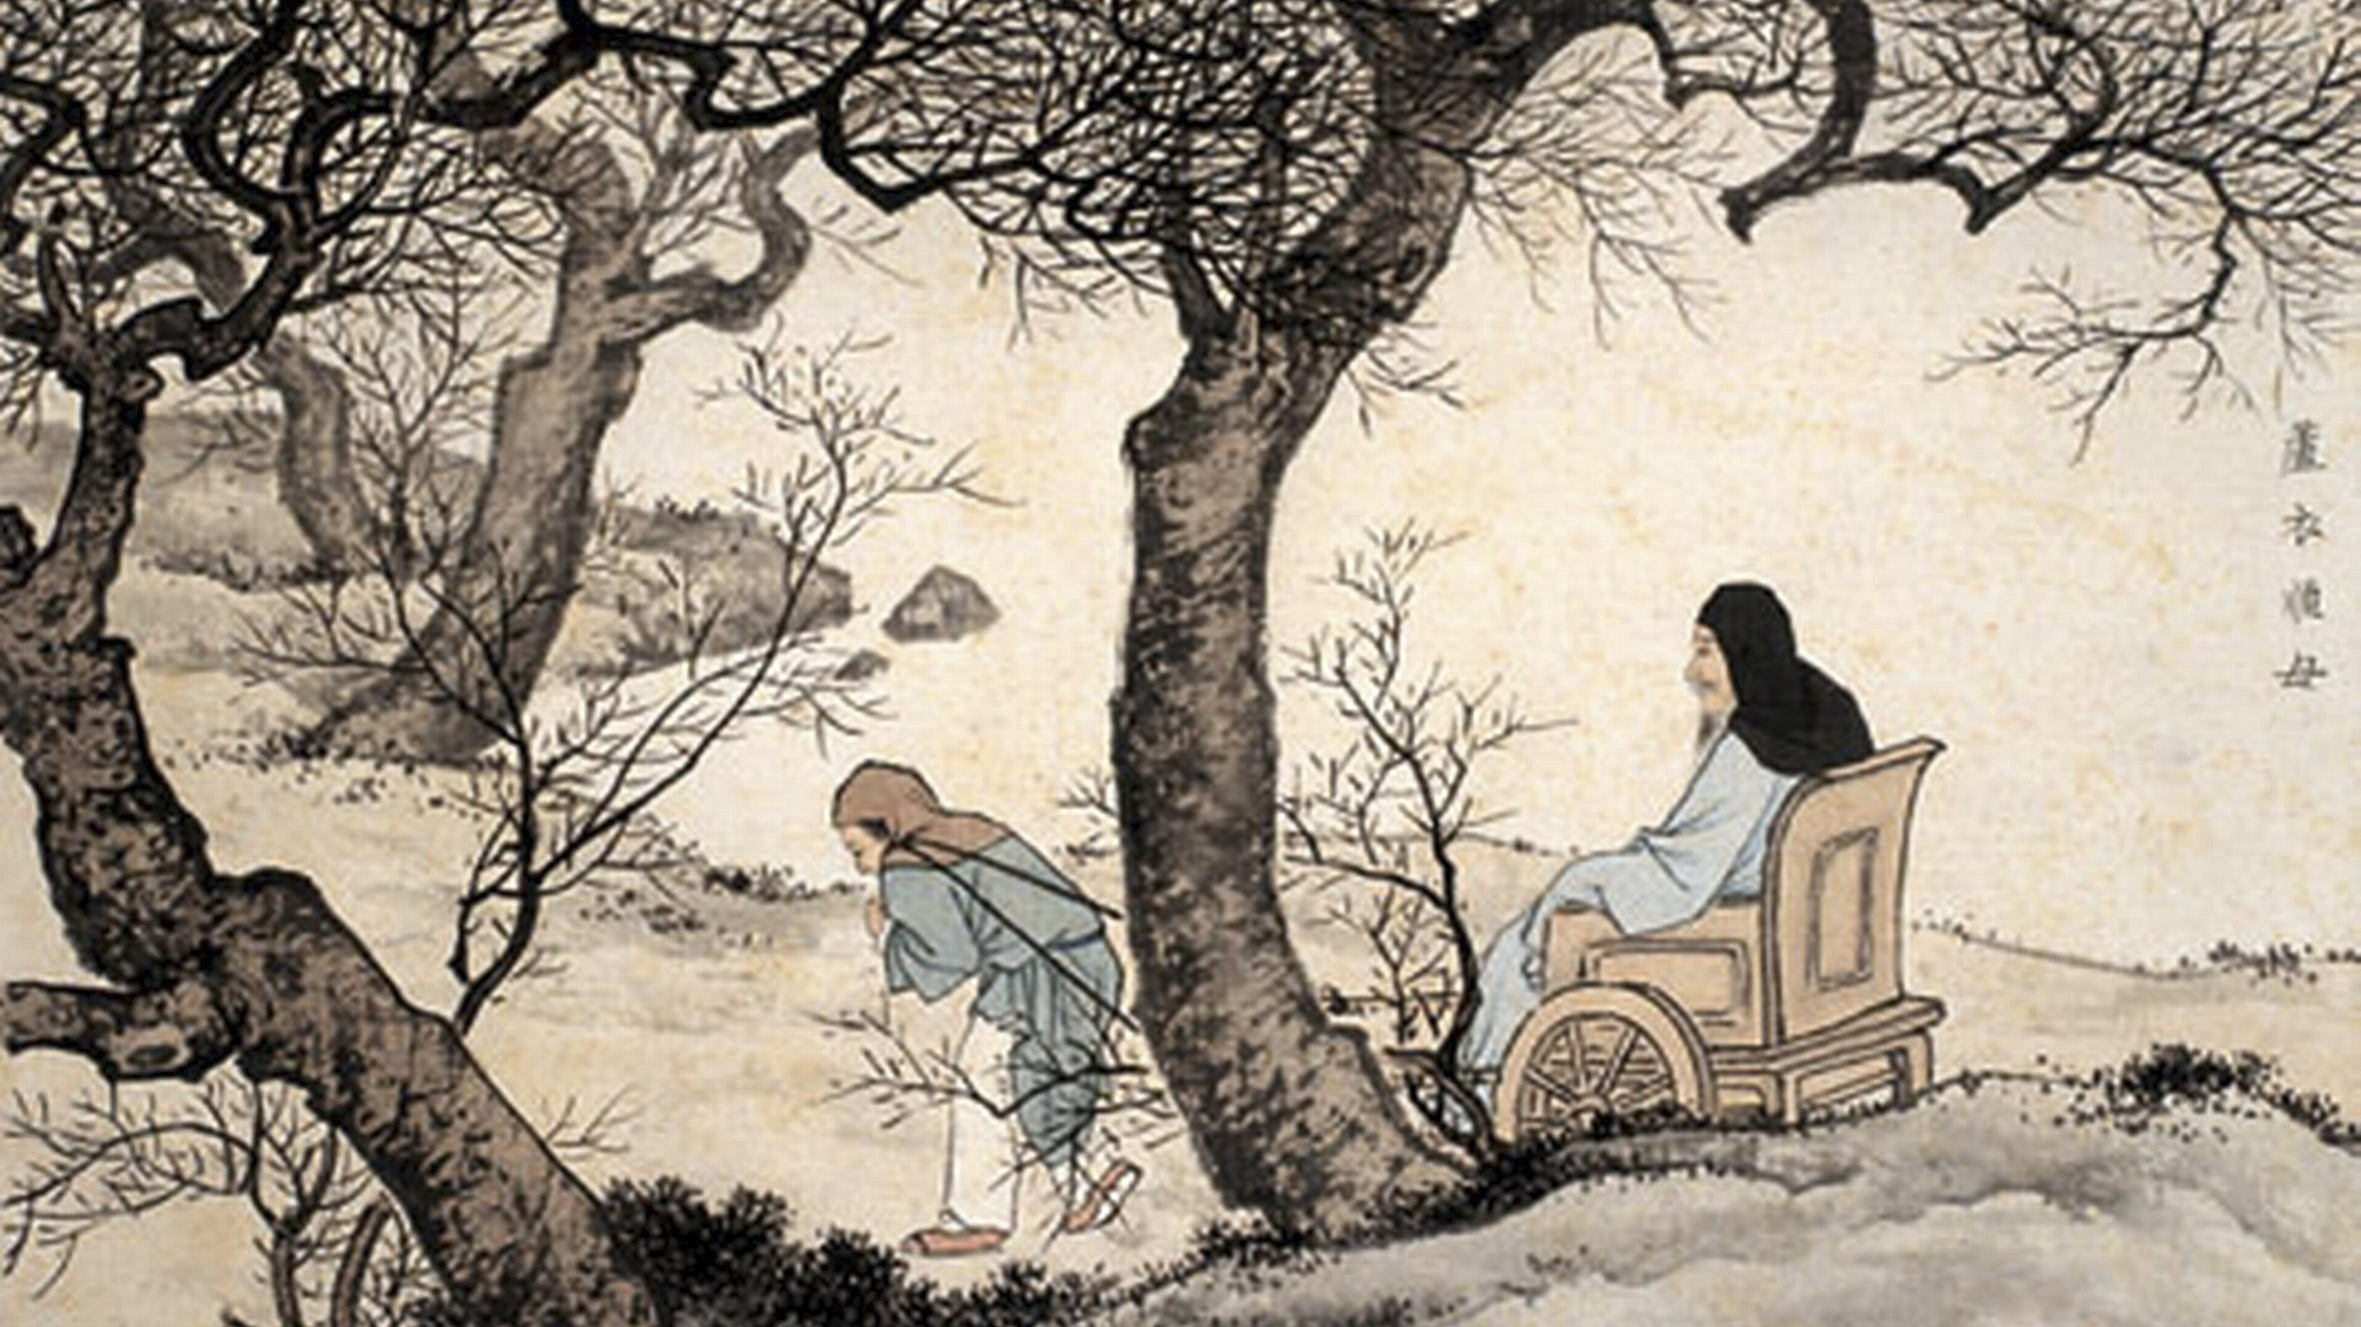

Slide 9
Care respect | making sure parents are comfortable in every single way
Victual respect | taking the parents' preferences into account, e.g. favorite food
Gift respect | giving gifts or favors, e.g. presiding meetings
Presentational respect | polite and appropriate decorum
Linguistic respect | use of honorific language
Spatial respect | having elders sit at a place of honor, building graves at respectful places
Celebrative respect | celebrating birthdays or other events in honor of elders
Public respect | voluntary and public services for elders
Acquiescent respect | listening to elders without talking back
Consultative respect | consulting elders in personal and family matters
Salutatory respect | bowing or saluting elders
Precedential respect | allowing elders to have priority in distributing goods and services
Funeral respect | mourning and burying elders in a respectful way

Slide 10
‘You shall rise up before the grayheaded and honor the aged, and you shall revere your God; I am the LORD.
– Leviticus 19:32

Slide 11
Children, obey your parents in the Lord, for this is right. HONOR YOUR FATHER AND MOTHER (which is the first commandment with a promise), SO THAT IT MAY BE WELL WITH YOU, AND THAT YOU MAY LIVE LONG ON THE EARTH.
– Ephesians 6:1-3

Slide 12
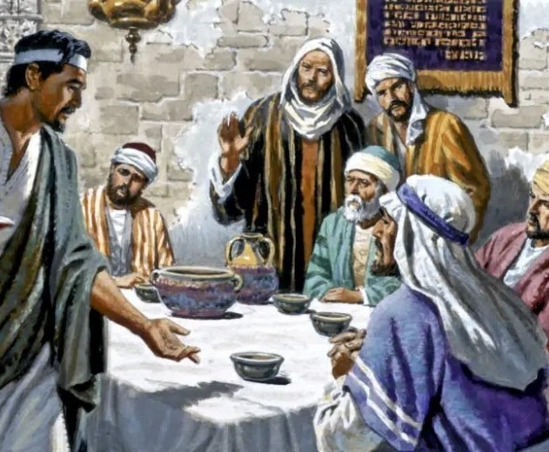
“We have obeyed the voice of Jonadab the son of Rechab, our father, in all that he commanded us, not to drink wine all our days, we, our wives, our sons or our daughters…”
- Jeremiah 35

Slide 13
Honoring Your Parents Means:
Obedience
Speaking Respectfully
Caring for financially
Showing preference toward

Slide 14
HONOR
Faithful Christians

Slide 15
So receive him in the Lord with all joy, and honor such men, for he nearly died for the work of Christ, risking his life to complete what was lacking in your service to me.
– Philippians 2:29-30
We need to demonstrate the practice of showing honor to those who serve God faithfully

Slide 16
Let the elders who rule well be considered worthy of double honor, especially those who labor in preaching and teaching. For the Scripture says, “You shall not muzzle an ox when it treads out the grain,” and, “The laborer deserves his wages.”
– 1st Timothy 5:17
Church leaders often face double hardship instead of double honor

Slide 17
So then, as we have opportunity, let us do good to everyone, and especially to those who are of the household of faith.
– Galatians 6:10
Really everyone who has confessed Christ deserves our special attention

Slide 18
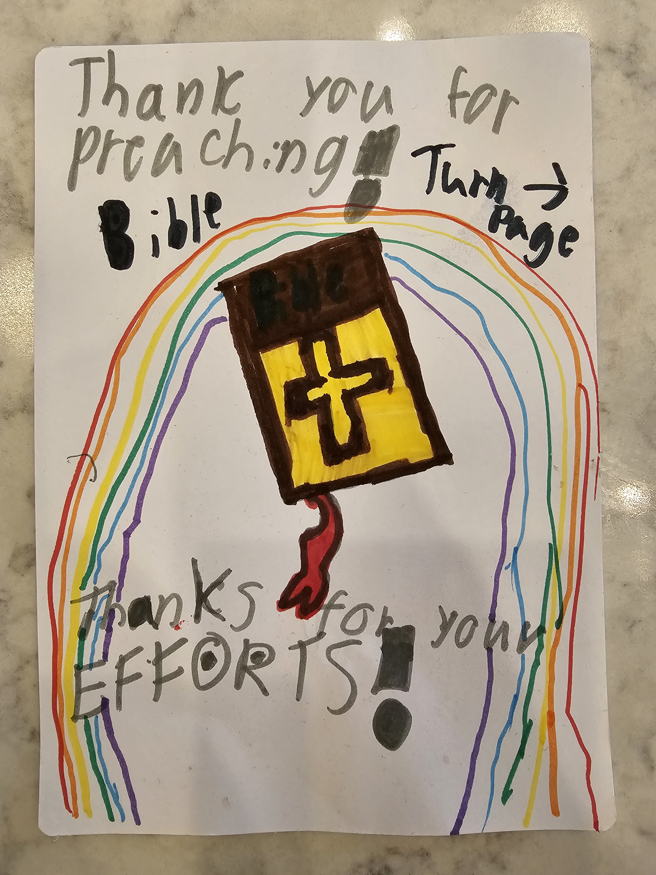
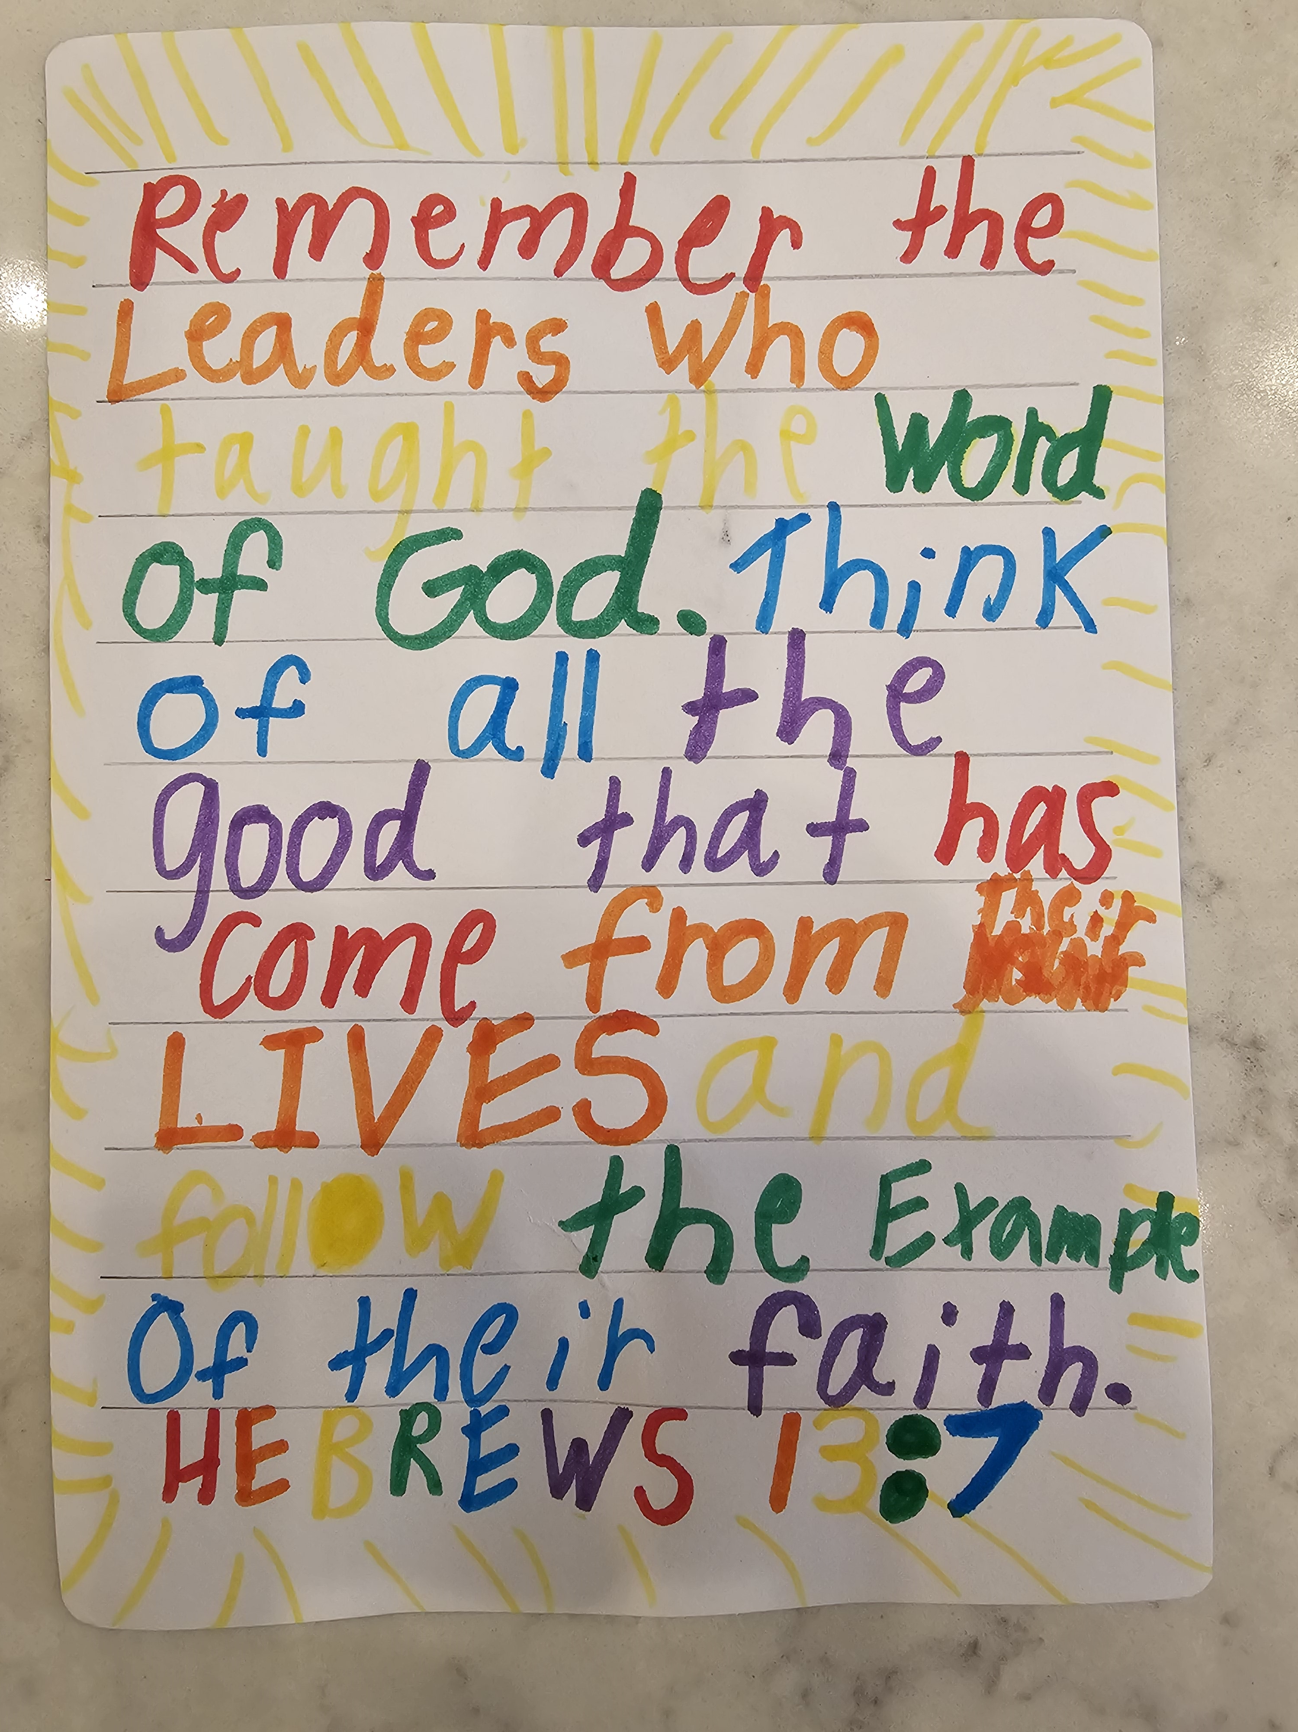
Remember your leaders, those who spoke to you the word of God. Consider the outcome of their way of life, and imitate their faith.
– Hebrews 13:7

Slide 19
Do not rebuke an older man but encourage him as you would a father, younger men as brothers, older women as mothers, younger women as sisters, in all purity. Honor widows who are truly widows.
– 1st Timothy 5:1-3
Serve those of the faith who need it.

Slide 20
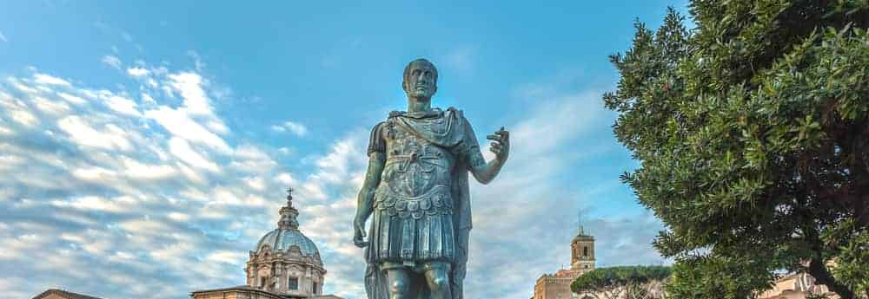
HONOR
Extends Beyond Church

Slide 21
Those who stood by said, “Would you revile God's high priest?”
And Paul said, “I did not know, brothers, that he was the high priest, for it is written, ‘You shall not speak evil of a ruler of your people.’” – Acts 23:4-5
Christianity calls us to be respectful even when people don’t deserve it

Slide 22
God wants us to be especially respectful of those in authority
Honor everyone. Love the brotherhood. Fear God. Honor the emperor.
– 1st Peter 2:17

Slide 23
For because of this you also pay taxes, for the authorities are ministers of God, attending to this very thing. Pay to all what is owed to them: taxes to whom taxes are owed, revenue to whom revenue is owed, respect to whom respect is owed, honor to whom honor is owed.
– Romans 13:6-7
We are to be seen as people of honor to the outside world

Slide 24
If anyone serves me, he must follow me; and where I am, there will my servant be also. If anyone serves me, the Father will honor him.
– John 12:26

