Slide 1
How to Glorify God

Slide 2
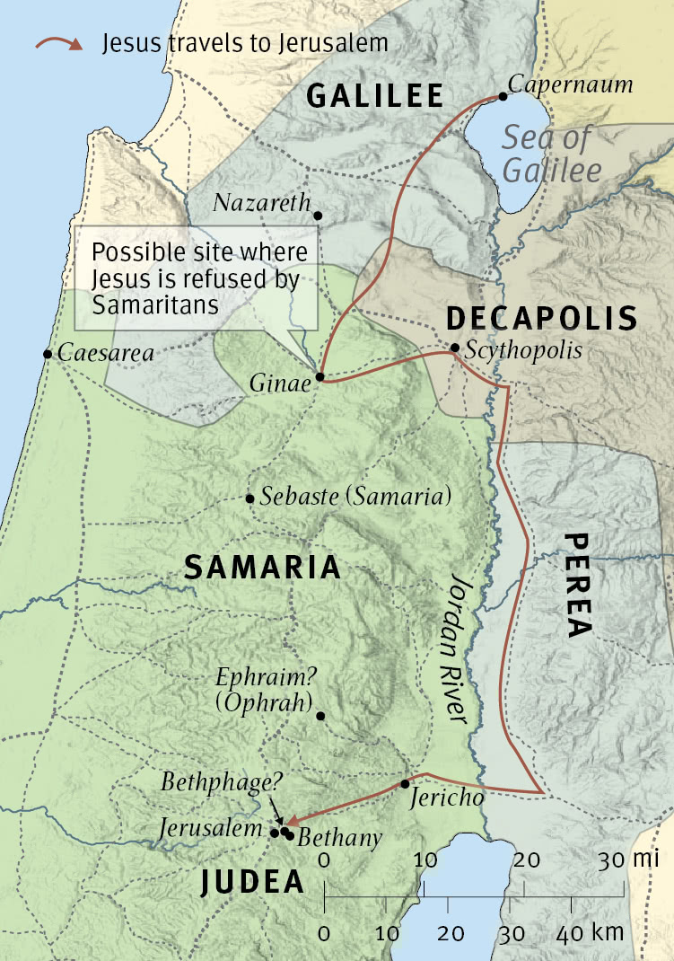
Lk.19:28f., triumphal entry into Jerusalem
From Jericho to Jerusalem: continual ascent
Jn.11:57
29-31: Bethany, about 2 m. from Jeru- salem, a descent; eastern slope of Mount Olivet (37)
Disciples bring Him an unbroken colt

Slide 3
Lk.19:32-36
Garments for a saddle / red carpet. 2 K.9:13
Lk.19:37
People praised God for Lord’s miracles
Matthew / John quote Zech.9:9 – Rejoice greatly, O daughter of Zion! Shout, O daughter of Jerusalem! Behold, your King is coming to you; He is just and having salvation, Lowly and riding on a donkey, A colt, the foal of a donkey.

Slide 4
Lk.19:38
People who think “king” and “glory” usually think worldly power and splendor
Lk.19:39-40
Pharisees fear blaspheming God . . . and Roman response (rival to Caesar)
Their real fears –
1. Religious opposition (they may lose power over people)
2. Political opposition (Jn.18 – do not want Rome to intervene)
Their shouting is unavoidable
How do we glorify God?

Slide 5
I. Sanctification, Mt.5:13-16

Slide 6
Matthew 5:13
Industries put salt to about 14,000 uses
Jesus calls disciples salt
Some say more wars were fought over salt than gold
Rome: highway (Via Salarium)
Rome: paid soldiers a salarium

Slide 7
Matthew 5:13
Salt suggests ideas of . . .
Purity, Lv.2:13
Preservative, Mk.9:50
We must have qualities that promote truth / love in the world
Peace (flavor), Mk.9:50; Col.4:6
You can lead a horse to water…
If we are salt, more people want the gospel

Slide 8
Matthew 5:13
Salt can lose its flavor: become tasteless
Deposits in salt mines can last thousands of years, yet retain flavor
Refined salt can be stored for extended periods and retain flavor
Even salt that is dissolved in water diffuses its flavor
Salt loses its flavor when it is...
1. Contaminated by mixing. 1 Co.15:33
2. Affected by environment. Ep.5:16

Slide 9
Matthew 5:14-16
You are light
14-15: Lord’s highest compliment: be like Him (Jn.9:5)
14:
We must be seen
We must be seen in the world
15-16: we shine (glorify)… How?
Good works: winsome, attractive. Ac.9
Draw attention to God, not self [Mt.6:1, 5, 15]

Slide 10
I. Sanctification, Mt.5:13-16
II. Duplication, 2 Co.3:18

Slide 11
Transform
Change inward reality to something else
The glory Christians share with Christ increases from one stage of glory to higher one
Ro.12:1-2
Transfiguration, Mt.17:2 – displayed His inner, divine nature
Christians display inner, redeemed nature
Romans 12: writer is Saul of Tarsus!

Slide 12
Transform
Eph.4:17…20
As Gentiles learned gospel, they changed their ways
Jews learned Law; Christians learned Christ
Ephesians became Christians years after Lord left earth [Ac.1 . . . 19]
Results of learning Christ: dramatic change in conduct

Slide 13
Transform
1 Pt.2:12 – progression
Honorable conduct: good, noble, praiseworthy, lovely, winsome, excellent. Dn.6:3
Speak…evildoers. Dn.6:4-5
Day of visitation: when God visits with blessing (salvation); the hearer inspects the pure life of the Christian. Dn.6:20-27

Slide 14
I. Sanctification, Mt.5:13-16
II. Duplication, 2 Co.3:18
III. Persecution, 1 Pt.4:16

Slide 15
Written during persecutions
Paul: 2 Tim.1:12
Lord to Peter: Jn.21:18-19
Peter will glorify God because he is willing to suffer for Christ Ac.5:41
Ezk.24:16, Ezekiel
Mt.19:27, apostles. Then Peter answered and said to Him, “See, we have left all and followed You. There-fore what shall we have?”

