Slide 1
TEACHING
LIKE NEW TESTAMENT CHRISTIANS

Slide 2
The Importance of Teaching
James 5:19-20
¹⁹Brethren, if anyone among you wanders from the truth, and someone turns him back, ²⁰let him know that he who turns a sinner from the error of his way will save a soul from death and cover a multitude of sins.
Our ability to teach well can save souls
Secular wisdom is inconsistent
Look to God-given success stories

Slide 3
1. ETHIOPIAN EUNUCH
ACTS 8:26-40

Slide 4
Ask questions
Acts 8:30
So Philip ran to him, and heard him reading the prophet Isaiah, and said, “Do you understand what you are reading?”
Philip wasn’t condescending or trapping
Gathering Information
Allows them to reason for themselves
Prov 18:13
He who answers a matter before he hears it, It is folly and shame to him
Listen to determine what needs to be said.
Ethiopian Eunuch
Ask questions

Slide 5
Allow them to ask questions
Acts 8:34
So the eunuch answered Philip and said, “I ask you, of whom does the prophet say this, of himself or of some other man?”
Philip asked the question, then stopped talking
Typically, willing to listen when asking questions
The eunuch is ready to hear about Jesus
James 1:19-20
¹⁹So then, my beloved brethren, let every man be swift to hear, slow to speak, slow to wrath; ²⁰for the wrath of man does not produce the righteousness of God.
We’ve lost as soon as we get angry
Ethiopian Eunuch
Ask questions
Allow them to ask questions

Slide 6
Be ready to answer them
Acts 8:35
Then Philip opened his mouth, and beginning at this Scripture, preached Jesus to him.
Philip had the knowledge necessary to explain the truth
2 Tim 2:15
Be diligent to present yourself approved to God, a worker who does not need to be ashamed, rightly dividing the word of truth.
Ethiopian Eunuch
Ask questions
Allow them to ask questions
Be ready to answer them

Slide 7
Take advantage of opportunities
Col 4:5-6
⁵Walk in wisdom toward those who are outside, redeeming the time. ⁶Let your speech always be with grace, seasoned with salt, that you may know how you ought to answer each one.
May only have one chance
Philip had to be ready to deliver the specific message that this man needed to hear
Ethiopian Eunuch
Ask questions
Allow them to ask questions
Be ready to answer them
Take advantage of opportunities

Slide 8
Emphasize salvation
Acts 8:36
Now as they went down the road, they came to some water. And the eunuch said, “See, here is water. What hinders me from being baptized?”
His teaching obviously included baptism
Matt 28:19
Go therefore and make disciples of all the nations, baptizing them in the name of the Father and of the Son and of the Holy Spirit,
The mission from Christ himself
Ethiopian Eunuch
Ask questions
Allow them to ask questions
Be ready to answer them
Take advantage of opportunities
Emphasize salvation

Slide 9
2. Jailer and Prisoners
ACTS 16:20-34

Slide 10
Be an example during adversity
Acts 16:20-24
²⁰And they brought them to the magistrates, and said, “These men, being Jews, exceedingly trouble our city; ²¹and they teach customs which are not lawful for us, being Romans, to receive or observe.” ²²Then the multitude rose up together against them; and the magistrates tore off their clothes and commanded them to be beaten with rods. ²³And when they had laid many stripes on them, they threw them into prison, commanding the jailer to keep them securely. ²⁴Having received such a charge, he put them into the inner prison and fastened their feet in the stocks
Beaten with rods (many stripes)
Feet in stocks
Ethiopian Eunuch
Ask questions
Allow them to ask questions
Be ready to answer them
Take advantage of opportunities
Emphasize salvation
Jailer and Prisoners
Be an example during adversity

Slide 11
Be an example during adversity
1 Pet 3:14-15
¹⁴But even if you should suffer for righteousness’ sake, you are blessed. “And do not be afraid of their threats, nor be troubled.” ¹⁵But sanctify the Lord God in your hearts, and always be ready to give a defense to everyone who asks you a reason for the hope that is in you, with meekness and fear;
2 Tim 2:6-8
⁶Likewise, exhort the young men to be sober-minded, ⁷in all things showing yourself to be a pattern of good works; in doctrine showing integrity, reverence, incorruptibility, ⁸sound speech that cannot be condemned, that one who is an opponent may be ashamed, having nothing evil to say of you.
None of the prisoners left
Followed their example (songs and prayers)
Ethiopian Eunuch
Ask questions
Allow them to ask questions
Be ready to answer them
Take advantage of opportunities
Emphasize salvation
Jailer and Prisoners
Be an example during adversity

Slide 12
Be selfless
Acts 16:28
But Paul called with a loud voice, saying, “Do yourself no harm, for we are all here.”
Kindness / selflessness makes us stand out
Paul and Silas chose the jailer’s well-being over their own
John 13:34-35
³⁴A new commandment I give to you, that you love one another; as I have loved you, that you also love one another. ³⁵By this all will know that you are My disciples, if you have love for one another.”
We won’t have to tell people
Ethiopian Eunuch
Ask questions
Allow them to ask questions
Be ready to answer them
Take advantage of opportunities
Emphasize salvation
Jailer and Prisoners
Be an example during adversity
Be selfless

Slide 13
Teach passively
Acts 16:30
And he brought them out and said, “Sirs, what must I do to be saved?”
No direct teaching is recorded
Ethiopian Eunuch
Ask questions
Allow them to ask questions
Be ready to answer them
Take advantage of opportunities
Emphasize salvation
Jailer and Prisoners
Be an example during adversity
Be selfless
Teach passively

Slide 14
Include additional people
Acts 16:31-33
³¹So they said, “Believe on the Lord Jesus Christ, and you will be saved, you and your household.” ³²Then they spoke the word of the Lord to him and to all who were in his house. ³³And he took them the same hour of the night and washed their stripes. And immediately he and all his family were baptized.
They mentioned his household
Made sure they were included when teaching
Ethiopian Eunuch
Ask questions
Allow them to ask questions
Be ready to answer them
Take advantage of opportunities
Emphasize salvation
Jailer and Prisoners
Be an example during adversity
Be selfless
Teach passively
Include additional people

Slide 15
3. Athenians
ACTS 17:16-34

Slide 16
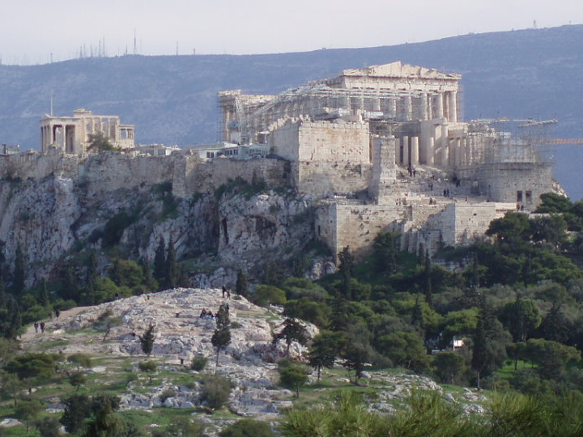

Slide 17
Be kind / Point out positives
Acts 17:22
Then Paul stood in the midst of the Areopagus and said, “Men of Athens, I perceive that in all things you are very religious
1 Cor 13:4-7
⁴Love suffers long and is kind; love does not envy; love does not parade itself, is not puffed up; ⁵does not behave rudely, does not seek its own, is not provoked, thinks no evil; ⁶does not rejoice in iniquity, but rejoices in the truth; ⁷bears all things, believes all things, hopes all things, endures all things.
We are to love the lost, which includes thinking the best of them.
We don’t have to point out error right away.
Ethiopian Eunuch
Ask questions
Allow them to ask questions
Be ready to answer them
Take advantage of opportunities
Emphasize salvation
Jailer and Prisoners
Be an example during adversity
Be selfless
Teach passively
Include additional people
Athenians
Be kind / Point out positives

Slide 18
Understand the culture
Acts 17:23
for as I was passing through and considering the objects of your worship, I even found an altar with this inscription:
TO THE UNKNOWN GOD.
Therefore, the One whom you worship without knowing, Him I proclaim to you:
Paul paid attention to his surroundings
He does not compromise the truth
Ethiopian Eunuch
Ask questions
Allow them to ask questions
Be ready to answer them
Take advantage of opportunities
Emphasize salvation
Jailer and Prisoners
Be an example during adversity
Be selfless
Teach passively
Include additional people
Athenians
Be kind / Point out positives
Understand the culture

Slide 19
Understand the culture
1 Cor 9:19-22
¹⁹For though I am free from all men, I have made myself a servant to all, that I might win the more; ²⁰and to the Jews I became as a Jew, that I might win Jews; to those who are under the law, as under the law, that I might win those who are under the law; ²¹to those who are without law, as without law (not being without law toward God, but under law toward Christ), that I might win those who are without law; ²²to the weak I became as weak, that I might win the weak. I have become all things to all men, that I might by all means save some.
Act in a way that will not cause unnecessary barriers
Taught Jews in the synagogue and Athenians at the Areopagus
Ethiopian Eunuch
Ask questions
Allow them to ask questions
Be ready to answer them
Take advantage of opportunities
Emphasize salvation
Jailer and Prisoners
Be an example during adversity
Be selfless
Teach passively
Include additional people
Athenians
Be kind / Point out positives
Understand the culture

Slide 20
Utilize common ground
Acts 17:28
for in Him we live and move and have our being, as also some of your own poets have said, ‘For we are also His offspring.’
Uses what they know to teach about God
Altars and poets
Ethiopian Eunuch
Ask questions
Allow them to ask questions
Be ready to answer them
Take advantage of opportunities
Emphasize salvation
Jailer and Prisoners
Be an example during adversity
Be selfless
Teach passively
Include additional people
Athenians
Be kind / Point out positives
Understand the culture
Utilize common ground

Slide 21
Use reason
Acts 17:29
Therefore, since we are the offspring of God, we ought not to think that the Divine Nature is like gold or silver or stone, something shaped by art and man’s devising.
God created us not the other way around
Use reasoning that aligns with their knowledge
Acts 17:1-3
¹Now when they had passed through Amphipolis and Apollonia, they came to Thessalonica, where there was a synagogue of the Jews. ²Then Paul, as his custom was, went in to them, and for three Sabbaths reasoned with them from the Scriptures, ³explaining and demonstrating that the Christ had to suffer and rise again from the dead, and saying, “This Jesus whom I preach to you is the Christ.”
Reasoned from the Scriptures when speaking to the Jews
Ethiopian Eunuch
Ask questions
Allow them to ask questions
Be ready to answer them
Take advantage of opportunities
Emphasize salvation
Jailer and Prisoners
Be an example during adversity
Be selfless
Teach passively
Include additional people
Athenians
Be kind / Point out positives
Understand the culture
Utilize common ground
Use reason

Slide 22
Emphasize common redemption
Acts 17:30
Truly, these times of ignorance God overlooked, but now commands all men everywhere to repent,
Shows the problem is easy to fix
Rom 3:23
for all have sinned and fall short of the glory of God
Eph 1:7
In Him we have redemption through His blood, the forgiveness of sins, according to the riches of His grace
Ethiopian Eunuch
Ask questions
Allow them to ask questions
Be ready to answer them
Take advantage of opportunities
Emphasize salvation
Jailer and Prisoners
Be an example during adversity
Be selfless
Teach passively
Include additional people
Athenians
Be kind / Point out positives
Understand the culture
Utilize common ground
Use reason
Emphasize common redemption

Slide 23
Ethiopian Eunuch (Acts 8:26-40)
Ask questions (30)
Allow them to ask questions (34)
Be ready to answer them (35)
Take advantage of opportunities (27)
Emphasize salvation (36)
TEACHING
LIKE NEW TESTAMENT CHRISTIANS
Jailer and Prisoners (Acts 16:20-24)
Be an example during adversity (20-24)
Be selfless (28)
Teach passively (30)
Include additional people (31-33)
Athenians (Acts 17:16-34)
Be kind / Point out positives (22)
Understand the culture (23)
Utilize common ground (23, 28)
Use reason (29)
Emphasize common redemption (30)

